Slide 1
St. Anthony New Brighton Schools 2023 Open Enrollment
Open Enrollment – May 12th – May 26th
Notes:
Hello and thank you for tuning into to St Anthony New Brighton schools’ Open Enrollment presentation. Open Enrollment this year will run from Monday, May 10th, through the end of the day on Friday, May 21st.

Slide 2
Open Enrollment Process
Submit forms for New Enrollments or Enrollment Changes
Paper forms available for changes to your medical and dental coverage
Paper form available to add or increase the voluntary life insurance for yourself, your spouse and/or dependent child(ren)
You must elect your FSA amounts each year, this will not rollover from your current 2022-23 election.
If you have any questions, please see Kim Lannier

Slide 3
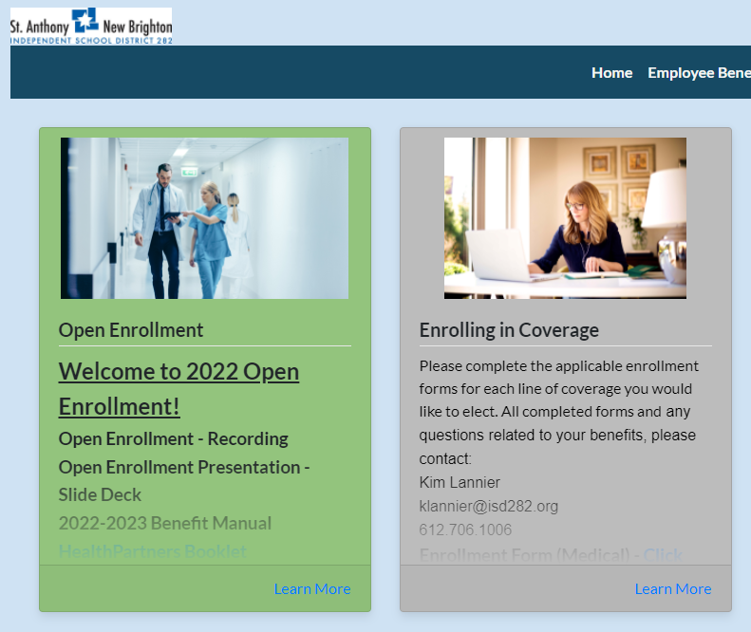
Online Benefit Portal
Your one stop for all benefits information!
All forms and plan summaries are available on this site
Accessible from home and work
www.c2mb.ajg.com/sanb282/home

Slide 4
Overview of Changes
No changes to the following benefits:
Dental – Delta Dental of Minnesota
Life/AD&D and LTD – No benefit change, still with The Standard
Standard Voluntary Life
Additional term life insurance on employee, spouse and children
Employee must be enrolled to purchase spouse and children benefit
If not currently enrolled, must provide Evidence of Insurability
Same Medical Plan option with Open Access Network
Rates increased per our two-year contract with Sourcewell/HealthPartners
District VEBA contribution maintained

Slide 5
Overview of 2023 Medical Renewal
Renewed with Sourcewell/HealthPartners as part of our two-year contract
Rates increased 9%, which was our rate cap and was also the co-op’s average increase for all groups in the co-op
Evaluated our overall costs, along with employee contributions
Final outcome for 2023
District will continue to offer the same medical plan and network option as we have today through Sourcewell/HealthPartners
Annual District contribution to the VEBA
$550 for single coverage
$1,100 for family coverage
2022-23 Medical Plan
$1,500 VEBA Plan | Open Access Network

Slide 6
HealthPartners – Open Access Network
More than 950,000 doctors
You
Anywhere
Choices to find a doctor wherever you live, work or travel nationwide
6,000 hospitals
National Network
CIGNA
Freedom
Freedom to get the
care and support you need

Slide 7
Medical Plan Comparison
In Network Benefits | Open Access $1,500 VEBA
Plan Year Medical & Rx Deductible | $1,500 per individual $3,000 per family
Plan Year Medical & Rx Out-of-Pocket Maximum | $1,500 per individual $3,000 per family
Embedded Status | Embedded
District VEBA Contribution* | $550 / single coverage $1,100 / family coverage
Preventive Care | 100%
Office/Urgent Care Visit | Deductible then 100% Coverage
Convenience Care | Deductible then 100% Coverage
ER Visit | Deductible then 100% Coverage
Hospital Services | Deductible then 100% Coverage
Retail Pharmacy (31 day supply) | Formulary: Deductible then 100% coverage Non-Formulary: No coverage

Slide 8
Here For You 24/7
Member Services | Help with all things related to your plan | Mon – Fri, 7 a.m. to 7 p.m., CT 952-883-5000 or 800-883-2177
Nurse NavigatorSM program | Support in finding the right care | Mon – Fri, 7:30 a.m. to 5 p.m., CT 952-883-5000 or 800-883-2177
Pharmacy Navigators | Help with your medicines | Mon – Fri, 8 a.m. to 6 p.m., CT 952-883-5000 or 800-883-2177
Behavioral Health Navigators | Help with mental or chemical health benefits | Mon – Fri, 8 a.m. to 5 p.m., CT 952-883-5000 or 800-883-2177
CareLineSM service nurse line | Trusted nurse advice | 24/7, 365 days a year 612-339-3663 or 800-551-0859
BabyLine phone service | Expert guidance on your pregnancy or new baby | 24/7, 365 days a year 612-333-2229 or 800-845-9297

Slide 9
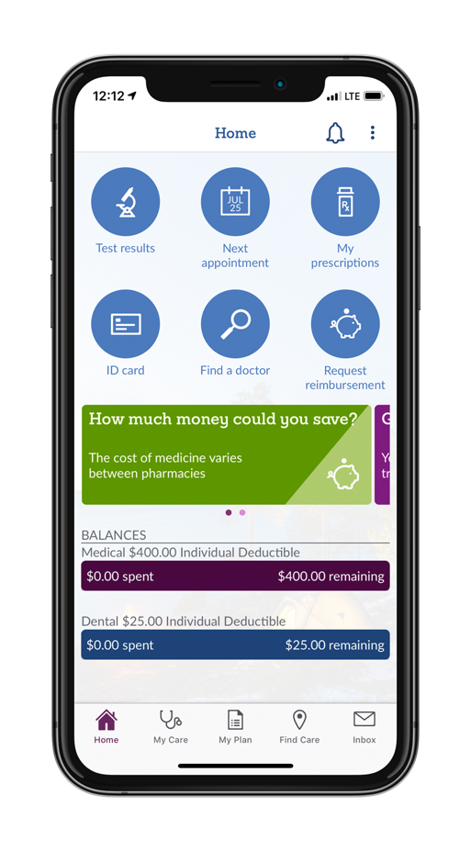
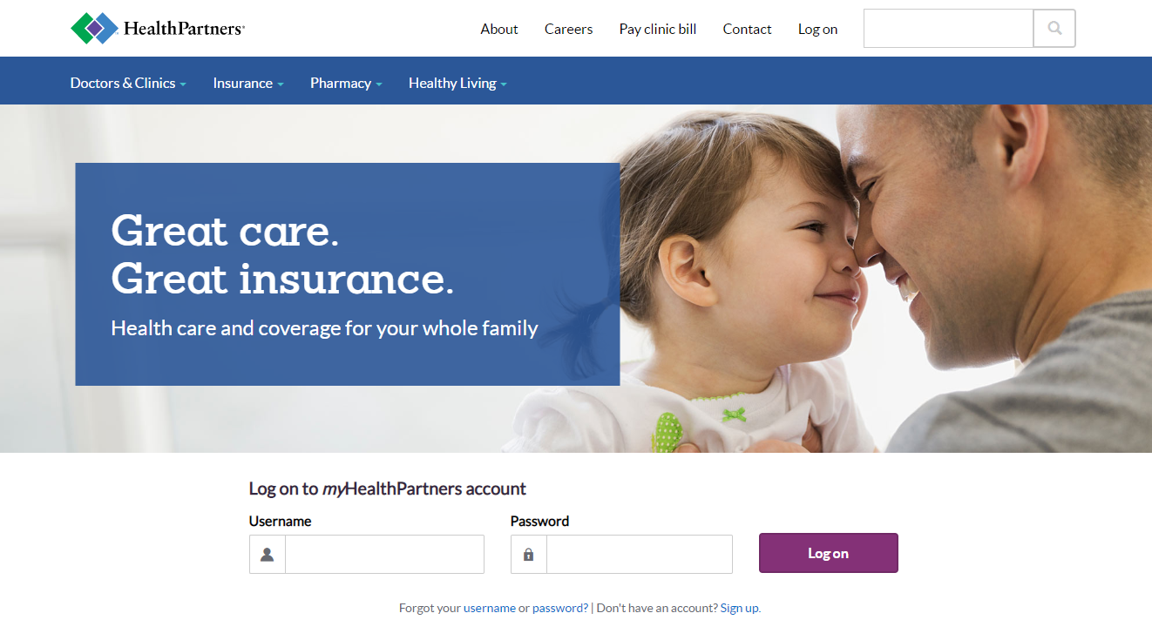
HealthPartners Resources
healthpartners.com
myHP mobile app

Slide 10
24/7 online care
Medical Visits
• Treat more than 60 common conditions
• Face-to-face video chat with a doctor
• 15 minutes or less
Mental Health Visits
• Licensed psychiatrists and psychologist
• Video chats 30-45 minutes
• Typically can be seen much quicker than in-person
Simple, convenient and safe
Treats more than 60 common conditions
You’re only charged if we can treat you
Never pay more than $59
Medical: No more than $59 per 15-minute visit
Mental Health: Varies by length of visit (30-45 min)
virtuwell.com
doctorondemand.com
Notes:
$40 Copay plan and $1500 Ded plan – first three Virtuwell visits are free

Slide 11
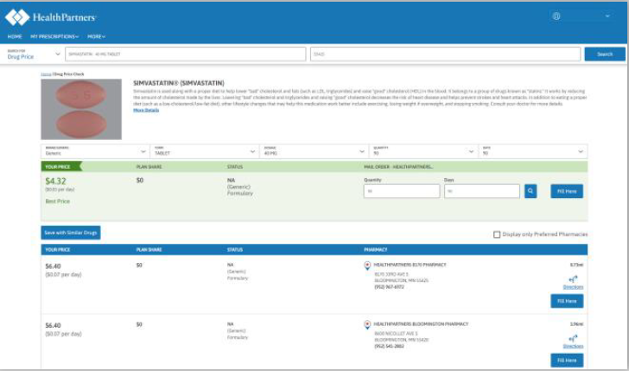
Prescription Drugs
Formulary List: PreferredRx Formulary
Tools & Resources
Rx Shopping Tool
Compare current prices at pharmacies near you
Understand what medicines are covered by your health plan
Transfer prescriptions to the lowest cost pharmacy
Mail-Order Pharmacy
Convenient for maintenance medications
Save time and money
healthpartners.com/pharmacy

Slide 12
Wellbeats
Wellbeats has on-demand workouts and challenges, along with a team of friendly, certified virtual trainers who are ready to help you reach your goals.
Enjoy classes like yoga, running, HIIT, strength training, recovery, meditation, and more
Personalized recommendations based on your preferences and goals
healthpartners.com/livingwell
Notes:
Do you love to work out with the help of a trainer or in a group fitness class? But can’t, or don’t want to, go to the gym? HealthPartners has partnered with Wellbeats to offer you FREE on-demand workouts and challenges to do when and where you like. Friendly, certified virtual trainers offer a variety of classes for every age, interest and ability. From office breaks to yoga to strength training, HIIT and more. You can get personalized recommendations based on your preferences and goals.
Get started signing in to your HealthPartners online account and selecting the Living Well tab. Don't have an account yet? It's quick and easy to sign up – you'll just need your member ID card.

Slide 13
Fitness Discounts
Get special savings from handpicked retailers as a HealthPartners member.
Show your member ID card to save money on:
Discounts on gym memberships
Eyewear
Exercise equipment
Fitness and well-being classes
Healthy eating delivery services
Healthy mom and baby products
Hearing aids
Orthodontics
Pet insurance
Swim lessons
And more!
GlobalFit’s Gym Network 360:
Discounts at over 8,000 gyms and studios, nutrition and weight loss programs, vitamins and supplements
The Active&Fit Direct™ program:
Access to 10,000+ participating fitness centers nationwide for a $25 monthly fee
healthpartners.com/discounts
Notes:
HealthPartners members get special savings on many products and services – all designed to help you live healthy every day.
Save money just by showing your member ID on things like eyewear, healthy eating delivery services and hearing aids. Even discounts with select pet insurance providers. So you can rest easy knowing your furry family is protected too.
We now also offer discounts through both GlobalFit’s Gym Network 360, as well as The Active&Fit Direct program.
GlobalFit’s Gym Network 360 provides access to premier fitness, weight loss and wellness brands – at discounted pricing. It includes over 8,000 gyms and studios across the U.S.
The Active&Fit Direct™ program is a fitness membership program that provides access to more than 10,000 participating fitness centers nationwide. Members pay only $25 a month, plus an initial, one-time $25 enrollment fee and applicable taxes.
Visit healthpartners.com/discounts to see all participating retailers and discounts.

Slide 14
Prescription Drugs
Formulary List: PreferredRx Formulary
Tools & Resources
Rx Shopping Tool
Compare current prices at pharmacies near you
Understand what medicines are covered by your health plan
Transfer prescriptions to the lowest cost pharmacy
Mail-Order Pharmacy
Convenient for maintenance medications
Save time and money
healthpartners.com/pharmacy

Slide 15
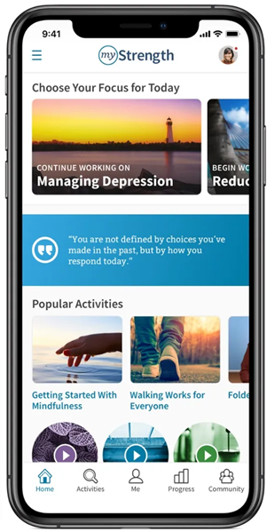
Mental Health Support
myStrength
What is myStrength?
Digital program for emotional health support
Learn from hundreds of activities, articles, guided meditations, and skill-building courses
Practice techniques to shift your thinking and feel more hopeful
How to access
Log onto your HealthPartners account
Select “My Plan” at the top
Then “Living Well” on the right-hand side of the top bar
Go to “myStrength” and click Get Started

Slide 16
Employee Assistance Program (EAP)
Making a budget
Finding child care
Grieving
Adopting a new baby
Knowing your legal options
Parenting tips and resources
Managing stress
EAP Contact:
Call: 866-326-7194
Text: 919-324-5523
Online: hpeap.com
Web Password – sourcewell
iConnectYou Mobile App: 56655

Slide 17
2023-2024 Medical Plan Contributions
 | Employee Contribution (73% to 100% FTE) |  | District Contribution
$1,500 VEBA | Per Pay Period | Difference from 2022-23 | Per Pay Period | Difference from 2022-23
Single | $70.82 | +$14.65 | $285.38 | +$14.65
Family | $213.30 | +$43.28 | $839.07 | +$43.29
*If you are in a different FTE status, please see your cost sheet for the cost of your coverage.

Slide 18
Healthcare Flexible Spending Account
This plan allows you to use pre-tax dollars to pay for any of your eligible out-of-pocket medical, dental and vision expenses.
Maximum Election: $3,050
When calculating your election amount, remember to include expenses for yourself, your spouse and/or your dependents.
Carryover Provision: If you have money leftover at the end of the plan year, up to the IRS limit will carryover into the next plan year
2022-23 Plan Year – Up to $570 will carryover into 2023-24 plan year
2023-24 Plan Year – Up to $610 will carryover into 2024-25 plan year

Slide 19
Dependent Care Flexible Spending Account
This plan will allow you to set aside pre-tax dollars to pay for your eligible dependent day care expenses.
Maximum Election: $5,000 per household ($2,500 if filing separately)
The IRS requires that you report certain information about your day care provider. You need to report the information whether you are taking the tax credit or are using a dependent care reimbursement account. The information necessary is:
The provider’s name
The provider’s address
The provider’s taxpayer identification number (or Social Security number)

Slide 20
Flexible Spending Accounts Summary
Healthcare FSA Maximum Election: $2,850
$570 Carryover Provision from current plan year to 2023-24 plan year
$610 Carryover Provision from 2023-24 plan year to 2024-25 plan year
Dependent Care FSA Maximum Election: $5,000
Healthcare and Dependent Care FSAs are separate.
Use-it-or-lose-it
Your plan year runs from July 1 through June 30
90-day runout period
All claims from the 2022-23 plan year must be submitted to Mid-America for reimbursement no later than September 28, 2023
Must enroll EACH YEAR if you want the FSA!

Slide 21
Dental Coverage
Service Category | Delta Dental PPO | Delta Dental Premier | Out-of-Network
Deductible (per person/per family) No deducible for Diagnostic & Preventive or Orthodontics | $25/$75 | $25/$75 | $25/$75
Annual Maximum (per person) | $1,000 | $1,000 | $1,000
Diagnostic & Preventive (exams/cleanings) | 100% | 100% | 100%
Basic Services (fillings) | 100% | 80% | 80%
Endodontics (root canals) | 80% | 80% | 80%
Periodontics (treatment relating to gum disease) | 80% | 80% | 80%
Oral Surgery (simple or complex oral surgery) | 50% | 50% | 50%
Major Restorative Services (crowns) | 50% | 50% | 50%
Prosthetic Repairs & Adjustments | 100% | 50% | 50%
Prosthetics (bridges, dentures) | 50% | 50% | 50%
Orthodontics | 50% | 50% | 50%
Orthodontic Lifetime Maximum per dependent child ages 8-18 | $1,000 | $1,000 | $1,000

Slide 22
In and Out of-Network Coverage
When you see an in-network (Delta Dental PPO/ Delta Dental Premier) dentist
Network savings on Covered Services
No Balance Billing
Dentist will submit claims directly to Delta Dental
Delta Dental will send plan payment directly to dentist
No need to pre-select a network or Dentist
If you see an out-of-network dentist
If the dentist’s fees are higher than Delta Dental’s allowable charge, you may be responsible to pay the difference beyond the 90th Percentile
Your dentist may assist you in submitting a claim form to Delta Dental
Benefit Payments go directly to you

Slide 23
Delta Dental Online Tools
Register at deltadentalmn.org
Resources and Self-Service Tools to make the most of your dental plan.
Check eligibility status
Review benefits
Find a participating dentist
Claim status and history
Order ID cards
Print forms
International Dental Program
Oral Health Information
MyDental Score Tool
Questions and Answers
Cost per pay period
 | Teachers | Non-Teachers
Single | $0.35 | $0.00
Family | $2.72 | $4.32
Notes:
2022-23: Rates did decrease for teachers, and non-teachers remained the same

Slide 24
Employer Paid Benefits
Basic Life and AD&D Insurance
Benefit Amount varies by class
Paid for 100% by the District
Make sure to choose a beneficiary!
Long-Term Disability Insurance
66.67% of monthly earnings
Max monthly benefit determined by class
90-day waiting period
Continue to SSNRA
Paid for 100% by the District

Slide 25
Voluntary Benefits
Additional Life Insurance
Employee: $10k increments to max $500k
$100,000 Guarantee Issue
Spouse: $5k increments to max $250k
Cannot exceed 50% of Employee amount
$20,000 Guarantee Issue
Child(ren): Choice of $1,000, $5,000 or $10,000
AD&D coverage will match Life benefit
Employee and Spouse rates are age-banded – see summary for more information
Note: You may newly enroll or increase existing coverage (if below guarantee issue) by either $10,000 or $20,000 during open enrollment. If your election exceeds these amounts, or brings you above the guarantee issue, you will be required to submit Evidence of Insurability.

Slide 26
Election Changes
After a new plan year begins, you generally cannot change your benefit election(s). However, if there is a Family Status Change, you may be able to change your election(s).
Family Status Changes include:
Marriage
Divorce
Birth or adoption of a child
Death of spouse or a child
Unpaid leave of absence
Change from full-time to part-time or vice versa by you or your spouse
Commencement or termination of your spouse’s employment

Slide 27
Check Your Beneficiaries!
Open Enrollment is a good time to annually check and ensure you have the correct individual(s) listed as your beneficiary
If you need to update your beneficiary, please complete the appropriate form(s) and return to HR.
Please see Kim Lannier with any questions regarding beneficiary elections.

Slide 28
What’s Next???
All enrollment/change forms
MUST be completed and
sent to Kim Lannier by end of day
Friday, May 26th, 2023

Slide 29
THANK YOU!

