Slide 1
Sotera Health –
Roadmap to Retirement
Retirement advisory services
Francis Enright, CFP®
Managing Director
September 2023
Mesirow Retirement Advisory Services is a division of Mesirow Financial Investment Management, Inc., an SEC-registered investment advisor
Confidential. Please note that this presentation contains information that is strictly limited to the intended recipient(s). It is not for use with the general public and may not be redistributed. Please reference the last page of this presentation for important additional information.

Slide 2
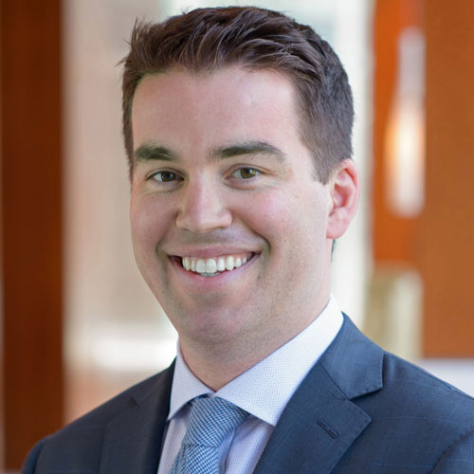

Introductions
Retirement planning
Education strategy and planning
Francis Enright, CFP ®
Managing Director
CERTIFIED FINANCIAL PLANNER™
Francis.Enright@mesirow.com
Income protection
Areas of expertise
Estate planning
Medicare
Social Security

Slide 3
Investing 101
There’s saving (amassing money) and then there’s investing (making it multiply). Two big differences between them: time and the type of account you use as a holding pen for your money.
Saving is what you do with the money you’re going to use to pay for short-term goals — ones in the next three - five years or so. That money belongs in an account where it’s liquid — that is, easily accessible — and safe, such as a savings account
Investing is what you do with money earmarked for long-term goals like retirement. With a long time horizon, you can make growth, rather than liquidity, the priority.

Slide 4
Longevity risk
Life expectancy upon retirement at age 65
A healthy 65-year-old female has a 50% chance of living until age 89 (24 more years).
Source: Chart: Social Security Administration, Period Life Table, 2016 (published in 2019), Figures assume you are in good health. Past performance not indicative of future results

Slide 5
Managing expectations of ability to work
Think you’ll work in retirement? Chances are you won’t.
Perception and reality are at odds here. While many Americans think they’ll work during retirement, the reality is that only a small portion of retirees actually do.
Source: EBRI, 2017 Retirement Confidence Survey, No. 431. Past performance not indicative of future results

Slide 6
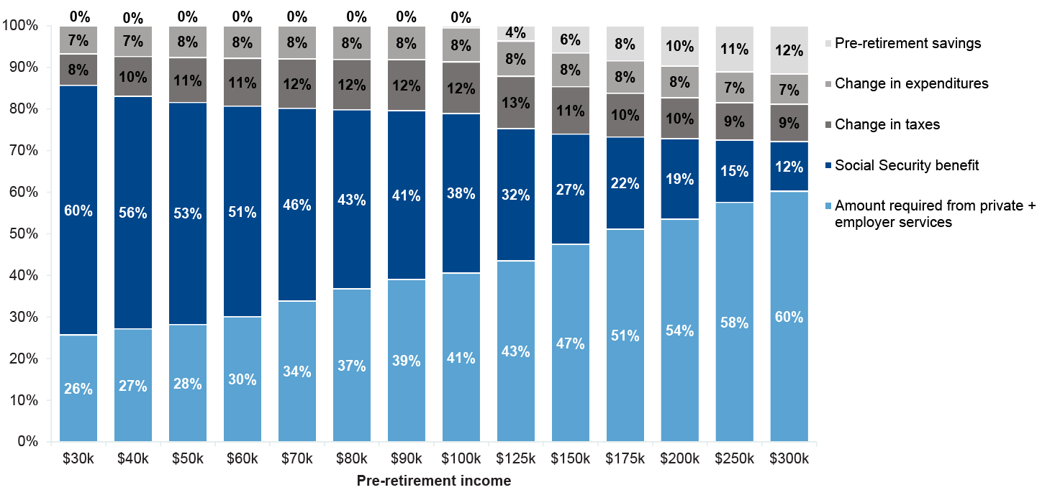
Income Replacement vary by Income
Replacement rate detail by household income
Source: J.P. Morgan Asset Management analysis, 2019. Household income replacement rates are derived from an inflation-adjusted analysis of: Consumer Expenditure Survey (BLS) data (2013-2016); Social Security benefits using modified scaled earnings in 2019 for a single wage earner at age 65 and a spousal benefit at age 62 reduced by Medicare Part B premiums. The income replacement needs may be lower for households in which both spouses are working and the second spouse’s individual benefits are greater than their spousal benefit. Single household income replacement needs may vary as spending is typically less than a two-spouse household; however, the loss of the Social Security spousal benefit may offset the spending reduction. Percentages and values may not sum due to rounding | Past performance not indicative of future results. Please see page 24 for additional disclosures from JP Morgan.

Slide 7
Common savings misconceptions
ADMASTER-STAMP!20210406-1588177-4760618
“I’ve already started saving a little – I should be okay.”
  Almost 4 out of 10 Retirees Underestimate Their Expenses in Retirement.*
“Retirement is so far away – I have plenty of time to think about it.”
  The sooner you begin, the more time you have to maximize the power of compounding.
  Start saving early and regularly. Early withdrawals, loans and missed contributions can results in lower savings, less compounding and fewer assets at retirement.
* Source: Invesco, EBRI 2019, Retirement Confidence Survey. No. 431.
Confidential: Please note that this presentation contains information that is restricted for use only with the intended recipient. It is not for use with the general public and cannot be redistributed.
Please see the last page for important additional information.
6
20210406-1588177-4760618

Slide 8
Understanding your budget
ADMASTER-STAMP!20210406-1588177-4760618
If you haven’t made a budget before, try the 50/30/20 rule as a simple budgeting framework.
  Allow up to 50% of your income for needs.
    Housing
    Utilities
    Insurance
    Child Care
    Groceries
    Minimum Loan Payments
  Leave 30% of your income for wants.
    Monthly Subscriptions
    Travel
    Entertainment
  Commit 20% of your income to savings and debt repayment
    Emergency Fund
    Retirement through Employer
    Paying off Debt, beginning with toxic, high-interest type
Source: Nerd Wallet, “Budgeting 101” 2021
Confidential: Please note that this presentation contains information that is restricted for use only with the intended recipient. It is not for use with the general public and cannot be redistributed.
Please see the last page for important additional information.
7
20210406-1588177-4760618

Slide 9
How can you maximize retirement savings?
Contribution limits – 2023
Pre-Tax and/or Roth deferrals available
Up to $22,500 for the 2023 calendar year
If over 50 years of age, catch up contribution of $7,500
Sotera company match:
  100% on the first 3% of contributions
  50% on the next 3% of contributions
Unengaged participants are more than twice as likely to leave money on the table: 48% don't maximize their employer match compared to 22% of engaged participants.
  Example
  $50,000 Annual salary
  6% Employee contribution = $3,000 ($250 per month)
  100% on first 3% match $1,500
  50% on the next 3% match $750__________
  Total Match $2,250
Participants not maxing the match
Source. Sotera Health
Source. Empower “ Empowering America’s financial Journey 2022”

Slide 10
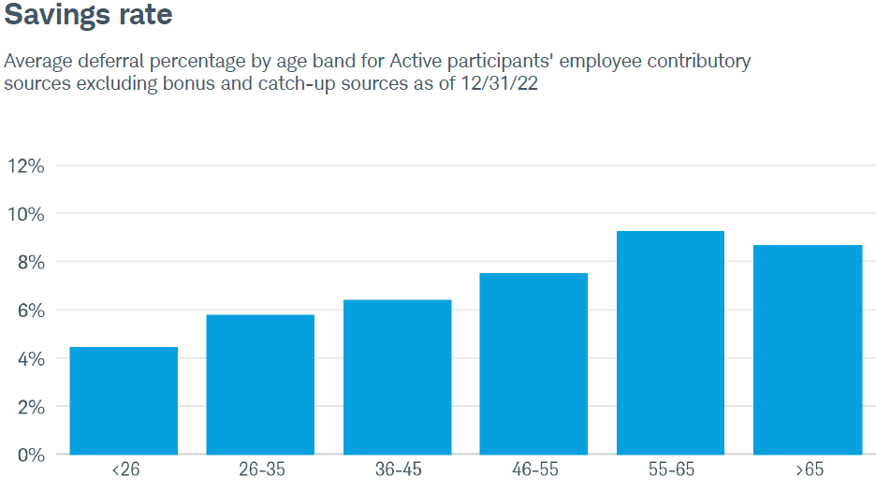
401(k) Plan for Sotera Health
Sotera Health 401(k) Plan Savings Rates
Savings rate
Average deferral percentage by age band for Active participants’ employee contributory sources excluding bonus and catch-up sources as of 12/31/22
Number of participants
Source: Charles Schwab

Slide 11
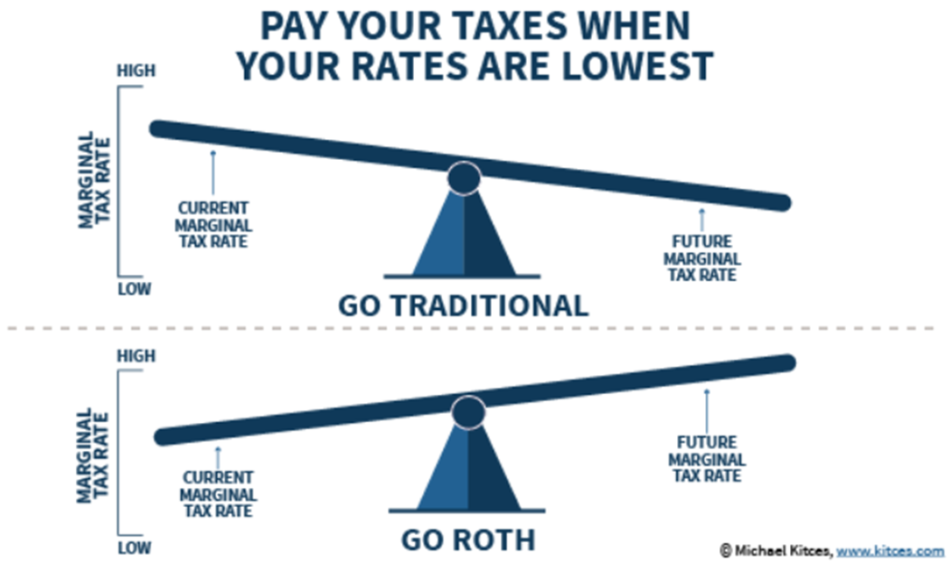
Roth vs traditional contribution
Mesirow does not provide tax or legal advice

Slide 12
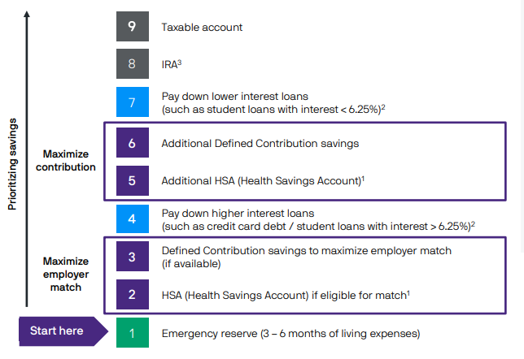
How can you maximize savings?
1. Must have a high-deductible health insurance plan that is eligible to be paired with an HSA. Those taking Social Security benefits age 65 or older and those who are on Medicare are ineligible. Tax penalties apply for non-qualified distributions prior to age 65; consult IRS Publication 502 or your tax professional. 2. This assumes that a diversified portfolio may earn 6.25% over the long term. Actual returns may be higher or lower. Generally, consider making additional payments on loans with a higher interest rate than your long-term expected investment return. 3. Income limits may apply for IRAs. If ineligible for these, consider a non-deductible IRA or an after-tax 401(k) contribution. Individual situations will vary; consult your tax professional. 4. Examples of low-cost funding sources include cash and current income. Source: J.P. Morgan Asset Management Guide to Retirement, 2020 page 46 Mesirow Financial does not provide tax or legal advice.

Slide 13
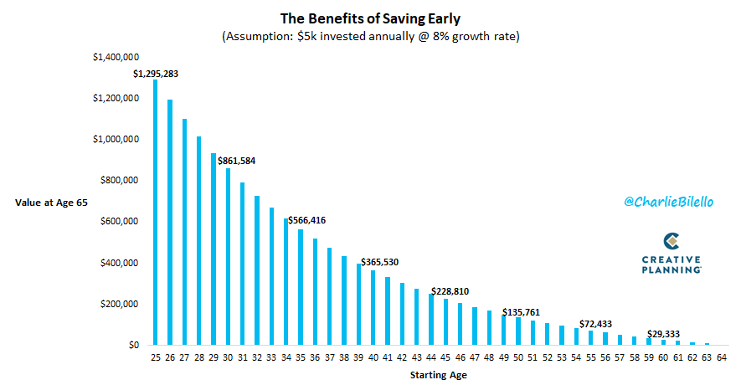
When you start savings matters!
This hypothetical example is for illustrative purposes only. Figures assume a beginning balance of $0, a $5,000 annual contribution, a 8% annual rate of return, and 10, 20, and 30 years of savings. Individual circumstances may vary. There is no guarantee that the results shown will be achieved or maintained over any time period. This example assumes no withdrawals; does not take into account fees associated with investing, which, if included, would reduce the account balance; and assumes reinvestment of earnings. Taxes are due at withdrawal.

Slide 14
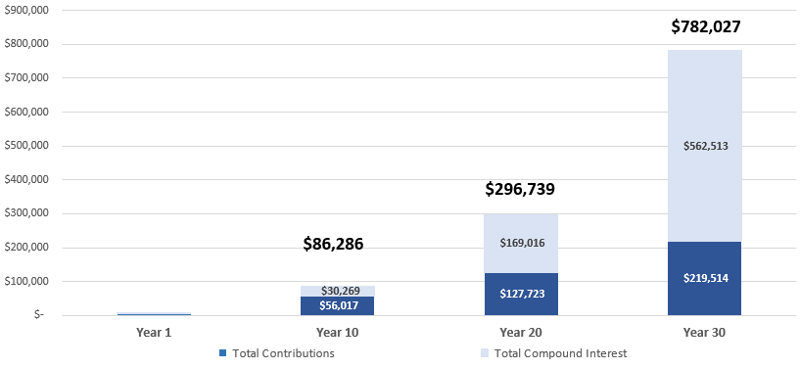
Earlier you start….the easier it easy to reach your goals
“Compound interest is the eighth wonder of the world.
He who understands it, earns it; he who doesn't, pays it”
– ALBERT EINSTEIN
This hypothetical example is for illustrative purposes only. Figures assume a beginning balance of $0, a $5,000 annual contribution, a 8% annual rate of return, and 10, 20, and 30 years of savings. Individual circumstances may vary. There is no guarantee that the results shown will be achieved or maintained over any time period. This example assumes no withdrawals; does not take into account fees associated with investing, which, if included, would reduce the account balance; and assumes reinvestment of earnings. Taxes are due at withdrawal.

Slide 15
Sources of retirement income
Source of income for people 65 and older
Social Security’s role today for retirees has never been greater. Social Security benefits account for 35% of income for those age 65 or older, which is a 13 percent increase from 1962.
35%
Source: Social Security Administration, "Fast Facts & Figures About Social Security,” 2014. | Past performance not indicative of future results

Slide 16
Benefits of dollar cost averaging
 | Fluctuating Price Per Share |  | Steadily Increasing Price Per Share |  | Steadily Decreasing Price Per Share
$100 Contribution | Share Price | Shares Purchased | Share Price | Shares Purchased | Share Price | Shares Purchased
Month 1 | $10 | 10.00 | $10.0 | 10.00 | $10.0 | 10.00
Month 2 | $9 | 11.11 | $10.5 | 9.52 | $9.5 | 10.53
Month 3 | $8 | 12.50 | $11.0 | 9.09 | $9.0 | 11.11
Month 4 | $11 | 9.09 | $11.5 | 8.70 | $8.0 | 12.50
Month 5 | $13 | 7.69 | $12.0 | 8.33 | $8.0 | 12.50
Month 6 | $15 | 6.67 | $12.5 | 8.00 | $7.5 | 13.33
Month 7 | $17 | 5.88 | $13.0 | 7.69 | $7.3 | 13.79
Month 8 | $9 | 11.11 | $14.0 | 7.14 | $7.0 | 14.29
Month 10 | $10 | 10.00 | $15.0 | 6.67 | $6.5 | 15.38
Month 11 | $12 | 8.33 | $15.5 | 6.45 | $6.3 | 16.00
Month 12 | $10 | 10.00 | $16.0 | 6.25 | $6.0 | 16.67
Total Shares Purchased |  | 102.39 |  | 87.85 |  | 146.10
Average Price |  | $11.27 |  | $12.80 |  | $7.70
This hypothetical example is for illustrative purposes only.

Slide 17
Sotera Health – Investment Options

Slide 18
Diversification and the average investor
ADMASTER-STAMP!20210406-1588177-4760618
20-year annualized returns by asset class (2002-2022)
Source: Morningstar Direct, Dalbers Inc. Past performance is not indicative of future results. For illustrative purposes only. Indices used are as follows: REITs: FTSE Nareit Equity REITs TR USD, Small cap: Russell 2000, EM Equity: MSCI EM NR, DM Equity: MSCI EAFE NR, Commodity: Bloomberg Commodity TR, High Yield: Bloomberg Global High Yield TR, Bonds: Bloomberg Barclays U.S. Aggregate Bond TR, Cash: Bloomberg Barclays 1-3m Treasury, Inflation: US BLS CPI All Urban SA 1982-1984. 60/40: A balanced portfolio with 60% invested in S&P 500 Index and 40% invested in high-quality U.S. fixed income, represented by the Bloomberg Barclays U.S. Aggregate Bond TR. Average asset allocation investor return is based on an analysis by Dalbar Inc., which utilizes the net of aggregate mutual fund sales, redemptions and exchanges each month as a measure of investor behavior and represents a 20-year period ending December 31, 2019. All other returns are annualized (and total return where applicable) and represent the 20-year period ending 12/31/22.
17

Slide 19
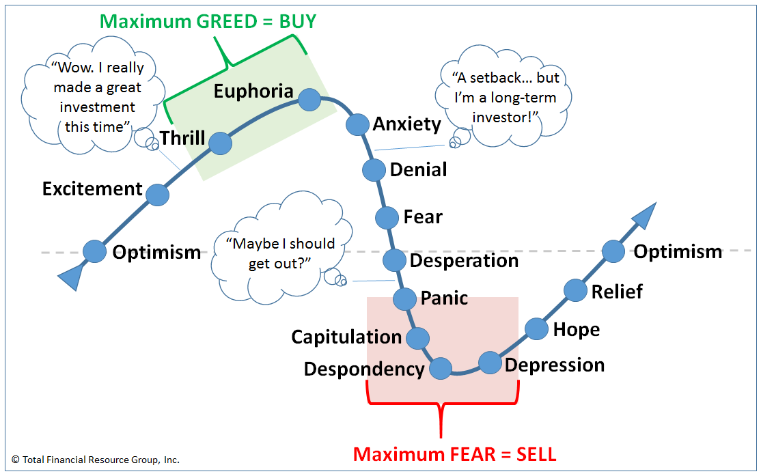
Behavioral finance and financial markets
Investors historically significantly underperform equity markets because…
investors traditionally buy high and sell low
What has the greatest impact on investment results?
Source: Total Financial Resource Group, Inc., ““Win by NOT Losing” Investment Strategies” 2022

Slide 20
Changing habits is difficult
100
Of participants surveyed...
68%
24%
3%
said they are not saving enough....
committed to taking action and raising their contribution amount...
actually did.
Source: Ramsey Solutions 2016 Study. Past performance not indicative of future results.

Slide 21
Resources available to all Sotera Employees

Slide 22



myFinancial Future® features
Advisor managed
account program*
Mesirow serves as a fiduciary for your account for you with a system that will select the line-up, monitor your portfolio, and rebalance your account regularly using a wide range of factors.
Regularly scheduled
group meetings
Every month Mesirow hosts live educational webinars on relevant financial topics that can impact your financial future.
Access to a
financial planner
Schedule a meeting with a Mesirow advisor and talk to a financial planner anytime you want.
*The annual fee for the managed account service is 0.40% of your account balance. The fee is based on your average daily plan account balance, excluding loan balances, and the number of days you are in the service

Slide 23
Access to financial planners

Slide 24
Employees have access to financial planning professionals
Am I on track for retirement?
Investment allocation/risk tolerance
How and when do I take Social Security and Medicare?
What do I do with my money in retirement?
Student debt planning
529 College savings planning
Francis Enright, CFP ®
Managing Director
CERTIFIED FINANCIAL PLANNER™
312.595.6366
Francis.Enright@mesirow.com
23

Slide 25
Comprehensive financial plans
    Goals planning
    College funding
    Life events
    Asset allocation Strategy
    Retirement Savings Strategy
Accumulate
Grow
YOUR
FAMILY
Retirement Income
Investment Planning in Retirement
    Retirement planning
    Social Security strategy
    Medicare Planning
Distribute
Protect

Slide 26
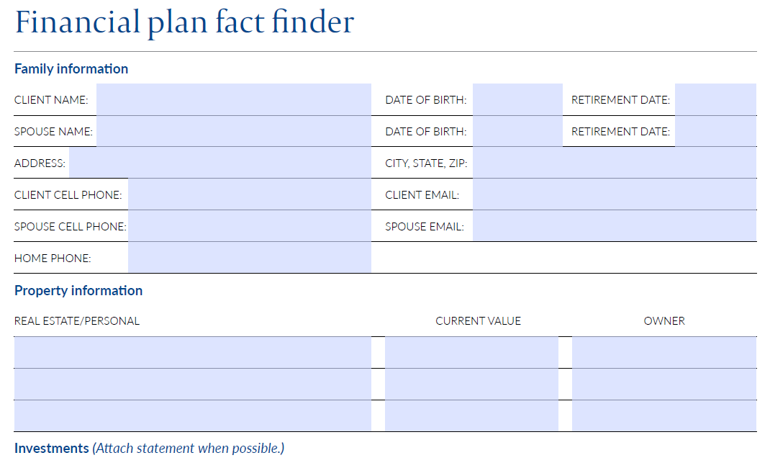
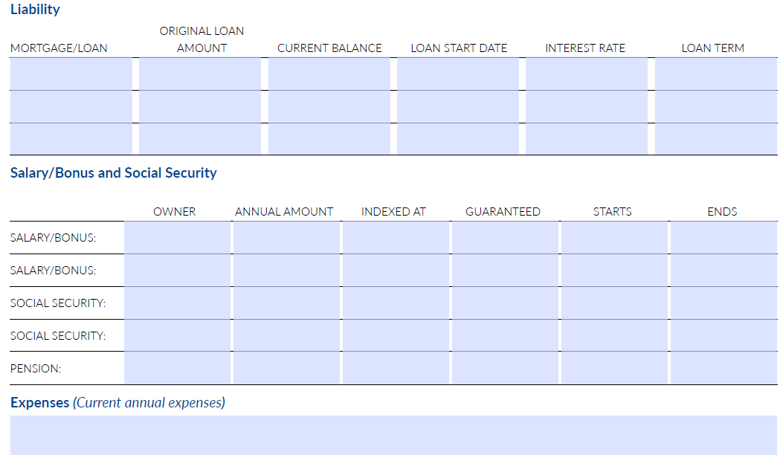
Comprehensive financial plans
Financial planning support
Participants will have the opportunity to meet with Certified Financial Planners to discuss all aspects of their financial life.
Mesirow will provide employees customized, on-demand and personal overview of their complete retirement outlook.

Slide 27
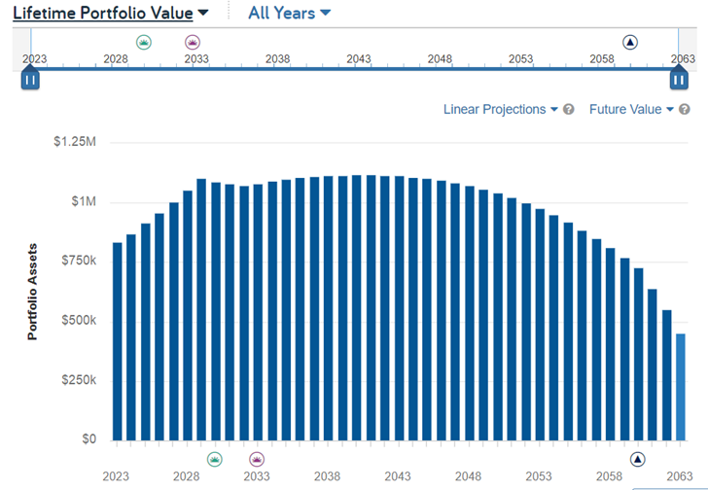
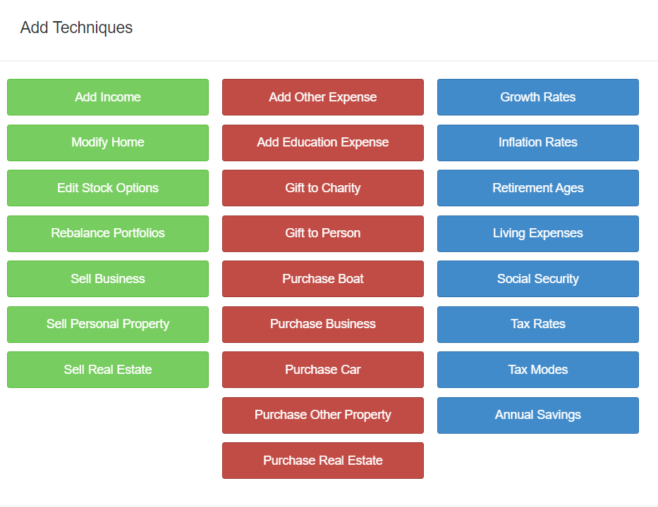
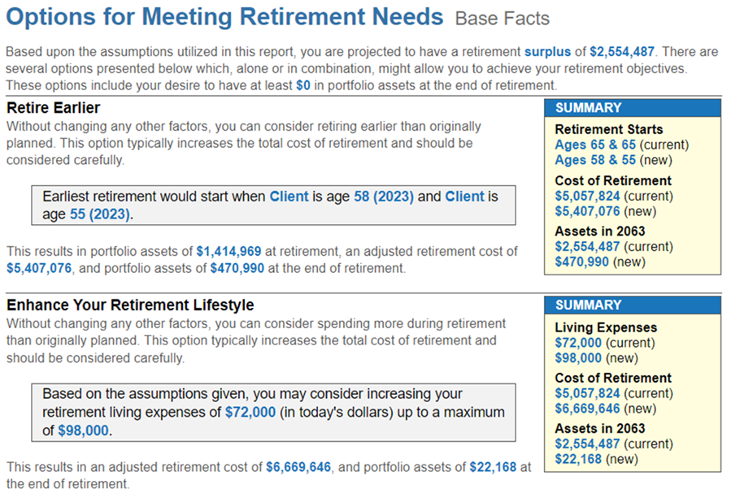
Comprehensive financial plans
Financial planning support
Delivers the important support participants need when making hard financial decisions:
How much will I need to retire? What is my retirement savings “income gap”?
Should I be savings money pre-tax or Roth?
Appropriate Investment Allocation for my Time Horizon and Risk Tolerance?
How to incorporating outside assets for a complete investment approach?
As I near retirement, when should I be reaching out to Social Security and Medicare?
Best course of action to save for child’s education?
Source: EMoney

Slide 28
Advisor managed account program

Slide 29

Managed accounts
Advice continuum and leveraging known participant data
Target date fund
Personalized asset allocation approach
Neither principal nor the underlying assets of target date investments are guaranteed at any time, including the target date, and investment risk remains at all time. There is no assurance that the recommended asset allocation will either maximize returns or minimize risk or be the appropriate allocation in all circumstances for every investor with a particular time horizon. Confidential. Please note that this presentation contains information that is strictly limited to the intended recipient(s). It is not for use with the general public and may not be redistributed. Please reference the last page of this presentation for important additional information.

Slide 30
Going beyond just retirement date
Employee 1
  Retirement date: 2030
  Savings rate: 12%
  Annual income: $50,000
  Account balance: $75,000
  Social Security as % of income: 35%
Employee 2
  Retirement date: 2030
  Savings rate: 6%
  Annual income: $100,000
  Account balance: $300,000
  Social Security as % of income: 25%
Recommended portfolio: Aggressive
Recommended portfolio: Moderate
Source: Charles Schwab. For illustration purposes only. Confidential. Please note that this presentation contains information that is strictly limited to the intended recipient(s). It is not for use with the general public and may not be redistributed. Please reference the last page of this presentation for important additional information.

Slide 31
Index definitions & disclosures
Unless otherwise indicated, all illustrations are shown in U.S. dollars.
Past performance is no guarantee of comparable future results.
Diversification does not guarantee investment returns and does not eliminate the risk of loss.
Indexes are unmanaged and an individual cannot invest directly in an index. Index returns do not include fees or expenses.
The S&P 500 Index is widely regarded as the best single gauge of the U.S. equities market. This world-renowned index includes a representative sample of 500 leading companies in leading industries of the U.S. economy. Although the S&P 500 Index focuses on the large cap segment of the market, with approximately 75% coverage of U.S. equities, it is also an ideal proxy for the total market. An investor cannot invest directly in an index.
The Barclays Capital U.S. Aggregate Index represents securities that are SEC registered, taxable and dollar denominated. The index covers the U.S. investment-grade fixed rate bond market, with index components for government and corporate securities, mortgage pass-through securities and asset-backed securities. These major sectors are subdivided into more specific indexes that are calculated and reported on a regular basis.
Bonds are subject to interest rate risks. Bond prices generally fall when interest rates rise. The price of equity securities may rise or fall because of changes in the broad market or changes in a company's financial condition, sometimes rapidly or unpredictably. These price movements may result from factors affecting individual companies, sectors or industries, or the securities market as a whole, such as changes in economic or political conditions. Equity securities are subject to "stock market risk," meaning that stock prices in general may decline over short or extended periods of time.
Investing in alternative assets involves higher risks than traditional investments and is suitable only for sophisticated investors. Alternative investments involve greater risks than traditional investments and should not be deemed a complete investment program. They are not tax efficient and an investor should consult with his/her tax advisor prior to investing. Alternative investments have higher fees than traditional investments and they may also be highly leveraged and engage in speculative investment techniques, which can magnify the potential for investment loss or gain. The value of the investment may fall as well as rise and investors may get back less than they invested.
Opinions and estimates offered constitute our judgment and are subject to change without notice, as are statements of financial market trends, which are based on current market conditions. We believe the information provided here is reliable, but do not warrant its accuracy or completeness. References to future returns are not promises or even estimates of actual returns a client portfolio may achieve.
This document is a general communication being provided for informational purposes only. It is educational in nature and not designed to be a recommendation for any specific investment product, strategy, plan feature or other purposes. By receiving this communication you agree with the intended purpose described above. Any examples used in this material are generic, hypothetical and for illustration purposes only. Communications such as this are not impartial and are provided in connection with the advertising and marketing of products and services. Prior to making any investment or financial decisions, you should seek individualized advice from your personal financial, legal, tax and other professional advisors that take into account all of the particular facts and circumstances of your own situation.

Slide 32
Disclosures
ADMASTER-STAMP!20210406-1588177-4760618
Neither principal nor the underlying assets of target date investments are guaranteed at any time, including the target date, and investment risk remains at all time. There is no assurance that the recommended asset allocation will either maximize returns or minimize risk or be the appropriate allocation in all circumstances for every investor with a particular time horizon.
Mesirow refers to Mesirow Financial Holdings, Inc. and its divisions, subsidiaries and affiliates. The Mesirow name and logo are registered service marks of Mesirow Financial Holdings, Inc. © 2023. All rights reserved. Nothing contained herein constitutes an offer to sell or a solicitation of an offer to buy an interest in any Mesirow investment vehicle. Any offer can be made only through the appropriate Offering Memorandum to Qualified or “accredited” investors. The information contained herein has been obtained from sources believed to be reliable, but is not necessarily complete and its accuracy cannot be guaranteed. Any opinions expressed are subject to change without notice. It should not be assumed that any recommendations incorporated herein will be profitable or will equal past performance. Mesirow Financial Investment Management, Inc. and its affiliated companies and/or individuals may, from time to time, own, have long or short positions in, or options on, or act as a market maker in, any securities discussed herein and may also perform financial advisory or investment banking services for those companies. Mesirow Financial does not provide tax or legal advice. Investment management and advisory services offered through Mesirow Financial Investment Management, Inc., Mesirow Advanced Strategies, Inc. and Mesirow Financial Private Equity Advisors, Inc., all SEC-registered investment advisors. Insurance services offered through Alliant Mesirow Insurance Services. Mesirow maintains a financial interest in and strategic relationship with Alliant Mesirow Insurance. Compensation and executive benefit strategies provided by Mesirow Financial, Inc. Securities offered through Mesirow Financial, Inc., member FINRA, SIPC. Additional services offered through Mesirow Realty Services, Inc., Mesirow Real Estate Investments, Inc., Mesirow Realty Sale-Leaseback, Inc., Mesirow Financial Services, Inc., Mesirow Financial Hong Kong, Limited, Mesirow Financial International UK Limited. Mesirow Financial International UK, Limited is authorized and regulated by the Financial Conduct Authority.
Footnote page 10:
1. Investment horizon is defined as from prior US stock market high, to the bottom and then to the recovery to the prior high. The investment is considered "under water" during this entire horizon. The hypothetical investor moved to cash or/and stopped contribution at an emotional trigger, which is defined as US stock market drop 20% from prior high, which is commonly defined as bear market.
Monthly returns of below indexes are used.
Stocks: 1926-Jan 1987 US Large Cap Stocks; DJ US Total Market Feb 1987-Present
Bonds: 1926-Dec 1975 US Intermediate Bond; Barclays Agg Bond Jan 1976-Present
Short-Term: 1926 - Present IA SBBI US 30-day T-Bill
The Ibbotson Associates SBBI 30 Day T-Bill Total Return Index is an index that reflects US Treasury bill returns. Data from the Wall Street Journal are used for 1977–present; the CRSP US Government Bond File is the source from 1926 to 1976. Each month, a one-bill portfolio containing the shortest-term bill having not less than one month to maturity is constructed.
Dollar cost averaging does not assure a profit or protect against loss in declining markets. It also involves continuous investment in securities, so you should consider your financial ability to continue your purchases through periods of low price levels.
Keep in mind that investing involves risk. The value of your investment will fluctuate over time, and you may gain or lose money.
Stock markets are volatile and can fluctuate significantly in response to company, industry, political, regulatory, market, or economic developments. Investing in stock involves risks, including the loss of principal.
Past performance is no guarantee of future results.
Diversification and asset allocation do not ensure a profit or guarantee against loss

Slide 33
ADMASTER-STAMP!20220216-2038187-6296414
Mesirow refers to Mesirow Financial Holdings, Inc. and its divisions, subsidiaries and affiliates. The Mesirow name and logo are registered service marks of Mesirow Financial Holdings, Inc. Some information contained herein has been obtained from sources believed to be reliable, but is not necessarily complete and its accuracy cannot be guaranteed. Any opinions expressed are subject to change without notice. Any performance information shown represents historical market information only and does not infer or represent any past performance of any Mesirow affiliate. It should not be assumed that any historical market performance information discussed herein will equal such future performance. It should be assumed that client returns will be reduced by commissions or any other such fees and other expenses that may be incurred in the management of the account. Performance information provided also contemplates reinvestment of dividends. Advisory Fees are described in Mesirow Financial Investment Management, Inc.’s Part 2A of the Form ADV. Mesirow does not provide legal or tax advice. Advisory services offered through Mesirow Financial Investment Management, Inc. an SEC-registered investment advisor. Securities offered by Mesirow Financial, Inc., member FINRA, SIPC. Intellectual property of Mesirow Financial Investment Management may not be copied, reproduced, distributed or displayed without MFIM’s express written permission. © 2023. All rights reserved.

Slide 34
Questions?
ADMASTER-STAMP!20230124-2696342-8563610
20230124-2696342-8563610

