Slide 1

City of Hastings
Annual Enrollment 2024
Life Insurance
Long Term Disability
Dental Insurance
Vision Insurance
Group Critical Illness – New Benefit!
Group Accident Insurance – New Benefit!
Group Hospital Insurance – New Benefit!

Slide 2
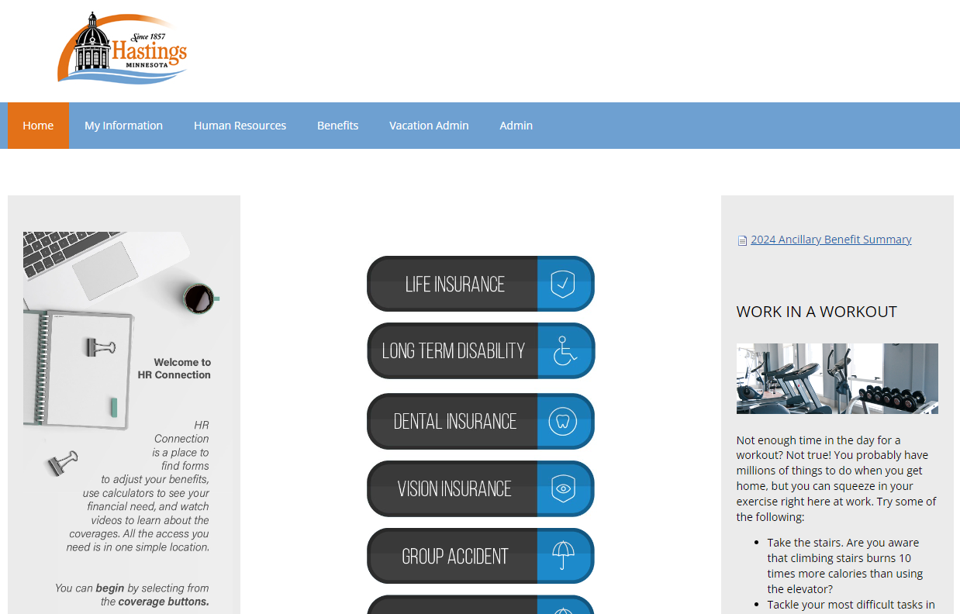
To Log-In Go to: hrconnection.com/guestlogin.aspx
Guest Key: Hastings

Slide 3

Provides cash to your family after your death to help them meet important financial needs
Funeral costs, Medical bills, Taxes, Debts, Lawyers’ fees, Rent/Mortgage, Daily living expenses, College, Savings

Slide 4
Life Insurance
No change to rates or plan design
Employer-provided Basic Life/AD&D $50,000
All existing coverage amounts will roll over to the new year
Optional Life Insurance Maximums:
  Employee – up to $500,000 (in $5,000 increments)
    Not to exceed 8x salary when combined with Basic
  Spouse – up to $250,000 (in $5,000 increments)
    Not to exceed Employee’s Optional Election amount
  Child Life - $10,000 Child(ren) (Covers to age 26)
    Not to exceed Employee’s Optional Election amount
All increases require health history questionnaire
Review your beneficiary designation

Slide 5

Protecting your income should you suffer a serious illness or injury and can’t work and
earn your paycheck over 90 days

Slide 6
Long Term Disability
Employer-provided benefit
All eligible employees participate
Benefits begin after 90 days of being out from work due to an injury or illness
60% of gross monthly income to maximum of $6,000 per month
Benefits could continue to normal social security retirement age (65,66 or 67)

Slide 7

Save money on dental care with pre-tax premiums and negotiated discounts for in-network providers.

Slide 8
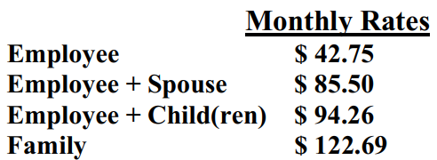
Dental
No change to rates or plan
Freedom to choose any dentist.
Make changes online if joining the plan for the first time, discontinuing coverage, or changing dependent coverage.
Save even more by going In-network (search on the HRconnection site)

Slide 9
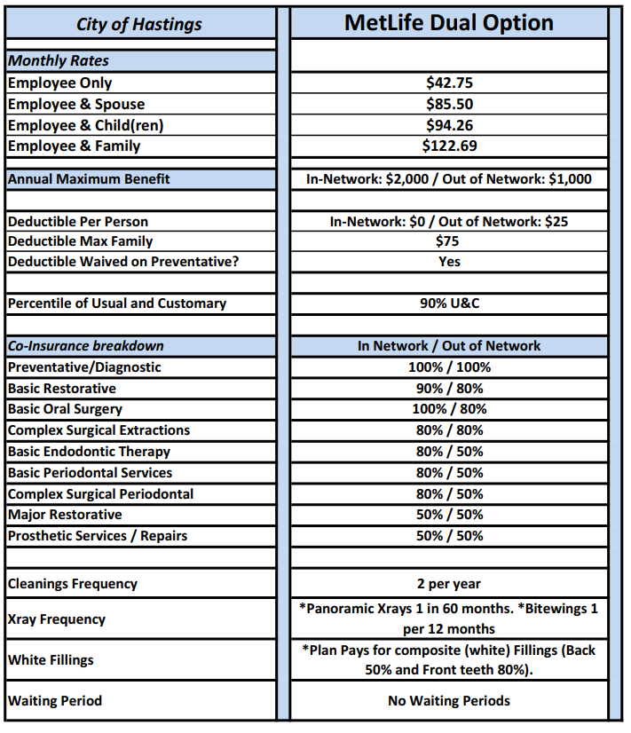

Slide 10

A benefit designed to save you money on prescription eyewear and other vision materials

Slide 11
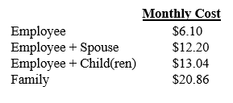
Vision
No change to rates or plan
Eyeglass frames – Every 24 months (Up to $150)
Eyeglass lenses – Every 12 months
Or in lieu of frames and lenses;
Contact lenses – Every 12 months (Up to $150)
Additional Discounts:
  Progressive and Specialty Lenses
  $25 Co-Pay per year (Frames or Lenses only, not contacts)
  Go to HRconnection to search In-Network providers

Slide 12

Group Accidental Injury insurance provides fixed benefits according to a payout schedule for covered accidents.
It can help you pay for out-of-pocket expenses that may not
be covered by traditional insurance, such as rehabilitation, transportation, or childcare and can help you pay for high deductibles and co-pays.

Slide 13
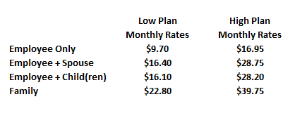
Group Accident Plan
Protect your finances for you and your family in the event of an Accidental Injury.
Help bridge the gap (out of pocket) with High Deductible Health plans.
Benefit is a lump sum, tax-free cash payment to you.
On/Off the job accidents.
No health history needed!
$50 Health Screening/Wellness Benefit per year per person.

Slide 14
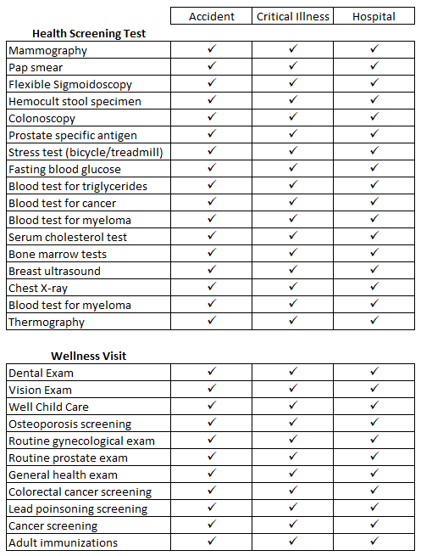
Wellness Benefit
Qualifying visits/health
screening tests (see chart)
Wellness Benefit:
$50 per person per year
for Accident and Hospital
$75 per person per year
for Critical Illness

Slide 15

Critical Illness insurance pays a fixed, lump sum benefit if you’re diagnosed with a covered condition, to help you focus on getting better.

Slide 16
Group Critical Illness Plan
Protect your finances for you and your family in the case of a critical illness such as; heart attack, stroke, invasive cancer, major organ failure, kidney disease, paralysis, etc.
Employee / Spouse / Child Benefit: $15,000 / $7,500 / $3,750
Help to bridge the gap with High Deductible Health plans.
No health history needed and no pre-existing condition limitation!
Invasive Cancer Exclusion: 12-month treatment-free lookback period.
$75 Health Screening Benefit per year per person.

Slide 17
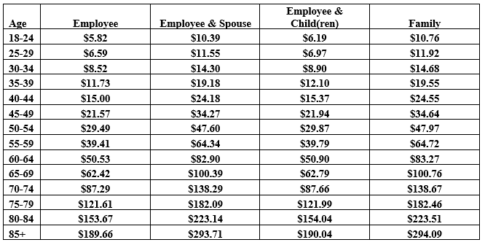
Group Critical Illness Plan
Monthly Premium Rates:

Slide 18
Cigna Hospital Care insurance pays a fixed benefit for hospital stays resulting from a covered injury or illness

Slide 19
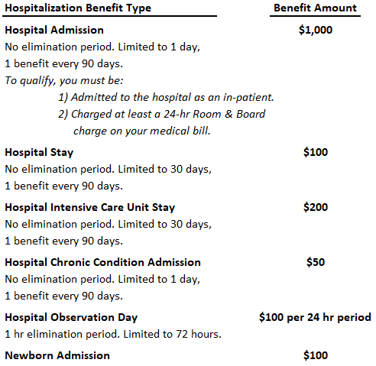
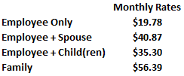
Group Hospital Care
The plan pays you a lump sum benefit if you have a hospital stay. Includes pregnancy. Help to bridge the gap with High Deductible Health plans.
No pre-existing limitation! This includes pregnancies/deliveries and/or scheduled surgeries!
$50 Health Screening/Wellness Benefit per year per person

Slide 20
How to make changes:
Make changes during your enrollment process.
Fill out Health Questions for relevant Life insurance
increases.
Additional Information and forms on HRconnection:
Log-In Go to: www.hrconnection.com
Guest Key: Hastings
              Benefit Summaries
              Health Questionnaires
              Calculators, Videos and resources

Slide 21

Questions?
651-437-7977
integrity@integrityeb.com

