Slide 1
Newly Eligible Enrollment and Benefits Employee Benefits 2024-2025
Notes:
Welcome to Aegis Living’s presentation for employee benefits for

Slide 2
Agenda
Eligibility
Benefit Plans
How to Enroll
Ongoing Resources
Notes:
We will cover the health and welfare benefits effective April 1st, 2022 including open enrollment, plan changes, what action you need to take, and the resources available to you.

Slide 3
Eligibility

Slide 4
Eligibility
Full-Time Employees
Full-time Aegis Living employees who regularly work at least 30 hours/week are eligible for health and welfare benefits on the first day of the month following date of hire.
For example, an employee hired in January would be eligible for benefits on February 1st.
All of our employees are eligible for our voluntary benefits, discount programs, retirement plan and much more….
Notes:
Aegis Living offers the following additional benefits:
Pet Insurance
Employee Cash Advance Program
Home Purchase Program
Read slide
Find more information on the aegisliving.benefithub.com site.

Slide 5
Benefit Plans

Slide 6
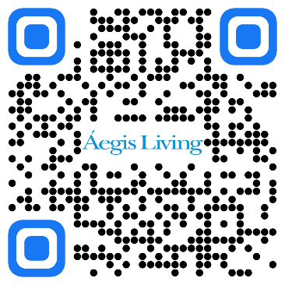
Plans for All Employees
Aegis Living offers the following benefits to All employees:
Voluntary Life Insurance and Accidental Death & Dismemberment
Voluntary Critical Illness
Voluntary Hospital Indemnity
Voluntary Accident
Voluntary Long Term Disability
Employee Discount Programs
Employee Assistance Program
Education Reimbursement Program
401(k) Retirement Plan
MoveSpring Physical Wellness Plan
WellCents Financial Wellness Plan
Home Purchase Program – Enhanced Benefits
Employee Cash Advance Program – PayActiv
Information about each can be found at https://c2mb.ajg.com/aegisliving/home/
Notes:
Aegis Living offers the following additional benefits:
Pet Insurance
Employee Cash Advance Program
Home Purchase Program
Read slide
Find more information on the aegisliving.benefithub.com site.

Slide 7
Voluntary Life and AD&D Insurance
All team members can elect voluntary life and AD&D insurance for yourself, your spouse, and dependents.
You pay the cost of coverage, based on the amount you elect and your age.
You must be enrolled to purchase life insurance for your spouse and/or children.
If you enroll when you are initially eligible you can elect up to $250k for yourself and $50k for your spouse (guaranteed issue) without Evidence of Insurability (EOI). If it is outside of your initial enrollment any amount you elect will require EOI.
Refer to the Benefit Guide and the enrollment system for more information.
Notes:
You can purchase supplemental life insurance for yourself, your spouse, and dependents with The Hartford. You can also purchase additional AD&D insurance for yourself.
You will pay the cost of this coverage, based on the amount you elect and your age. You must be enrolled in order to purchase life insurance for your spouse and/or children.
Why should you consider buying additional insurance? It provides financial protection for your family in the event of death and/or accidental death.
Find more information in the benefit guide or on the enrollment system.

Slide 8
Voluntary Plans
Voluntary Accident
Voluntary Critical Illness
Voluntary Hospital Indemnity
Long Term Disability
You choose how to spend – childcare, deductibles, etc.
$75 wellness screening reimbursement benefit per person per year
LTD benefits can replace up to 60% of your salary, to a maximum benefit of $10,000 per month
Elimination Period 180 days
Duration SSNRA
Pays cash benefits directly to you after a mishap
Pays lump sum benefits directly to you upon diagnosis (Cancer, Heart Attack, Stroke, Major Organ Failure)
Coverage is guarantee issue
Pays a lump sum benefits directly to you for a hospital admission (Hospital admission, ICU confinement etc.)

Slide 9
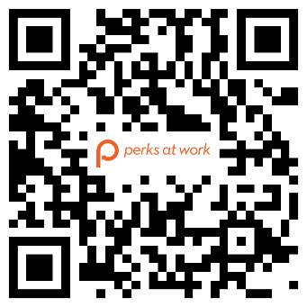
Employee Discount Programs
Passport Corporate
The Passport Mobile Card is a complimentary employee benefit that allows you and your family to access exclusive savings from thousands of local and national merchants – now all from your smartphone! Save on dining, shopping, travel, and all kinds of everyday services.
To Activate Your Mobile Card:
Visit https://passportcorporate.com
Click the ‘Register here’ button, enter your email and the activation code AEGIS-PASS on the next page.
Complete your profile to generate your Passport Mobile Card number.
Download and sign into the Passport Mobile app (simply search for “Passport Mobile” in your app store or marketplace).
Perks at Work!
We’ve partnered with Perks at Work to give you access to employee discounts, so you don’t have to pay full price on the things you buy.
From 30% off movie tickets to hundreds of dollars off a new personal laptop, discounted gym memberships and more
Community Online Academy (COA) We recognize the challenges of managing work, family and life while still trying to maintain our own health/immune systems. We have partnered with Perks at Work to provide ALL Aegis Employees and their families access to Community Online Academy.
COA offers a full Thursday of 30-45 min virtual sessions focused on learning and health & wellness as well as a robust video library.
Simply log on to:
perksatwork.com/aegisliving
Register with your work email or use the code “AEG” to activate your account.

Slide 10
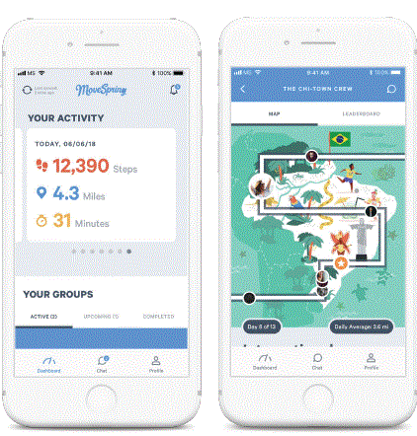
Wellness Program
The MoveSpring App allows you to connect your wearable device or smartphone to automatically track your activity. Compete in fun challenges against others and set new goals for yourself.
How to sign up
You can access the MoveSpring app by creating an account on app.movespring.com or by downloading the iOS or Android app.
Click this join link: https://link.movespring.com/join?orgCode=AegisWellness
You’ll be navigated to the MoveSpring website, or to download the mobile app.
Follow the steps to create your MoveSpring account and connect a device.
Our organization code is AegisWellness and you will need your 5 digit Employee Identification Number (EID).

Slide 11
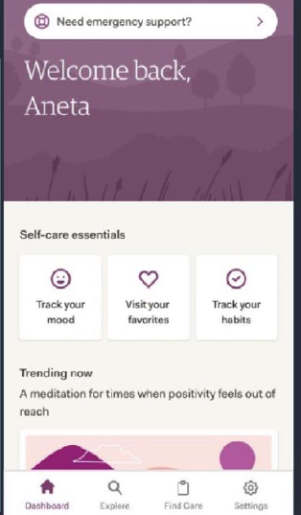
Employee Assistance Program
Administered by ComPsych® GuidanceResources®
Your Life. Your Work. Your Best.
Sometimes life can feel overwhelming. It doesn’t have to. Your ComPsych® GuidanceResources® program provides confidential counseling, expert guidance and valuable resources to help you handle any of life’s challenges, big or small.
Services include:
Counseling Services
Legal Guidance
Financial Resources
Digital Support
Help for New Parents
Estate Preparation
And more….
Call: 877.595.5281 TRS: Dial 711
Online: guidanceresources.com
App: GuidanceNowSM
Web ID: EAPBusiness
Self Care from AbleTo
With your Sun Life insurance coverage, you and your family (ages 13+) have access to Self Care, which offers 24/7 access to self-care tools to help build resilience and improve mental health.
Self-care tools, like mood and habit trackers, guided journals
Curated blog posts, meditations, videos
Guides to help you navigate life challenges
Content suggestions based on your unique needs
Sign up at AbleTo.com/selfcare-sunlife
Access code: SUNLIFE

Slide 12
Pet Insurance
Administered by ASPCA®
The coverage they need the way you want
Our best plan ever Complete Coverage with an accident & illness plan provided by the ASPCA® Pet Health Insurance program, you have help choosing the care you want when your pet is hurt or sick. You can take comfort in knowing they have coverage.
Simple to Use
Customizable
Preventive Care
Accident Care
Cover Exams, Fees, Diagnostic and Treatments for a variety of conditions

Slide 13
Education Reimbursement Program
Áegis Living recognizes that our staff members are the source of our immense success. We want to provide you with career opportunities that will challenge and reward you, both personally and professionally by offering education reimbursement of $1,500 in a 12-month period.
To become eligible for the Áegis Education Reimbursement Program, you must:
Be a full-time or part-time staff member
Complete one (1) year or more of continuous Áegis service
Exception: 6 months of continuous service for CNA/HCA reimbursement
Demonstrate “Very Good” or better performance
What are qualified expenses?
Tuition and fees
Student activity fees
Expenses for books, supplies and equipment

Slide 14
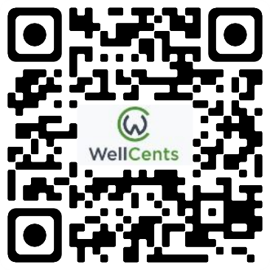
Financial Wellness Program
WellCents is a comprehensive, holistic financial wellness solution designed to help you create confidence in your financial life and help you secure a financially sound retirement.
One on One meetings with a financial advisor
Retirement Workshops
And more…
Go to https://mywellcents.com/AegisFinancialWellness to get started or download the app from the Apple App Store or Google Play. Use the business code: AegisFinancialWellness

Slide 15
401(k)Retirement Savings Plan
You are eligible for the 401(k)-retirement savings plan if you are an employee who is at least 18 years of age.
You may begin participation in the plan as soon as the first day of the month following your date of hire.
You may enroll at any time after you are eligible, and you may change your payroll deduction as often as every paycheck.
Once eligible, you decide how much of your salary you want to contribute from your paycheck (full percentage only)
You may contribute to Pre-tax Traditional, Post-tax Roth or both.
Aegis Living may make a matching contribution to your 401(k):
Matching contribution is equal to $0.50 cents for each $1 you contribute, up to 4% of pay you contribute to the plan. For example, if you contribute 4% or more, the match will be 50% of that, or 2%.
You must be employed for at least one year to be eligible
You must be employed on the last day of the calendar year to be eligible for the match.
Matching contributions are funded during the first quarter of each year for the following year
You vest at the rate of 20% for each calendar year you work 1,000 hours for Aegis Living. You will be fully vested after years of service with 1000 hours.
Your Contribution | Matching Contribution
1% | .50%
2% | 1%
3% | 1.5%
4% | 2%
5% and above | 2%
Notes:
Once eligible, you decide how much of your salary you want to contribute from your paycheck:
Up to $22,500 in 2023 with before-tax or after-tax (Roth) contributions, or up to $30,000 in 2023 if you are over the age of 50 in the year
Pre-tax contributions lower your taxable income now.
Roth after-tax contributions are deducted from pay after taxes are calculated. Withdrawals after age 59-1/2 are tax-free for employee contributions and investment earnings provided your first Roth contribution was made at least five years prior.

Slide 16
Benefit Plans
Full Time Employees

Slide 17
Medical Plans
Administered by Premera Blue Cross
These Premera medical plans provide excellent coverage of preventive services, such as routine physical exams and immunizations that are important to you and your family’s health. Prescription drug benefits are also included with the medical plan.
Low-Cost Plan – Prime Network Only (Employee Only)
Core PPO Plan
Buy Up PPO Plan
What is the difference between the plans?
How much you pay in premiums (per paycheck amount).
How much you pay when you access care (copay, deductible and out-of-pocket maximums)
Networks
California – Blue Card Network
In Washington state only - Network selection
Heritage Prime network – limited network
Heritage network – broader network
Notes:
You have multiple medical plan options to choose from. All plans are with Premera Blue Cross and cover the same services, procedures, and medications.
The differences are:
How much you and Aegis Living pay in premiums
How much you pay when you access care
And in Washington state the provider networks. In Washington, you will have the choice between the Heritage Prime and Heritage networks.

Slide 18
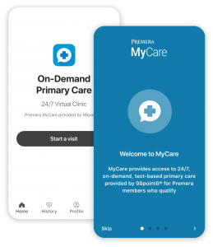
Medical Plans
Premera Virtual Care
Only available if you are enrolled in an Aegis Medical Plan
Try the Premera MyCare App for your on-demand healthcare!
DoctorOnDemand Primary and Behavioral Healthcare | doctorondemand.com/premera
98point6 Primary Care/Text-Based | 98point6.com/premera
Talkspace Behavioral Health | talkspace.com/premera
Boulder Care Substance Abuse Counseling | www.boulder.care/getstarted
Omada Physical Therapy | go.omadahealth.com/premera
Notes:
You have multiple medical plan options to choose from. All plans are with Premera Blue Cross and cover the same services, procedures, and medications.
The differences are:
How much you and Aegis Living pay in premiums
How much you pay when you access care
And in Washington state the provider networks. In Washington, you will have the choice between the Heritage Prime and Heritage networks.

Slide 19
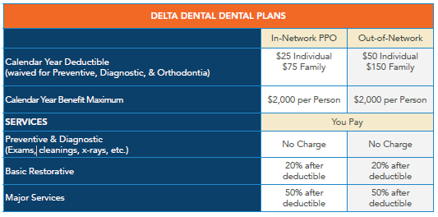
Dental Plan
Aegis Living offers a comprehensive dental plan with Delta Dental of Washington to help you and your eligible family members pay for dental care services such as routine exams, filings, x-rays and orthodontia.
Your deductible, out of pocket maximum and visit limits accumulate January - December of each year and reset on January 1.
Notes:
Here is an outline of the dental benefits with Delta Dental of Washington. The deductible and benefit maximum on the plan accumulate during the calendar year and reset every January 1st. You will typically pay more when seeing an out-of-network provider and may be balance billed. To get the most out of your plan, it is important to ensure you see in-network providers within the PPO or Premier network. We’ll focus on the in-network benefits.
You can receive preventive and diagnostic services such as exams, cleanings, and x-rays at no charge. Non preventive and diagnostic care has a deductible before the plan begins to pay. For basic services like fillings, endodontics, periodontics, and oral surgery, you pay 20% of the cost after your deductible. For newly enrolled employees there is 12 month waiting period for major services like crowns, dentures, and bridges. Once the waiting period has ended, you will pay 50% of the cost after your deductible. Your preventive, basic, and major services all accumulate toward the $2,000 per person calendar year benefit maximum.
This plan also has an orthodontia benefit for covered children through age 25. You will pay 50% for orthodontia services and the plan will pay 50% up to $1,500. The orthodontia maximum benefit is a lifetime benefit for each person covered under the plan. It does not count towards the annual benefit maximum.

Slide 20
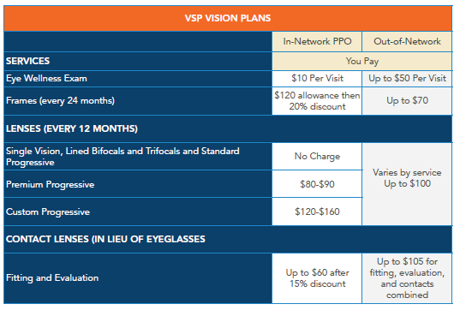
Vision Plan
Aegis Living offers a comprehensive vision plan with Vision Service Plan (VSP) to help with vision care costs for eye exams and corrective eyewear. You can access vision care services from any provider you wish. However, your costs will typically be lower if you choose a VSP Signature network provider.
Notes:
Vision insurance is offered through VSP. As with medical and dental, you will get the most out of your benefit when seeing in-network providers. We’ll review in-network benefits. You can go in for one eye exam every 12 months for a $10 copay. These benefits are available based on your last date of service. Meaning if you have an eye exam on June 1st, you would need to wait until the following June to have your next exam.
You can get one pair of frames every two years up to a $120 allowance. VSP offers a discount on the cost above this allowance.
Basic Lenses are covered after a $25 copay each 12 months. If you upgrade your lenses with things like scratch coating or polarization, there may be additional cost--although VSP does discount these lens enhancements. Ask your provider for a quote before ordering prescription glasses.
You can choose to get contact lenses instead of glasses with a $120 annual allowance. There will be a separate fitting and evaluation exam if you get contacts. The most you would have to pay is $60 for this service.

Slide 21
Flexible Spending Accounts (FSA)
Aegis Living offers flexible spending accounts (FSA) through Navia Benefit Solutions. An FSA allows you to set aside money on a pre-tax basis to pay for qualified out-of-pocket healthcare and dependent care expenses. Putting money in an FSA helps you save by reducing your taxable income and therefore, reducing your taxes.
FSA | Eligible expenses | Minimum election | Maximum election
Healthcare FSA | Medical, prescription drug, dental, and vision expenses for you and your tax dependents – regardless of if they are covered on your medical plan. | $100 | $3,200
Dependent Care FSA | Before and after school care, day care, preschool, day camps for your dependent children 12 and under that allows you to work, look for work, or be a full-time student | $500 | $5,000 if single or filing jointly ($2,500 if married, filing separately)
Use it or lose it!
Healthcare FSA Amounts over $640 and ALL Dependent Care FSA balances will be forfeited (lost) at the end of the plan year (3/31/2025)
Notes:
Carry over For 2022 into 2023 it's $570. For 2023 into 2024 it's $610.
You can set money aside through payroll deduction on a pre-tax basis and use the funds to pay for qualified health and dependent care expenses through the Navia Benefits Flexible Spending Accounts (or FSA).
Your FSA election is evenly deducted from your paycheck, pre-tax, throughout the year.
The plan year runs from April 1st to March 31st
The Healthcare FSA allows you to use funds for eligible medical, prescription drug, dental, and vision expenses for you and your tax dependents – regardless of if they are covered on your medical plan.
The dependent care FSA allows you to use funds for eligible before and after school care, day care, preschool, day camps for your dependent children 12 and under that allows you to work, look for work, or be a full-time student. Certain elder care expenses are also eligible.
To find more detail on eligible expenses, visit the Navia Benefits or the IRS websites.
You may carry over up to $610 in unused healthcare FSA money from one year to the next. Unused amounts in your Dependent Care FSA cannot be carried over and will be forfeited.
We recommend you only elect an amount to contribute for known expenses in the coming year.

Slide 22
Basic Life and AD&D Insurance
Aegis Living provides basic life and accidental death and dismemberment (AD&D) insurance to all eligible employees at no cost.
What is Basic Life and AD&D Insurance?
Life insurance pays your beneficiary a benefit if you die while you are covered. AD&D insurance provides benefits due to certain injuries (e.g., loss of limbs, sight, speech, or hearing, paralysis, etc.) or death from an accident.
What is my Benefit?
Aegis Living provides you $10,000 of basic life insurance and $10,000 of AD&D insurance.
Aegis Living pays the full cost on your behalf.
Notes:
Aegis Living provides basic life and accidental death and dismemberment (or AD&D) insurance to all eligible employees at no cost. Life insurance pays your beneficiary a benefit if you die while you are covered. AD&D insurance provides benefits due to certain injuries (for example, loss of limbs, sight, speech, or hearing, paralysis) or death from an accident. Aegis Living provides a $10,000 benefit for Basic Life and $10,000 for AD&D.
When you first enroll, you will need to designate a beneficiary for this policy. You may change your beneficiaries at any time.

Slide 23
How to Enroll

Slide 24
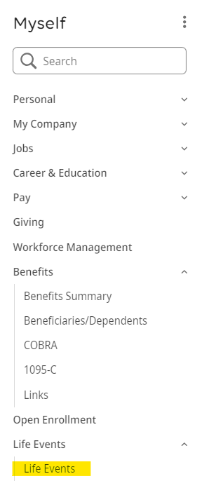
How to Enroll
You can easily access and update your benefits through UKG Pro.
Simply go to:
Myself
Life Events
I am a New Employee
You have 30 days from your hire date to elect your coverage
Please note that the Benefits Enrollment is not available on the Mobile App at this time. You must use a computer to access and change your benefit elections.
Notes:
You will need your Employee ID number to enroll.
Your username will be AEG plus your 5 digit employee ID number.
Here are some examples.
If your ID number is 12345, your username would be AEG12345
If you have a 4 digit ID number like 1234, you will need to add a zero before your ID number. In this example, your username would be AEG01234
Your password is your date of birth formatted as 2-digit month, 2-digit day, and 4-digit year without slashes.
As an example, if your date of birth is June 10th, 1964, your password would be 06101964
You can access your Aegis Living ID number on your paystub on the ADP mobile app or contact your Business Office Manager

Slide 25
Ongoing Resources

Slide 26
Aegis Living Advocate Center
For assist with:
Questions about benefits or provider bills
Claim issues
Pharmacy or prescription issues
Guidance around difficult situations like denied procedures or appeals
Benefit Advocates available at Gallagher
1-833-262-1832
bac.aegisliving@ajg.com
Mon – Fri, 8 am – 6 pm PT
Language interpretation assistance available in 200+ languages

Slide 27
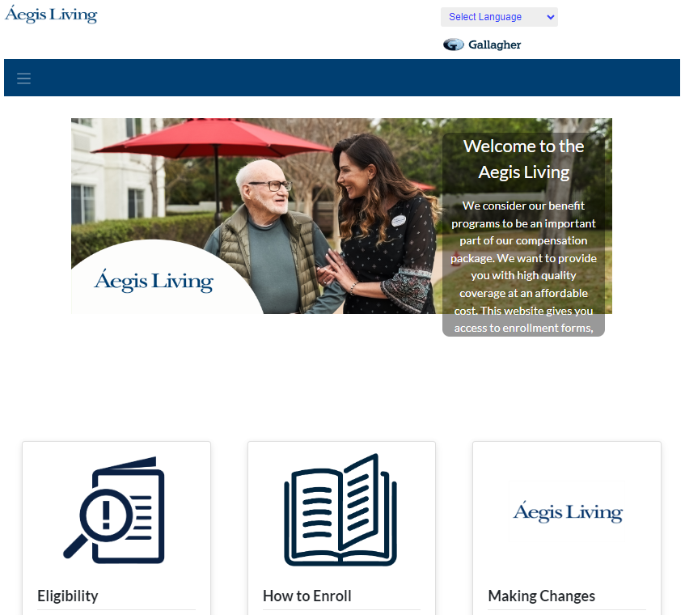
Benefit Portal Connect2MyBenefits Portal
To review all of the information in this presentation and more, visit the Aegis Benefits Hub:
c2mb.ajg.com/aegisliving/home/

Slide 28
Aegis Living Benefits Team
Aegis Living Benefits Team
Joycee Santos
Benefits and Leave of Absence Administrator
Bobbie Benavente
Director, Benefits and Leave of Absence
Email: benefits@aegisliving.com
Phone: 1(425) 364-5190

