Slide 1
St. Anthony New Brighton Schools 2025 Open Enrollment
Open Enrollment – May 14th – May 29th
©2019 ARTHUR J. GALLAGHER & CO.
Notes:
Hello and thank you for tuning in to Saint Anthony New Brighton’s open enrollment presentation for the twenty twenty-five, twenty-six plan year. During this presentation we will review all the benefits available to you here at the District, providing the education and information you need to make the best benefits decisions for yourself and/or your family.
This recording allows you the opportunity to listen to the presentation straight through, or if you would like to learn about specific benefits, you may click on the item of interest using the left-hand table of contents to navigate directly to that slide.

Slide 2
Overview of Changes
Medical will remain with HealthPartners
Same plan option – District VEBA contribution maintained
Two network options – Open Access and Achieve networks
Rates increased with the District sharing in that increase
Dental will remain with HealthPartners
Maintain self-funded dental plan
No change to benefits – No change to rates
Dental network remains Dental Distinctions Network
Life/Disability remains with The Hartford
No change to benefits and rates
2
©2019 ARTHUR J. GALLAGHER & CO.
Notes:
To begin the review of our benefits, here is a high-level overview of what to expect for this upcoming plan year.
Our medical plan will remain with HealthPartners, with no changes to the plan benefits. Our plan design will continue to be paired with a VEBA, which is administered by Mid America. The same two network options will remain available, which are called the Open Access network and the Achieve network. Rates are increasing, and the District is sharing in that increasing. The District continues to cover a large portion of the total cost of coverage.
Our dental plan will remain with HealthPartners, and there will be no change to the plan benefits. The cost for coverage will remain the same as well, meaning there is no increase to the premiums, and the District will continue to coverage a large portion of the total cost of coverage. The dental network remains the HealthPartners dental distinctions network.
For both the medical and dental premium costs, there are slides contained within this presentation that show what those premium costs are for the upcoming plan year. You may also refer to the premium cost sheet for your specific F.T.E status.
The Life and Disability coverages are also continuing at no change to plan benefits, and the claims administrator remains with The Hartford.

Slide 3
Open Enrollment Process
Passive Enrollment for medical, dental and life coverage –
Only complete an enrollment form if you are making changes
Changes include:
Adding/dropping coverage
Changing Medical plan networks
Adding/dropping enrolled dependents
Adding/increasing life insurance
You must elect your FSA amounts each year, this will
not rollover from your current 2024-25 election.
3
©2019 ARTHUR J. GALLAGHER & CO.
Notes:
This year the district will be conducting a passive open nrollment for medical, dental and life insurance coverage. This means that if you want to keep your benefits exactly the same as they are today, you do not need to complete an enrollment form. However, if you wanted to make any changes, you would need to complete a form noting the change or changes that you would like to make. For instance, if you would like to newly enroll in a coverage or waive an existing coverage, that would require a form. If you are currently on the open access network and would like to switch to the Achieve network, that would be a change. Finally, if you want to add or drop dependents from your coverage, you have the opportunity to do that during open enrollment, you simply need to complete a form with the applicable information.
If you would like to add or continue contributing to an F.S.A, or Flexible Spending Account, that election does need to be make each year. The I.R.S does not allow us to roll that election forward from year to year, so if you want the F.S.A in the next plan year, you do have an action item during open enrollment, as you must make an active election each plan year.

Slide 4
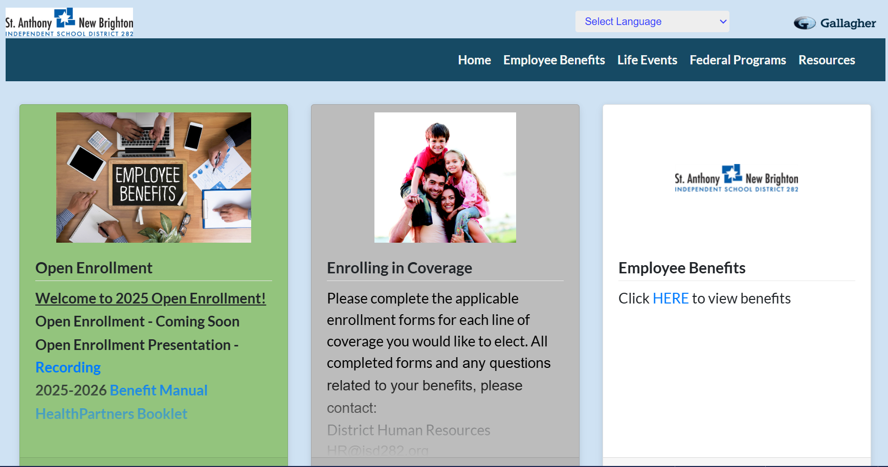
Online Benefit Portal
Your one stop for all benefits information!
All forms and plan summaries are
available on this site
Accessible from home and work
https://c2mb.ajg.com/sanb282
©2019 ARTHUR J. GALLAGHER & CO.
Notes:
As you go throughout the open enrollment process, please visit the online benefits portal. All of the benefits information, including this presentation, is located out on the benefits portal. Simply visit the website listed on the screen and navigate to the variety of resources available for each of our insurance carriers and vendors. You can access full plan summaries and documents, enrollment forms, carrier contact information and website links, and much more, all through this portal. In addition, you do not need to be at the District to access, you can view this portal at home, any time. Please utilize this throughout the year to assist you with any benefits questions or needs that may come up!

Slide 5
Medical Plan Comparison
In Network Benefits | $1,500 VEBA
Plan Year Deductible | $1,500 per individual $3,000 per family
Plan Year Out-of-Pocket Maximum | $1,500 per individual $3,000 per family
Embedded Status | Embedded
District VEBA Contribution* | $550 / single coverage $1,100 / family coverage
Preventive Care | 100%
Office/Urgent Care Visit | Deductible then 100% Coverage
Convenience Care | Deductible then 100% Coverage
ER Visit | Deductible then 100% Coverage
Hospital Services | Deductible then 100% Coverage
Retail Pharmacy (31 day supply) | Formulary: Deductible then 100% coverage Non-Formulary: No coverage
5
©2019 ARTHUR J. GALLAGHER & CO.
Notes:
Let’s start by diving into the medical plan.
Since the plan design is remaining the same as it is today, I will review some terms on the lefthand side to ensure we have a good understanding of how our benefits work. First, the deductible and out of pocket maximum run on the plan year, which means they reset each year on July first. The deductible is the amount that you must pay before the plan starts to pay for most services. The out of pocket maximum includes what you pay in the deductible, as well as any copayment and coinsurance amounts you pay throughout the year. For all in network, covered services you pay throughout the plan year, they all accumulate into the out of pocket maximum. We call the out of pocket maximum your total risk for being on the plan. It’s the most you would pay in any given plan year.
For the district’s plan the deductibles and out of pocket maximums are embedded. This pertains to those of you with dependents enrolled on the plan. Having an embedded deductible and out of pocket maximum means that one person could not pay up to the family deductible and out of pocket for their own medical expenses. Each family member is capped at the per person deductible and out of pocket maximum. Once one member of the family has paid up to the per person out of pocket maximum for their own expenses, they would have 100% coverage for the remainder of the plan year. Then, when the family as a whole has paid up to the family out of pocket maximum, the entire family will then be covered at 100% for the remainder of the year for any eligible in-network expenses.
Preventive care services are covered at one hundred percent before the deductible. This includes your annual physical, immunizations, well child visits, and age appropriate cancer screenings. We want all of our members each year to receive their eligible preventive, as that will help to catch conditions early and reduce future healthcare expenses. All of these services are again covered at one hundred percent before the deductible.

Slide 6
HealthPartners – Two Networks
Open Access Network
Largest network
Higher premium cost
No referrals needed
Healthpartners.com/openaccess
Achieve Network
Narrower network
Lower premium cost
No referrals needed
Healthpartners.com/achieve
National Network:
Cigna Providers
©2019 ARTHUR J. GALLAGHER & CO.
Notes:
Here at the District we have two network options that you can choose from, which pair with your medical plan. The first is the open access network. This is HealthPartners’ largest, most broad network they have to offer, encompassing all major hospital and care systems. The second network option is the Achieve network. This is a slightly narrower network, including about 70% of the providers included in the Open Access network, focusing primarily on the HealthPartners and Park Nicollet family of clinics and care systems. No matter which network you choose, you will have access to HealthPartners national network, which they have through their partnership with Cigna. For both networks, if you are traveling on vacation, or maybe you have an adult dependent child living out of state for college, they will have access while outside the HealthPartners's service area through this Cigna network. To search for providers in your area, simply go onto the websites listed on the screen and search using the city and state or zip code that you are interested to review all the providers that are in that area.

Slide 7
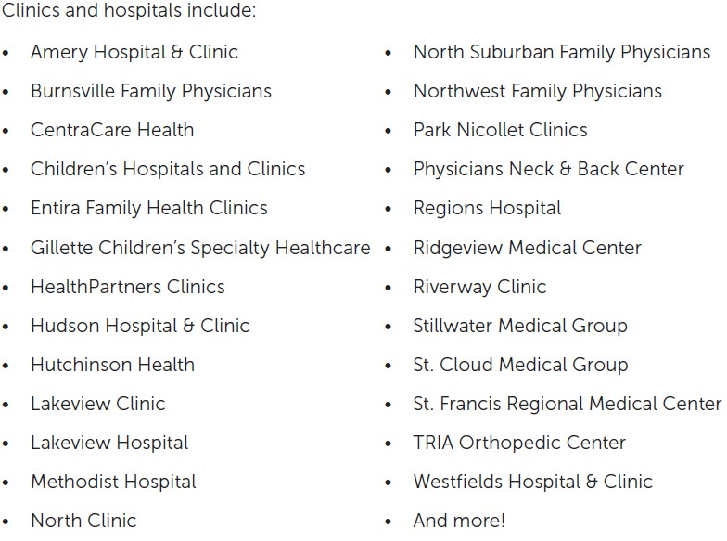
HealthPartners – Achieve Network
Local Providers IN-Network
oHealthPartners Medical Group
oSt Anthony Clinic
oAxis Family Clinic
oCentral Pediatrics
Local Providers OUT-of-Network
oNorth Memorial Health
oM Health Fairview Clinic
oAllina Health Clinic
©2019 ARTHUR J. GALLAGHER & CO.
Notes:
Again, the Achieve network is focused primarily on the HealthPartners and Park Nicollet family of clinics and care systems, but there are also several other clinics and care systems that are included, such as Children's Hospital. The snapshot on the right is just a sampling of the popular care systems that are included in this network option. Locally, you can see that some popular systems such as St Anthony clinic and Axis Family Clinic, are included in the Achieve network. Other local providers such as M Health Fairview Clinic, Allina Health Clinic and North Memorial Health are not in the Achieve network. However, all these providers would be included in the Open Access network.
Let's say you choose the Achieve network, and you have an emergency such as a heart attack, for example. Because it is an emergency, no matter where the paramedics bring you, your services will be covered because all emergency care is covered at the in-network benefit level. So don't worry if they were to bring you to an out-of-network hospital! Once stable, they would then coordinate to transport you to an in-network facility for the remainder of your treatment.
The achieve network might be right for you if you are already directing your care to a clinic or system in this network and want to continue receiving your care there. This network may also work for you if you don't have an affiliation with any particular clinic yet and are OK with directing your care to these care systems. In either case, the Achieve network is a lower premium cost than the Open Access network, so you will save money on premiums by directing your care to the high quality, lower cost providers in the Achieve network.

Slide 8
HealthPartners Resources
Member Services
952-883-5000
24/7 Care Lines
Nurse Line – 800-551-0859
Baby Line – 800-845-9297
Behavioral Health Navigators
Available on the back of your ID Card!
Nurse Navigators
Pharmacy Navigators
8
©2019 ARTHUR J. GALLAGHER & CO.
Notes:
HealthPartners has a variety of resources available to you as a member. The first place you should go for questions is Member Services. They can answer most questions, and if needed, they can direct your question or situation to the most appropriate resource within HealthPartners. There also is three individual navigator programs designed to assist you with any complex care needs. For your medical needs there are the Nurse navigators, your medication needs the Pharmacy navigators, and your mental health and substance use needs the BH navigators. There are also two 24/7 care lines - the nurse line and baby line - that you can call anytime for non-emergency questions. These nurses are located locally in Bloomington, MN, and can help you determine the best route of treatment for any non-emergency need. The numbers for those resources are on the back of your member ID card, so when you're in a situation where you can take a step back and think about what to do for care, give the nurseline a call, describe your situation, and they can provide advice and tips to best care for whatever it is that you need.

Slide 9
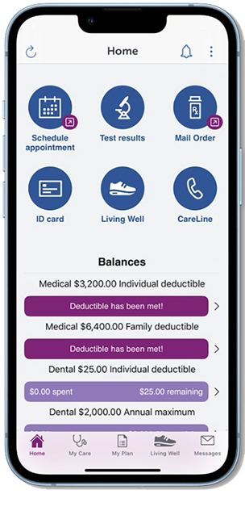
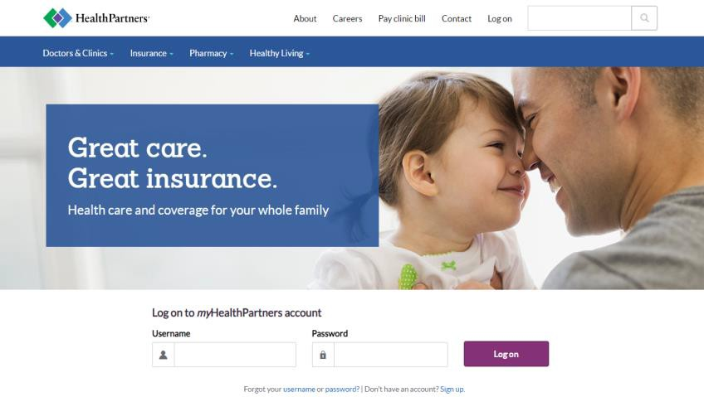
HealthPartners Resources
healthpartners.com
HealthPartners Mobile App
9
©2019 ARTHUR J. GALLAGHER & CO.
Notes:
The best way to engage with the health plan is by creating your personalized myHealthPartners account. Once you have your ID card, simply use your Member ID number to create an account at healthpartners.com. Then, download the HealthPartners mobile app and login using the same information you created on the desktop. The mobile app is fully-integrated and includes the many of the tools and resources available on the desktop. With both tools, you can search the provider network and prescription formulary, review where you are at in satisfying your deductible and out-of-pocket maximum, register for mail-order pharmacy, and much more. With the mobile app, you can even bring up a digital ID card for yourself and every member of your household, right on your phone. Again, we highly recommend creating your account once you receive your Member ID card. If you previously had an account with HealthPartners, your prior login information should still work, and you can work to reset that online or with Member services if you don't remember.

Slide 10
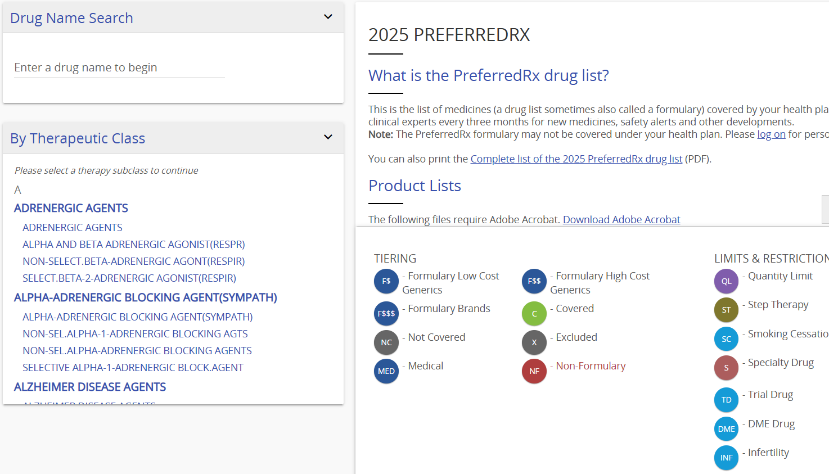
Prescription Drugs
Check your formulary to understand your costs and get support if your medicine isn’t
working for you.
Covered
Formulary
Might be covered but costs more
Not
covered
healthpartners.com/preferredrx
10
©2019 ARTHUR J. GALLAGHER & CO.
Notes:
The formulary for HealthPartners is the PreferredRx Formulary. Formulary is just a fancy word for a long list of approved medications. Go to healthpartners.com/preferredrx to look up the medications you're taking to see where they fall on the formulary, as well as if there are any coverage criteria such are prior authorizations or quantity limits, to better prepare you when you go to the pharmacy.

Slide 11
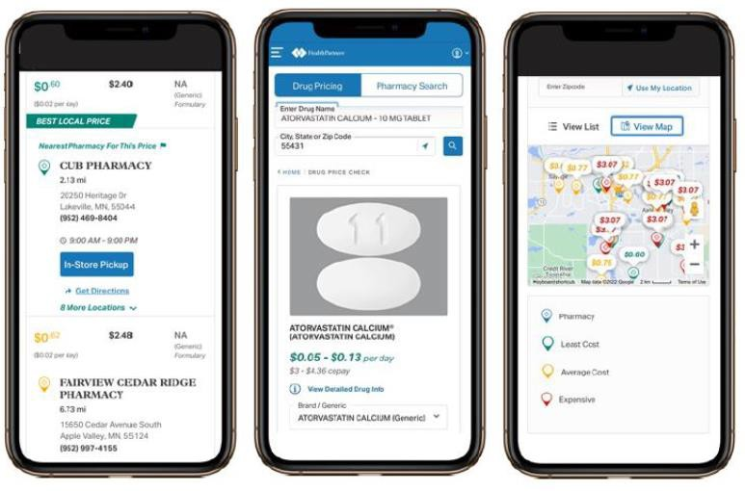
Prescription Drugs
Rx Shopping Tool
Search for the lowest cost
Find the lowest cost for your medicine
Compare prices at pharmacies near you
Transfer prescriptions to the lowest cost pharmacy
Know if you have available refills
See if you have a prior authorization and when it expires
healthpartners.com/pharmacy
11
©2019 ARTHUR J. GALLAGHER & CO.
Notes:
HealthPartners has a proprietary prescription shopping tool that you can use to save money on your prescriptions, and here at the District we have a great opportunity to utilize this tool to its fullest extent. Here’s how it works – This tool allows you to enter the prescription you're looking to fill, and the zip code in which you're looking to fill that prescription, and the tool will bring up the real cost of that medication at all the pharmacies in your area. Sometimes the difference is a dollar or two, sometimes the difference can be hundreds of dollars for the same exact medication simply by filling at one pharmacy instead of the other. Prices for medications can change periodically throughout the year based on the pharmacy, so it is good practice to check the cost of your medications throughout the year as well. If you find a pharmacy that is lower cost, you can transfer that prescription from the tool as well. This is especially important to help you save money out of your own pocket.

Slide 12
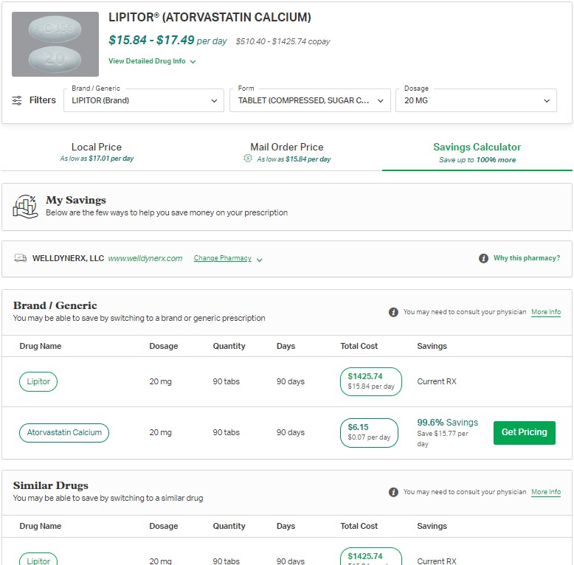
Prescription Drugs
Rx Shopping Tool
Suggested savings opportunities
Switching between brand and generic
Changing day supply or between retail/mail order
Review the drug list to see similar drugs that may help you
Alternative dosage
healthpartners.com/pharmacy
12
©2019 ARTHUR J. GALLAGHER & CO.
Notes:
In addition to shopping between pharmacies, the prescription shopping tool also provides different ways to take the medication you’re prescribed. The tool will list the cost of other alternatives in the same drug class. It will also list different dosing methods of taking your medication. Cost savings can sometimes be as simple as taking two pills of a lower dose compared to one pill at the higher dose. Once you’ve reviewed these alternatives, you now have the information to talk to your doctor about adjusting your prescription accordingly and begin saving money. An easy way to communicate with your doctor and potentially avoid an office visit charge is to communicate through your online clinic portal.
To being shopping your prescriptions and reviewing alternative ways to save on your medication costs, simply visit the website listed on the screen and navigate to the prescription shopping tool.

Slide 13
Prescription Drugs
Mail-Order Pharmacy – WellDyne Rx
Five great things about mail order:
1. You’ll never pay for standard shipping.
Getting your medicine through mail order often costs less than retail pharmacies.
Refilling your medicine online or with our mobile app is easy.
All orders are sent in a tamper resistant, plain package to make it more private.
Safety is important to us. You’ll get the best
quality medicine.
You'll get your medicine delivered within seven to ten days.
healthpartners.com/mailorder
13
©2019 ARTHUR J. GALLAGHER & CO.
Notes:
HealthPartners utilizes Well Dine Rx to process their mail-order prescriptions. If you routinely take a medication to manage some sort of condition, the mail-order pharmacy can be a great way for you to save time and add some convenience to your life by avoiding waiting in line at the pharmacy and having the medication sent right to your home. You also can save money on some prescriptions through the mail-order, compared to what they are priced at in the retail setting. Simply go online to healthpartners.com/mailorder to begin the process and register for mail-order delivery. Please note that it is best practice to process your prescription refill within 7 to 10 days prior to running out, as that will allow enough time for the medication to be sent and delivered to your home. If you currently take a medication routinely, we encourage you to review this option and strongly consider utilizing to the Mail-Order pharmacy.

Slide 14
Virtual Care – Cost Savings!
3 Options
Answer a few questions anytime, anywhere.
Treatment plan and prescription in about one hour.
More than 60 common conditions.
You’re only charged if Virtuwell® can treat you, plus unlimited follow-up calls are free.
Available during regular clinic hours
Video chat with MD
Convenient, quick and affordable.
Assessment, diagnosis and prescriptions when necessary.
10 to 15-minute visit to treat conditions like colds, the flu and allergies
Mental health visits available!
Available 24/7/365
Fill out a brief medical history
Connect with medical experts by phone, video or mobile app
Can treatment many common medical conditions
Available 24/7/365
14
©2019 ARTHUR J. GALLAGHER & CO.
Notes:
HealthPartners has three vendors they partner with for online virtual care. For all three of these options, they can treat more than 60 common medical conditions such as the common cold or flu, sinus infections, pink eye, bladder infections, certain types of rashes, and much more. With Virtuwell, you simply go online to virtuwell dot com and complete a questionnaire that is sent off to a nurse practitioner, who reviews your symptoms. If they can treat you, they will provide a treatment plan, as well as a prescription to the pharmacy of your choice if it needs it. The nice thing about Virtuwell is that if they can’t treat you, they don’t charge you, so this is really a no-risk option for the non-emergency care need. Virtuwell is available to treat during regular clinic hours, however you can submit a questionnaire at any time.
With Doctor on Demand and Teladoc, these services can treat the same common medical conditions as Virtuwell, however with these service you are able to have a face-to-face, live video chat with a doctor. You can discuss with them your symptoms over a live conversation, and if they can treat you, they’ll similarly provide a treatment plan and prescription, if needed. Both of these services are available 24/7, 365 days a year, so you can access care anywhere, anytime. Visits are traditionally no more than 10 to 15 minutes in length, so you can receive care for these common conditions much sooner than going into the doctors office or urgent care center.
Doctor on Demand also provides on demand mental health services, in addition to treating medical conditions. They have licensed psychologists and psychiatrist on staff so that you can access mental health care much sooner than scheduling an in person visit. The visits with these providers are generally 30 to 45 minutes in length, so the cost with vary compared to the medical visit that is shorter in length. Finally, with Doctor on Demand, you don’t have to only wait for the next available doctor. Through their online portal and mobile app, you have the ability to research providers and find one that best aligns with what you need. You can then schedule future visits with that doctor and receive cost effective, regular care with a provider you trust, all through the Doctor on Demand portal and from the comfort of your own home.

Slide 15
Access of Care
Average Cost
Average Cost of Care*
Diagnosis | Nurseline | Virtuwell / DoD / Teladoc | Office Visit | Urgent Care Visit | Emergency Room
Influenza | $0 | $65-$79 | $249 | $338 | $1,308
Acute Sinusitis | $0 | $65-$79 | $225 | $294 | $1,294
*HealthPartners; Sept 2024
18
©2019 ARTHUR J. GALLAGHER & CO.
Notes:
This slide illustrates that where you go for care matters and can impact what you pay out of pocket. Here we have the real average cost to treat the common flu and a common sinus infection at the various sites of care. The Nurse line, as a reminder, is a no cost option to help you determine if you should go in for care, and if so, where is the best place to direct your care. Starting with this team of licensed nurse practitioners is the best way to ensure you receive the most efficient and cost effective means of care.
For these common conditions, the virtual care providers are going to be the lowest cost options, ranging from 65 to 79 dollars per visit, or less depending on your plan design. From there, you can see that the average cost of service drastically rises as you go from the office visit, to the urgent care, all the way up to the emergency room. Utilizing these virtual care options is a fantastic way to save on out-of-pocket costs for yourself, as well as the plan as a whole.

Slide 16
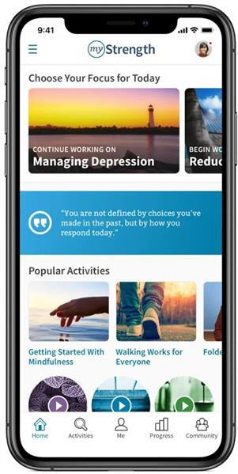
Mental Health Support
myStrength
What is myStrength?
Digital program for emotional health support
Learn from hundreds of activities, articles, guided meditations, and skill-building courses
Practice techniques to shift your thinking and feel more hopeful
How to access
Log onto your HealthPartners account
Select “My Plan” at the top
Then “Living Well” on the right-hand side of the top bar
Go to “myStrength” and click Get Started
16
©2019 ARTHUR J. GALLAGHER & CO.
Notes:
myStrength is a free resource available to all members on the medical plan to support your mental health needs. To access, simply log on the your HealthPartners account, and follow the instructions listed on the screen. Through this tool you have access to many different articles and resources, such as guided meditations and activities, that can help you manage stress, anxiety and depression. Our mental health is just as important as our physical health, so having access to these important resources can be useful when you are in a time of need.

Slide 17
2025-2026 Medical Plan Contributions
$1,500 VEBA | Employee Contribution (75% to 100% FTE) |  | District Contribution
Open Access Network | Per Pay Period | Difference from 2024-25 | Per Pay Period | Difference from 2024-25
Single | $90.65 | +$18.60 | $318.47 | +$18.60
Family | $268.53 | +$54.94 | $940.17 | +$54.94
$1,500 VEBA | Employee Contribution (75% to 100% FTE) |  | District Contribution
Achieve Network | Per Pay Period | Difference from 2024-25 | Per Pay Period | Difference from 2024-25
Single | $78.38 | +$17.48 | $306.19 | +$17.48
Family | $232.28 | +$51.65 | $903.91 | +$51.65
*If you are in a different FTE status, please see your cost sheet for the cost of your coverage.
©2019 ARTHUR J. GALLAGHER & CO.
Notes:
This year there will be a 10% increase to medical premiums. This is part of our two year agreement with HealthPartners. The District is sharing in this increase and will continue to cover a large portion of the total cost. The rates shown are for employees with FTE status of 75% or higher. If you have a different FTE status, please see your cost sheet for the actual cost of your coverage.

Slide 18
Flexible Spending Accounts Summary
Administrator: MidAmerica
Healthcare FSA Maximum Election: $3,300
Expenses for yourself, your legal spouse, and tax dependent children
Supporting documentation
Carryover provision: up to $640 will carryover into 2025-26 plan year
Dependent Care FSA Maximum Election: $5,000 ($2,500 if filing separately)
Healthcare and Dependent Care FSAs are separate accounts.
Use-it-or-lose-it!
Your plan year runs from July 1 through June 30
90-day runout period
All claims from the 2024-25 plan year must be submitted to
MidAmerica for reimbursement no later than September 28, 2025
Must enroll EACH YEAR if you want the FSA!
21
©2019 ARTHUR J. GALLAGHER & CO.
Notes:
The F.S.A., or Flexible Spending Account, is available for you to set aside money on a pre-tax basis for eligible expenses. Thera re two types of Flexible spending accounts – The Healthcare F.S.A. and the Dependent Care F.S.A. Each of these are separate elections based on your needs. The Healthcare F.S.A can be used for eligible medical, dental and vision expenses for yourself and your eligible tax dependents, such as your legal spouse and tax dependent children. The I.R.S. allows a maximum election of $3,300 for the twenty twenty-five, twenty-six plan year. Any amount you elect in this account is available in full for reimbursement of expenses incurred on or after July first. The Dependent Care F.S.A. is available for eligible child and elder care expenses, such as daycare. The I.R.S. maximum election remains at $5,000 for the upcoming plan year. Any amount you elect into this account is available for reimbursement of expenses as you fund it throughout the year.
Mid America is the administrator of our Flexible Spending Accounts. For both accounts, MidAmerica will require supporting documentation to substantiate that your reimbursement or payment was for an eligible expense. Please be sure to provide your receipt, invoice and/or explanation of benefits to substantiate your reimbursement. This is an I.R.S. requirement, so be sure to provide the documentation as soon as you are able.
Both accounts also have a use it or lose it provision, which the I.R.S. places on flexible spending accounts. This means that you must only elect what you expect to spend in any given plan year. Should you have funds leftover at the end of the plan year, those would be forfeited back to the plan. After the end of each plan year, you have 90 days to submit for expenses incurred during the plan year, which runs from July first to June 30th each year. If you currently have an F.S.A. please be sure to submit for your reimbursement as soon as you are able so that you don’t lose out on the funds you have elected.
Finally, as a reminder, you must make your F.S.A. elections each year during open enrollment. The I.R.S. does not allow your election to roll forward from one year to the next. You must actively elect the F.S.A. each and every year.

Slide 19
Dental Coverage
Service Category | HealthPartners Level 1 | HealthPartners Level 2 | Out-of-Network
Deductible (per person/per family) No deducible for Diagnostic & Preventive or Orthodontics | None | $25/$75 | $50/$150
Annual Maximum (per person) | $1,250 | $1,250 | $1,250
Diagnostic & Preventive (exams/cleanings – 2x per year) | 100% | 100% | 100%
Basic Services (fillings) | 100% | 80% | 80%
Endodontics (root canals) | 80% | 80% | 80%
Periodontics (treatment relating to gum disease) | 80% | 80% | 80%
Oral Surgery (simple or complex oral surgery) | 50% | 50% | 50%
Major Restorative Services (crowns) | 50% | 50% | 50%
Prosthetic Repairs & Adjustments | 100% | 50% | 50%
Prosthetics (bridges, dentures) | 50% | 50% | 50%
Orthodontics | 50% | 50% | 50%
Orthodontic Lifetime Maximum per dependent child ages 8-18 | $1,000 | $1,000 | $1,000
©2019 ARTHUR J. GALLAGHER & CO.
Notes:
Our dental plan remains with HealthPartners and maintains the same benefits as we have today. We will continue to have an annual maximum of $1,250, and that is per person on the plan. Anything the plan pays towards the cost of your dental services comes out of the annual maximum. The annual maximum benefit resets each year on July first. This means that if you’ve already used all or a portion of that annual maximum during the current plan year, the full annual maximum benefit will be available again for your dental services starting on July first. Again, anything the plan pays toward the cost of your dental services comes out of the annual maximum benefit.
You will notice that you have two network options for dental coverage, Level 1 and Level 2. This is determined by which dental provider you see, and your benefits will process accordingly at the time of service. You do not need to choose the network level during benefit enrollment. Again, the benefit level is determined at the time of service, and based on which provider you see, that will determine the benefit level for that particular service.
In all levels, your annual maximum benefit is the same, and preventive exams and cleanings are covered 100 percent by the plan. We want to encourage all members to receive their regular cleanings to maintain good oral and overall health. Seeing a provider within the Level 1 network will provide you with some benefit enhancements, such as no deductible, and 100 percent coverage for certain Basic services, such as fillings, and certain prosthetic repairs. Other than that, all other benefits remain the same between provider levels.
There is an orthodontia maximum for eligible children ages 8 to 18. This ortho maximum is $1,000 per eligible child, and that is a lifetime maximum, meaning that amount does not reset each year.
Out of network benefits are available should your provider choose to not participate in the HealthPartners network. If you see an out of network dentist, you will still receive coverage as noted in the table, however you will be subject to the usual and customary fees that HealthPartners has contracted with their in network providers. This means that you could be balanced billed for the difference charged by your out of network dentist. So in short, there are still benefits to seeing an out of network dentist, they just may not be as great as if you direct your care in network.

Slide 20
Dental Network
HealthPartners Dental Distinctions Network
In-Network coverage can be access through
providers within HealthPartners’ Dental Distinctions
network
You will receive the best benefits by directing care in- network
Benefits still available out-of-network, however you are
subject to usual & customary rates
Local Level 1 Providers
Park Dental
The Dental Specialists
St. Anthony Endodontics
HealthPartners Dental Clinic
St. Paul Oral Surgery
Local Level 2 Providers
Saint Anthony Village Dentistry
Almond Dental
Midwest Dental
Armstrong Dental
Forbes Dental Care
Search the Network
Simply go to healthpartners.com/dentaldistinctions
and search for a dentist or clinic near you!
23
©2019 ARTHUR J. GALLAGHER & CO.
Notes:
HealthPartners network is called the Dental Distinctions network. You can search the network for dentists near you by going to the website noted on the screen. We have listed some of the local providers in and the around the District, and have noted with network Level they fall into. This is not a comprehensive list, and a providers status can change throughout the year based on how they decide to contract with HealthPartners, so we encourage you to check the website to confirm your dentist is in network, as well as which benefit level they fall into.
Again, your benefit level is determined at the time of service, so you do not select the level during enrollment. When you receive a service at any point through the year, your benefits will process under the applicable level at that time. Directing care to a Level 1 provider will provide you the best benefits, as well as the lowest average cost for services, helping your annual maximum stretch a little bit further in the year.

Slide 21
2025-2026 Dental Plan Contributions
Dental Plan | Employee Contribution (73% to 100% FTE) |  | District Contribution
Teachers | Per Pay Period | Difference from 2024-25 | Per Pay Period | Difference from 2024-25
Single | $2.48 | $0 | $18.23 | $0
Family | $8.33 | $0 | $46.08 | $0
Dental Plan | Employee Contribution (75% to 100% FTE) |  | District Contribution
Non-Teachers | Per Pay Period | Difference from 2024-25 | Per Pay Period | Difference from 2024-25
Single | $2.13 | $0 | $18.58 | $0
Family | $9.93 | $0 | $44.48 | $0
*If you are in a different FTE status, please see your cost sheet for the cost of your coverage.
©2019 ARTHUR J. GALLAGHER & CO.
Notes:
There will be no changes to the dental premiums this year, and the District is continuing to cover a large portion of the total cost. The rates shown are for employees with FTE status of 75% or higher. If you have a different FTE status, please see your cost sheet for the actual cost of your coverage.

Slide 22
Employer Paid Benefits
Basic Life and AD&D Insurance
Benefit Amount varies by class
Paid for 100% by the District
Make sure to choose a beneficiary!
Long-Term Disability Insurance
66.67% of monthly earnings
Max monthly benefit determined by class
90-day waiting period
Continue to SSNRA
Paid for 100% by the District
22
©2019 ARTHUR J. GALLAGHER & CO.
Notes:
As a reminder, the District provides Life and Accidental Death and Dismemberment, or A.D. and D, coverage, as well as long term disability coverage, at no cost to you. There are no changes to the benefits for the upcoming plan year, and The Hartford remains the claims processor for these benefits. We hop that none of our employees need to utilize these benefits, as that means something unfortunate has occurred, however it is good to know that you have these benefits available to you should you need them. Benefits vary by employee class, so if you are interested in learning more about these benefits, we encourage you to review the Hartford documents pertaining to your employee class.

Slide 23
Voluntary Benefits
Additional Life and AD&D Insurance
Employee: $10k increments to max $500k
$100,000 Guaranteed Issue
Spouse: $5k increments to max $250k
Cannot exceed 50% of Employee amount
$20,000 Guaranteed Issue
Child(ren): $1k increments to max $10,000
AD&D coverage will match Life benefit
Employee and Spouse rates are in 5-year age-bands
Your age on July 1 each year determines your age-band
Note: If you enroll during your initial eligibility period upon hire, you may elect coverage up to the guaranteed issue amounts noted above. If you previously waived coverage, or would like to increase existing coverage, you may do so during open enrollment. Any amount you add or increase would require evidence of insurability.
23
©2019 ARTHUR J. GALLAGHER & CO.
Notes:
You have the opportunity to purchase additional term life and A.D. and D coverage through The Hartford. You can purchase coverage for yourself in the increments noted on the screen up to the applicable maximum. If you purchase coverage for yourself, you have the opportunity to purchase coverage for your eligible spouse and dependent children, in the increments noted on the screen up to the applicable maximums for each. If you elect A.D. and D coverage, that amount will match your Life insurance amount. You must purchase coverage for yourself if you want coverage for your dependents.
If you are in your new hire period, you may elect coverage up to the guaranteed issue limits noted on the screen for yourself and your spouse, if you choose. If you previously waived coverage, or if you have coverage today that you want to increase, you may do so during open enrollment. However, any amount that you elect will require evidence of insurability to be submitted to The Hartford. These are medical questions that The Hartford asks to determine your eligibility for the coverage. Should you want to elect this coverage, please complete the enrollment form and submit the evidence of insurability information to The Hartford for their review. You may access this information on our online benefits portal or by contacting the District H.R. team.

Slide 24
Election Changes
After a new plan year begins, you generally cannot change your benefit election(s).
However, if there is a Family Status Change, you may be able to change your election(s).
Family Status Changes include:
Marriage
Divorce
Birth or adoption of a child
Death of spouse or a child
Unpaid leave of absence
Change from full-time to part-time or vice versa by you or your spouse
Commencement or termination of your spouse’s employment
If you experience on of these events and need to make a change to your benefits,
contact Destiny Sparks within 30 days to make a change.
24
©2019 ARTHUR J. GALLAGHER & CO.
Notes:
Open enrollment is your time of year to make all the changes to your benefits that you desire. When enrolling in your benefits, you are assuming that you will be enrolled for the full plan year. Outside of open enrollment, you may only make a change to your benefits if you experience a qualified family status change. These are events as noted on the screen. Should you experience one of these events and need to make a change to your benefits, please reach out to the District H.R. team within 30 days from the date of the event. If you are outside of that 30 day window, in most cases, you would need to wait until the following open enrollment to make a change to your benefits.

Slide 25
Check Your Beneficiaries!
Open Enrollment is a good time to annually check and ensure you have the correct individual(s) listed as your beneficiary
If you need to update your beneficiary, please complete the appropriate form(s) and return to HR.
Please see Destiny Sparks with any questions regarding beneficiary elections.
25
©2019 ARTHUR J. GALLAGHER & CO.
Notes:
Life changes can happen throughout the year, and in many circumstances your beneficiary designation is the last thing you are thinking about. Open enrollment is a good opportunity to confirm that who you have as a beneficiary is who it should be. Should something happen to you, the last beneficiary noted on file is who will received the applicable benefits, such as the District paid life insurance. If you experienced a life event in the past year and need to make a change to your beneficiary designation, please reach out to the District H.R. team and notify them of the beneficiary change you would like to make.

Slide 26
What’s Next???
All enrollment/change forms
MUST be completed and sent to Destiny Sparks by end of day
Thursday, May 29th, 2025
26
©2019 ARTHUR J. GALLAGHER & CO.
Notes:
Finally, if you are making changes to your benefits, you have until the end of the day on Thursday, May 29th to make your elections and changes, and have them submitted to the District H.R. Team. As soon as you know what your benefit elections will be, please complete enrollment and change forms and send those over. After the deadline, you will be locked into the benefit elections you currently have for the next plan year, and will not be able to make a change until the following open enrollment, unless you experience a family status change as previously noted. As another reminder, if you want to contribute to the Flexible Spending Account, that election must be made during open enrollment, your current election will not roll forward into the next plan year.

Slide 27
THANK YOU!
27
©2019 ARTHUR J. GALLAGHER & CO.
Notes:
We thank you for your time in reviewing this presentation. We hope your found it helpful! Should you have any questions, please reach out to the District H.R. Team. Have a wonderful rest of your day!

