Slide 1
Retirement & Financial Planning 101
Aegis Living
Securities and Investment Advisory Services Offered Through M Holdings Securities, Inc., A Registered Broker/Dealer and Investment Adviser, Member FINRA/SIPC.
Assured Partners of Washington LLC is independently owned an operated.

Slide 2

Why Invest in a Retirement Plan?
Do you plan to retire someday?
    Retirement Income
    Healthcare Expenses
    Travel
Despite market volatility, retirement plan advantages can remain
    Tax-deferred compounding interest
    Dollar cost averaging, and more.
Portable
Notes:
Medical needs during retirement

Slide 3
Americans Are Not Saving Enough
of workers are not confident they will have enough money to retire comfortably¹
36%
of workers have completed a retirement needs calculation¹
48%
of people expect to keep working during retirement¹
71%

Slide 4

Will Social Security Take Care of You in Retirement?
$1,544/month for retired workers and their dependents*
That’s $18,528 per year.
Could you live on that?
*www.SSA.gov. December 31, 2020. Social Security, Fact Sheet. ACR# 4021661 12/21

Slide 5
Life Expectancy

Slide 6


Good Health is the Best Wealth
Believe it or not, staying healthy just might make you wealthy. With small lifestyle changes and healthy choices, you may reduce your annual healthcare costs and increase your income. By adopting healthy habits, you can mitigate future healthcare costs. Data from HealthyCapital reveals that by simply making a few minor changes to daily routines, and reducing the risk factors leading to chronic disease, individuals could potentially add years to their lives and save thousands of dollars in lifetime medical expenses.
For Example:
Alisha
The average managed patient
Blood pressure of 150/95
Sometimes forgets medications
Sometimes doesn’t follow her suggested diet
Occasional smoker and drinker
Jasmine
The well managed patient
Takes prescribed medication
Exercises 30 minutes/day, 5 days/week
Moderate alcohol intake
Chooses healthy fats
Limits dietary salt
Quit smoking
For purpose of the case study, Alisha and Jasmine are compared in two levels of care: average managed (loosely follows physician recommendations) and well managed (fully complies with physician recommendations).
Alisha and Jasmine are both 45 years old and both sought medical treatment for high blood pressure. Alisha doesn’t follow the lifestyle changes her doctor suggested, whereas Jasmine diligently follows her doctor’s recommendations. With Jasmine’s small changes she saves more than $1,000 in out-of-pocket healthcare costs. Additionally, Jasmine’s combined pre-retirement and in-retirement savings will be $89,456 more than Alisha, as shown in the table below.
Annual Out-of-Pocket Healthcare Costs:
 | Alisha | Jasmine | Jasmine’s Savings in Health Expenditures
Age 45 | $2,477 | $1,286 | $1,192
Age 64 | $13,936 | $7,343 | $6,592
Total Pre-Retirement | $138,288 | $72,591 | $65,697
Total In Retirement | $51,790 | $28,031 | $23,759
Grand Total | $190,078 | $100,622 | $89,456
The hypothetical case study results are for illustrative purposes only and should not be deemed a representation of past or future results. This example does not represent any specific product, nor does it reflect sales charges or other expenses that may be required for some investments. No representation is made as to the accurateness of the analysis.

Slide 7
Investing Sooner May Help You Reach Your Goals
Total contributions value
(assuming a 7% annual rate of return)
Participant A
$40,000 total invested
$343,414
Participant B
$104,000 total invested
$293,935
31
33
36
38
40
43
45
47
49
51
53
55
58
61
63
65
68
Age
Participant A
Participant B
Hypothetical pretax contribution of $4,000 per year from ages 30 to 39 Total amount contributed = $40,000 Total contributions value = $343,414 (pretax) after 36 years
Hypothetical pretax contribution of $4,000 per year from ages 40 to 65 Total amount contributed = $104,000 Total contributions value = $293,935 (pretax) after 26 years
This hypothetical is not intended to predict or project investment performance. Your own results will vary. It assumes systematic $4,000 pretax contributions to a tax-deferred retirement plan account made annually on 1/1 for the years indicated above and an 7% annual rate of return. No distributions are taken from the plan account during the entire period. Taxes on distribution, and fees and expenses are not taken into account. If account fees and expenses were deducted, performance would be lower. Pretax contributions and any earnings will be taxed at the time of distribution and may also be subject to an early withdrawal penalty if distributed before age 59½. Systematic investing does not ensure a profit and does not protect against loss in a declining market.

Slide 8
Monthly Income Replacement
How much will your savings provide over a 30-year time span?
Retirement Savings | Monthly Income
$100,000 | $391
$250,000 | $977
$500,000 | $1,955
$1,000,000 | $3,910
Monthly income can be greatly influenced by the number of distribution years. A shorter payout over 10 years will result in the highest monthly distribution amount, but the risk is if you live longer than 10 years in retirement, you may run out of money. Perhaps the most important decision is to decide when you want the distributions to begin. Deferring the beginning date of distributions from your account a few years can not only reduce the payout timeframe but could allow an opportunity for additional asset growth depending on investment performance.

Slide 9
Retirement Savings: How Much?
Investors who are:
Should typically have:
30 half of your salary saved today
15%
35 1x your salary saved today
40 2x your salary saved today
45 4x your salary saved today
50 6x your salary saved today
55 8x your salary saved today
If possible, investors should strive to
6%
60 10x your salary saved today
SAVE
65 12x your salary saved today
Consider increasing contributions gradually to build toward 15% target.

Slide 10

The 15% Savings Goal
Most people need to save more to build a nest egg that can meet their needs. We recommend putting away 10 to 15 percent of your pay for retirement. There’s a relatively painless way to reach that goal.
Take small steps
Begin by contributing enough to receive your employer’s matching contribution
Consider gradually raising your contribution amount to 10 percent or higher
Raise your plan contributions once a year by an amount that’s easy to handle, on a date that’s easy to remember—say, 2 percent on your birthday. Thanks to the power of compounding (the earnings on your earnings), even small, regular increases in your plan contributions can make a big difference over time.

Slide 11

Rebalancing your Portfolio
As a participant in the company’s retirement plan, you are already serious about saving for your future. Whether you are retiring in a few weeks or a few decades, you may need to protect your investment. A healthy way to do this is to rebalance your portfolio.
Example:
Suppose you enrolled in the plan at the beginning of last year and allocated 40 percent of your portfolio to bond funds and 60 percent to equity funds. Further suppose that when you got your year-end statement, it shows that 70 percent of your assets are in equity funds and 30 percent are in bond funds.
To stay within your acceptable risk level (which is what you determined before entering into the plan), you should sell enough equity funds to bring that back to 60 percent of your assets and buy enough bond funds to bring them up to 40 percent of your assets.
What is rebalancing?
Rebalancing is simply readjusting your portfolio back to the original asset allocation that considered your risk tolerance and time horizon. Put another way, rebalancing forces you to adhere to your investment strategy. You rebalance by selling assets that make up too much of your portfolio and use the proceeds to buy back those that now make up too little of your portfolio. The net effect is to “sell high and buy low.” Ultimately, regular rebalancing can increase the overall return of your portfolio over time.
Keeping in check
It is recommended that you rebalance at least once a year and no more than four times a year. Consider this a good opportunity to evaluate if your investment strategy is still in line with your original goals.

Slide 12
Eligibility & Employee Contributions
Eligibility and Entry Date: Age 18, First of the month
Employee Contributions
  Pre-tax Contributions
    Traditional 401(k) contributions to a retirement plan are contributed on a pre-tax basis and help lower your current taxable income now.
    You not only defer taxes on the amount you save, but earnings on your savings are also tax deferred until distribution.
  ROTH Contributions
    Roth 401(k) contributions are made on an after-tax basis.
    Money in the Roth account and any earnings will be distributed tax-free if withdrawn after age 59½, death, disability and at the end of the five-year taxable period during which the participant’s deferral is first deposited into the Roth 401(k) account.
  You may increase, decrease or stop contributions to the plan during every pay period.
Contribution limits
  100% of compensation up to the IRS maximum, $22,500 for 2023 plus $7,500 for catch up contributions if over the age of 50.
Rollovers
  401(k), IRA rollovers
    Note: You must have an account set up with The Standard before rolling over any accounts into the plan.

Slide 13
Employer Contribution & Vesting
Employer Discretionary Contribution
  Aegis Living provides a discretionary match of 50% of the first 4% of an employee’s contribution to the 401(k) Plan. (If you contribute 4%, you will receive a max match of 2%).
  Eligibility: Age 18, employed last day of the plan year.
  Don’t say no to free money and save at least 4% of pay to get the full company match.
Vesting (ownership)
  You are 100% vested in your own contributions and rollover.
  Employer Discretionary contributions are subject to a 5-year vesting schedule commencing on participant’s date of hire: 0, 20, 40, 60, 80, 100.
  1,000 Hours of service per plan year = One (1) year of vesting
  Plan Year: January 1 through December 31
Under 1 = 0%
Year 1 = 20%
Year 2 = 40% Year 3 = 60% Year 4 = 80% Year 5 = 100%

Slide 14
Contributing: Tax Advantages
Tax advantages of contributing to your employer’s retirement plan:
$30,000 | Salary
-4% | Contribution ($1,200)
= $28,800 | Taxable Income
$7,200 | Taxes Owed*
$30,000 | Salary
-0% | Contribution
= $30,000 | Taxable Income
$7,500 | Taxes Owed*
*This chart is based on 25% tax bracket and for illustrative purposes only.
*This chart is based on 25% tax bracket and for illustrative purposes only.
$7,500 | (Taxes Owed 0% Contribution)
-$7,200 | (Taxes Owed 4% Contribution)
= $300 | (Current Tax Savings)

Slide 15
Loans
Participant Loans
  May borrow 50% of VESTED balance up to $50,000
  Permitted for any reasonable purpose including hardship
  Minimum loan amount - $1,000
  Loan limit (1)
  Five (5) year maximum repayment unless to purchase principal residence (up to 10 years)
  Repayments made through payroll deduction.
Remember that you are paying yourself back

Slide 16
Distributions
Qualified Distributions
  In-Service Distributions - Age 59½ and still working
  Death
  Disability
  Termination of Employment
    Option 1 - Rollover to IRA
    Option 2 - Rollover to a new 401(k) Plan
    Option 3 – Cash (beware of tax consequences)
Hardship Withdrawals
  Expenses
    Medical bills
    Post Secondary Education
    Burial or Funeral
  Principal Residence
    Purchase
    Prevent eviction or foreclosure
    Casualty losses
Note: Distribution amount can only be equal to required need and proceeds are subject to tax & penalty.

Slide 17

What Strategy is Right For You?
When choosing an investment strategy, consider these things:
Your current age
Your time to retirement
Your risk tolerance
Your financial situation and tax status
Investment objectives and experience
Liquidity Needs
Other investments
How much do you want to be involved in the research, fine tuning, rebalancing, etc., of the investments offered in your plan?

Slide 18
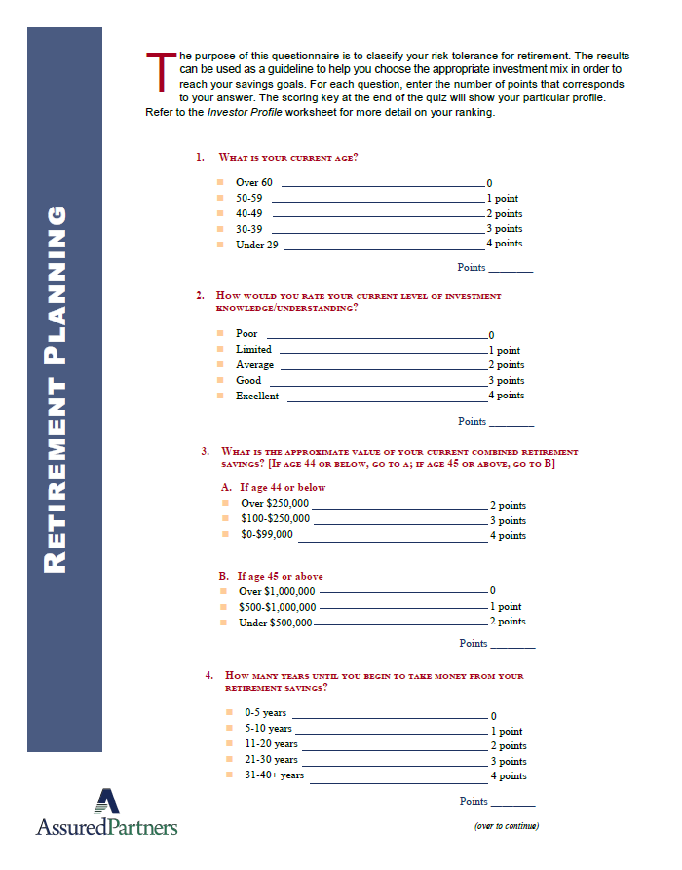
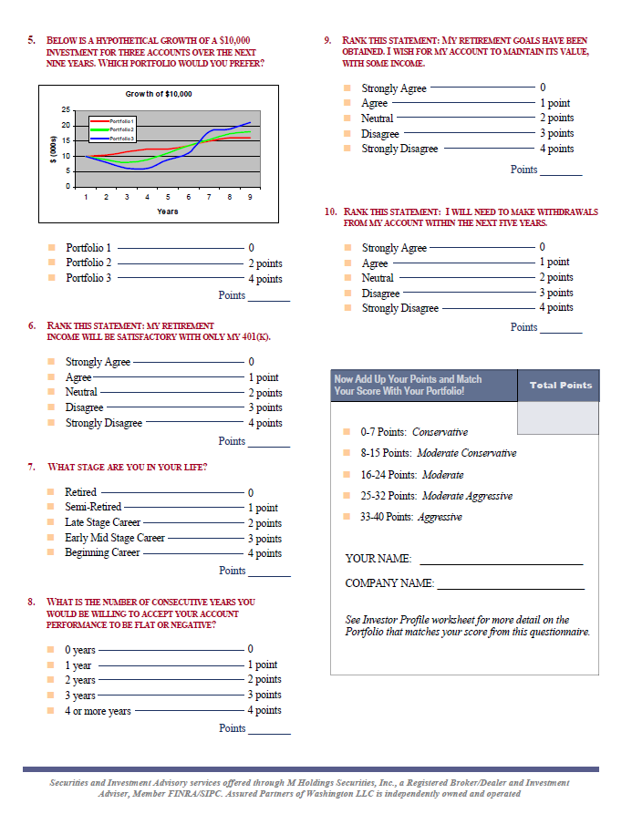
What Type of Investor Are You?

Slide 19

Investment Strategy
Two approaches to investing
Mix Your Own
  Your portfolio is composed of individual funds
  Build diversification through your own choice of funds. You must understand the different levels of risk and reward
  You should change the asset allocation and diversification of your portfolio as your needs and goals require (at least annually)
Ready-Mix
  Portfolio is composed of a fund of funds and managed to a target retirement date or risk profile
  Diversification is established for each fund
  Target date asset allocation and diversification happen according to a preset schedule whereby portfolio automatically shifts from aggressive to conservative as you get closer to your stated retirement date
Global/international
Large Cap Growth
Target Date 2070
(Target date: 2061 to 2070)
Small/Mid/Specialty
Target Date 2060
(Target date: 2051 to 2060)
Large Cap Value
Target Date 2050
(Target date: 2041 to 2050)
Potential Reward
Low Reward High
Balanced
Target Date 2040
(Target date: 2031 to 2040)
Income
Target Date 2030
(Target date: 2021 to 2030)
Stability of Principal
T. Rowe Price Target 2025
Risk
Low Risk High

Slide 20
Investment Options
Asset Allocation | Other Investment Options
Target Retirement Portfolio | Standard Stable Asset D
Target Date 2025 Portfolio | American Funds Bond Fund of America R6
Target Date 2030 Portfolio | Vanguard Total Bond Market Index Adm
Target Date 2035 Portfolio | American Funds American Balanced R6
Target Date 2040 Portfolio | American Funds Inv Co Am R6
Target Date 2045 Portfolio | JPMorgan Equity Income R6
Target Date 2050 Portfolio | Schwab Total Stock Mkt Index
Target Date 2055 Portfolio | Vanguard 500 Index Adm
Target Date 2060 Portfolio | American Funds Growth Fund of America R6
Target Date 2065 Portfolio | Nuveen Mid Cap Value I
Target Date 2070 Portfolio | Vanguard Mid Cap Index Adm
Other Investment Options | MFS Mid Cap Growth R6
Vanguard Emerging Market Stock Index Adm | MFS New Discovery Value R6
Vanguard Real Estate Index Adm | Vanguard Small Cap Index Adm
JPMorgan Small Cap Growth R6
American Funds New Perspective R6
American Funds SMALLCAP World R6
Fidelity International Index
American Funds EuroPacific Growth R6

Slide 21
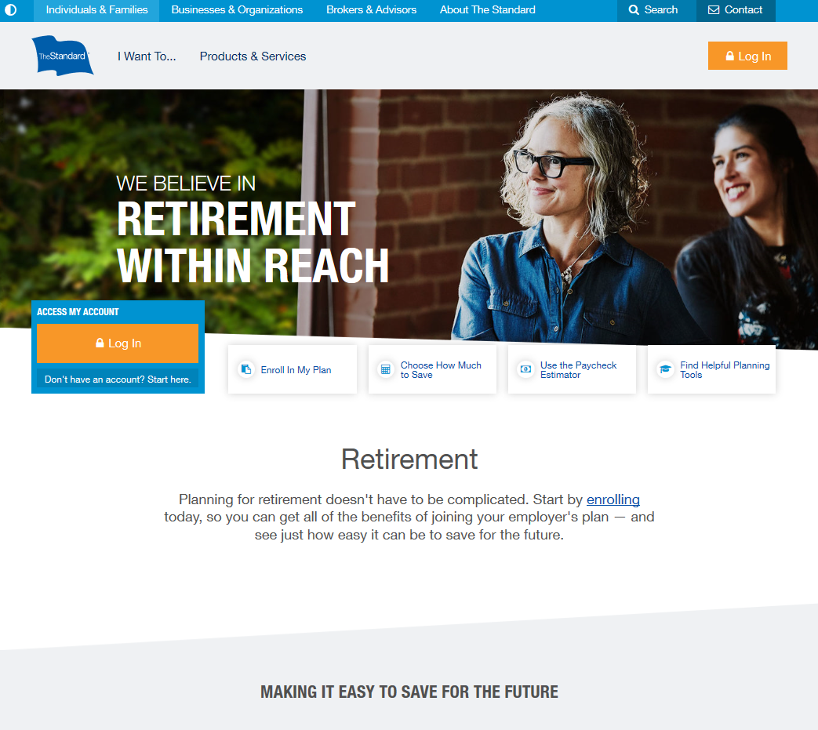
Enroll in the Plan
Create an Online Account
  Visit www.standard.com/retirement
  Click Enroll in My Plan and then Create an Account. Watch for a verification email that will request your response.
  Log in and click Go to my Account.
Enroll in the Plan
  On the website, you may choose a quick enroll option by using The Standard’s retirement readiness tool.
  Or, to choose investments and beneficiaries when you enroll, start by clicking My Plan, Enroll in My Plan. The website will walk you through a short step-by-step process.

Slide 22
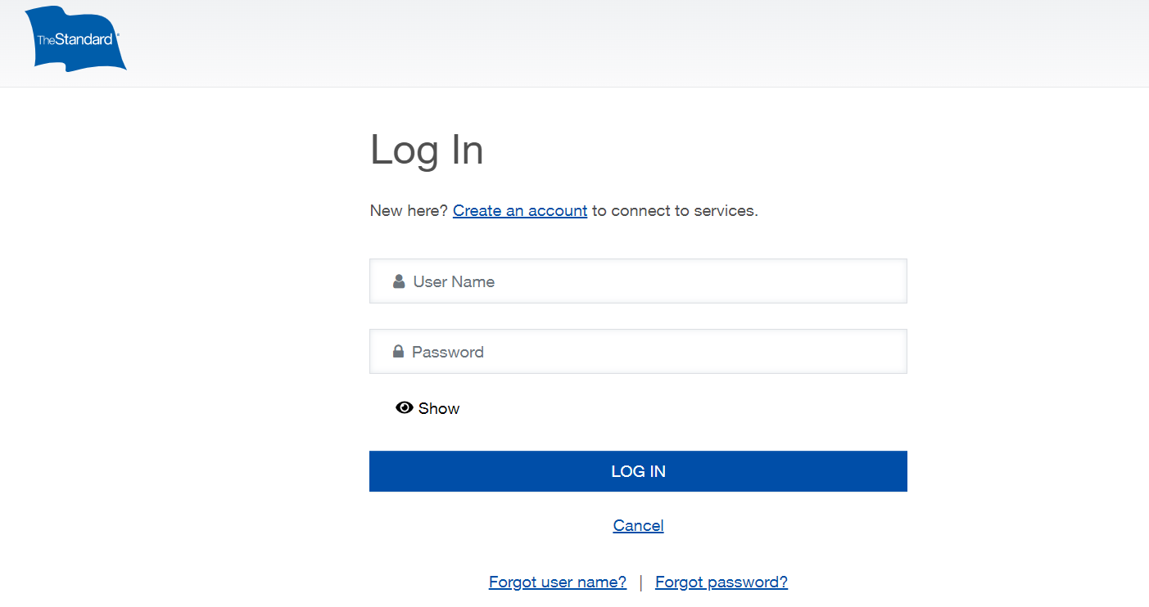
The Standard’s Website
Access the following information via your online account:
Account Balance
Quarterly statements
Change your future investment direction
Change your contribution amount
Update beneficiaries
Access to various retirement tools and calculators.

Slide 23
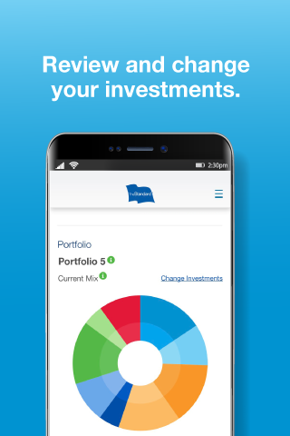
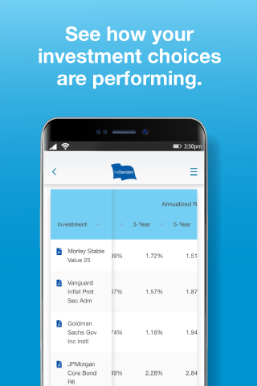
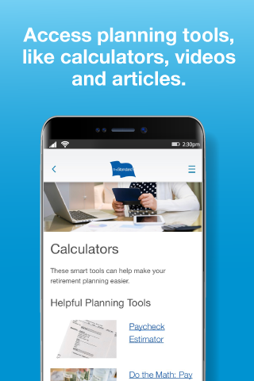
The Standard’s Mobile App
Access the following information:
View Account Balance
Request Transactions
Change your future investment direction
Change your contribution amount
View investments
Access planning tools and calculators

Slide 24
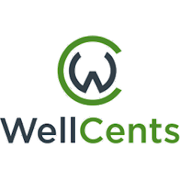
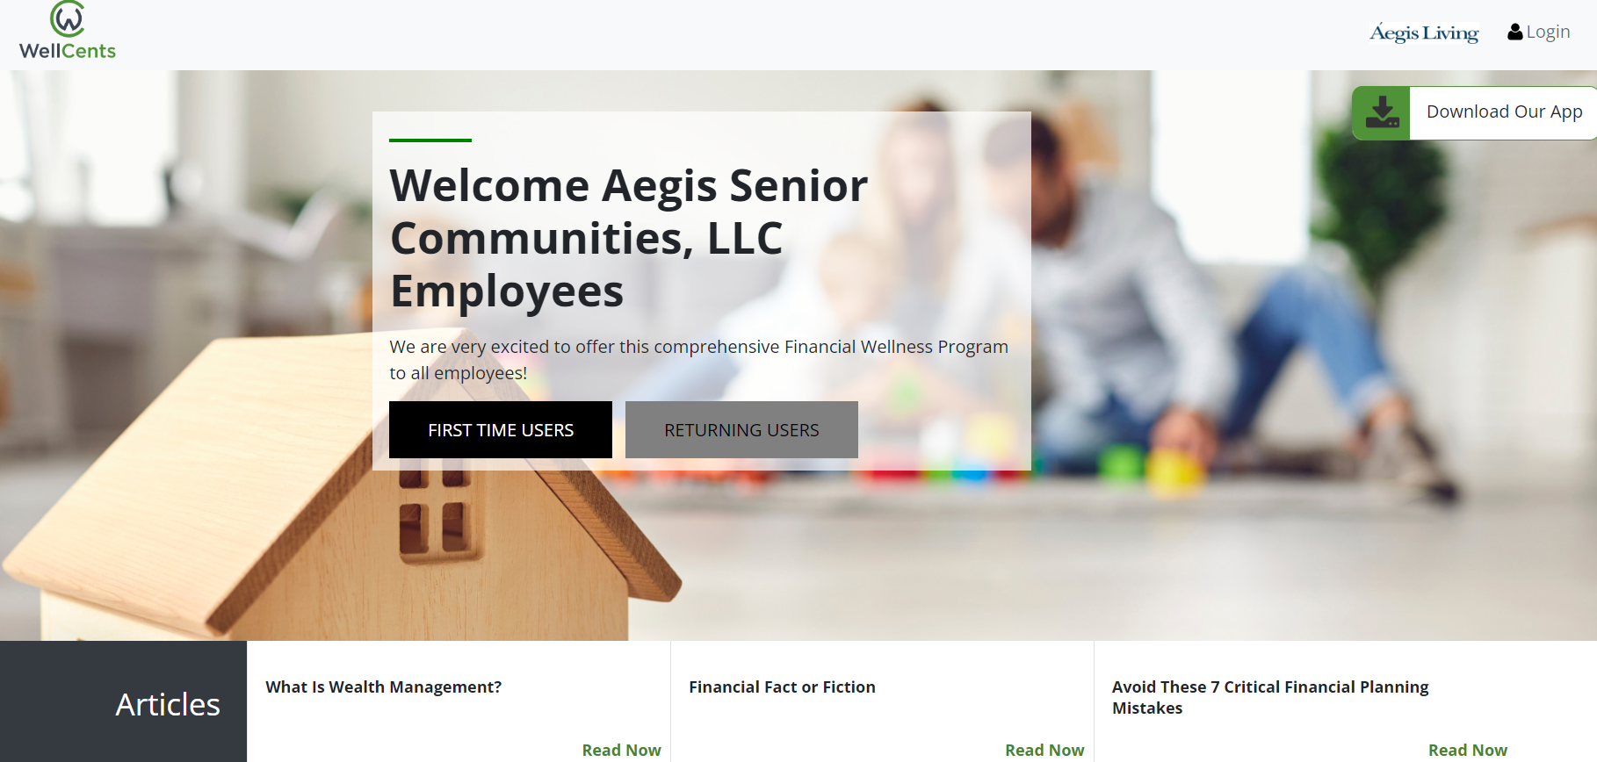
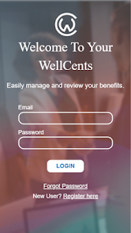
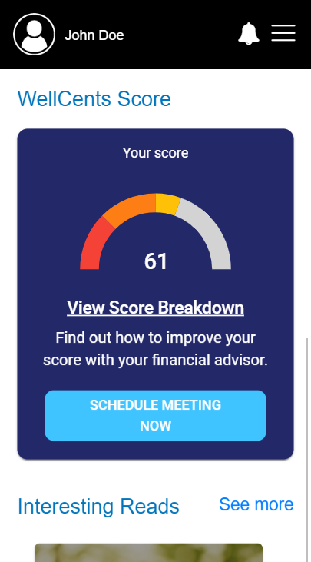
WellCents
How to access
  www.mywellcents.com/AegisFinancialWellness
  Click “First Time User” to create account
  Download App – Apple & Android
Access to:
  Calendar to schedule one-on-one meetings with AssuredPartners.
  Articles, calculators and more.

Slide 25
Personalized Paycheck Analysis
If you would like to have a personalized paycheck analysis done, please send the below information to mcm.401k@assuredpartners.com.
  Full Name
  Age
  Annual Income
  Location (state)
  Note that you are with Aegis Living
  Note: All information will remain confidential.

Slide 26
Questions?
We, at AssuredPartners, offer an individualized financial consulting resource to assist you in creating a healthy savings program through your 401(k) plan.
Our financial consulting includes:
Enrollment Questions
Financial Wellness
Investment Education
401(k) Plan Education
If you have questions about your investments, contributions, or anything in relation to the Aegis Senior Communities LLC 401(k) Plan, please contact us AssuredPartners and request to speak to:
  Rich Hultquist or Stephany Primitivo
    Phone: 206-343-2323
    Email: mcm.401k@assuredpartners.com

Slide 27
Asset Class Definitions
Conservative (CON): a diversified asset allocation strategy including equity with an emphasis on fixed income. Demonstrates a lower overall volatility (risk) level when compared to the other asset allocation categories.
Moderate Conservative (MC): a diversified asset allocation strategy including equity and fixed income. Demonstrates a higher overall volatility (risk) level when compared to CON, but lower volatility level when compared to MOD, MA and AGG.
Moderate (MOD): a diversified asset allocation strategy including equity and fixed income. Demonstrates a higher overall volatility (risk) level when compared to CON and MC, but lower volatility level when compared to MA and AGG.
Moderate Aggressive (MA): a diversified asset allocation strategy including equity and fixed income. Demonstrates a higher overall volatility (risk) level when compared to CON, MC, and MOD, but lower volatility level when compared to AGG.
Aggressive (AGG): a diversified asset allocation strategy including fixed income with an emphasis on equity. Demonstrates a higher overall volatility (risk) level when compared to the other asset allocation categories.
Large Cap Value (LCV): large capitalization companies who have lower prices in relation to their earnings or book value.
Large Cap Blend (LCB): large capitalization companies who display both value and growth like characteristics.
Large Cap Growth (LCG): large capitalization companies who have higher prices relative to their earnings or book value, generally due to a higher forecasted or expected growth rate.
Mid Cap Value (MCV): mid-capitalization companies who have lower prices in relation to their earnings or book value.
Mid Cap Blend (MCB): mid-capitalization companies who display both value and growth-like characteristics.
Mid Cap Growth (MCG): mid-capitalization companies who have higher prices relative to their earnings or book value, generally due to a higher expected growth rate.
SMID Cap Value (SMCV): small-mid capitalization companies who have lower prices in relation to their earnings or book value.
SMID Cap Blend (SCB): small-mid capitalization companies who display both value and growth like characteristics.
SMID Cap Growth (SCG): small-mid capitalization companies who have higher prices relative to their earnings or book value, generally due to a higher forecasted or expected growth rate.
Small Cap Value (SCV): small capitalization companies who have lower prices in relation to their earnings or book value.
Small Cap Blend (SCB): small capitalization companies who display both value and growth like characteristics.
Small Cap Growth (SCG): small capitalization companies who have higher prices relative to their earnings or book value, generally due to a higher forecasted or expected growth rate.
International Large Cap Value (ILCV): primarily large capitalization foreign companies displaying both value-like characteristics.
International Large Cap Blend (ILCB): primarily large capitalization foreign companies displaying both value and growth-like characteristics.
International Large Cap Growth (ILCG): primarily large capitalization foreign companies displaying both growth-like characteristics.
International Equity (IE): primarily large capitalization foreign companies displaying both value and growth-like characteristics domiciled in developed and emerging markets.
International Small-Mid Cap Value (ISMV): primarily small and mid capitalization foreign companies displaying both value-like characteristics.
International Small-Mid Cap Growth (ISMG): primarily small and mid capitalization foreign companies displaying both growth-like characteristics.
Emerging Market Equity (EME): foreign companies in countries that are not considered to have fully developed markets or economies.
Global Equity (GE): large capitalization domestic and foreign companies displaying both value and growth-like characteristics.
Core Fixed Income (CFI): domestic fixed income securities representing a broad array of fixed income securities including government, credit and mortgage-backed securities.
Intermediate Government (IG): domestic Government or Government-backed fixed income securities.
U.S. Government TIPS (UGT): treasury inflation protected securities which are Government securities designed to offer inflation protection by adjusting the principal based on changes in the Consumer Price Index.
Short-Term Bond (STB): a broad array of fixed income securities that have short durations and/or maturities (typically 1-3 years).
High Yield (HY): below investment grade domestic fixed income securities, which have a higher likelihood of default.
Global Fixed Income (GFI): a broad array of fixed income securities across many different countries.
Multisector Bond (MB): a broad array of fixed income securities across many different sectors including domestic government, corporate, sovereign and emerging markets debt. They generally have few limitations when it comes to domicile, sectors, maturities or credit ratings.
Specialty Fixed Income (SFI): a particular segment of the stock market focused on utility companies.
Stable Value (SV): a conservative fixed income strategy that is designed to preserve capital.
Money Market (MM): conservative, short-term oriented money market securities.
Guaranteed Investment Contract (GIC): products that have some type of guarantee from the issuer or provider.
REIT (RE): real estate securities traded on a stock exchange.
Technology (TEC): a particular segment of the stock market focused on technology related companies.
Natural Resources (NR): a particular segment of the stock market focused on natural resource related companies.
HealthCare (HC): a particular segment of the stock market focused on healthcare related companies.
Communication (COM): a particular segment of the stock market focused on communications related companies.
Financial Services (FS): a particular segment of the stock market focused on financial services companies.
Utilities (UTI): a particular segment of the stock market focused on utility companies.
Specialty (SPC): a unique area of the market.
-P: Asset Class abbreviations with a “-P” after the abbreviation indicate that the strategy was classified as passively managed. When not indicated, all other strategies are classified as actively managed and/or asset allocation.

Slide 28
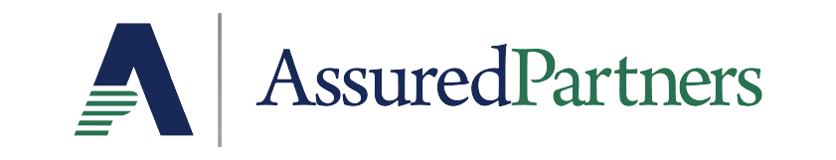
Important Notice
AssuredPartners cannot and does not engage in the practice of law or accounting. Consequently, the information provided in this presentation is not intended to present an opinion on legal, tax, accounting or investment matters. Please consult professional advisors for legal, tax, accounting or investment advice, as applicable, before taking any action based on this information.
1325 Fourth Avenue, Suite 2100, Seattle, WA 98101
800.347.2303
www.assuredpartners.com
Securities and Investment Advisory services offered through M Holdings Securities, Inc., a Registered Broker/Dealer and Investment Adviser, Member FINRA/SIPC. Assured Partners of Washington LL is independently owned and operated.

