Slide 1
Agenda
Medical Insurance
Dental Insurance
Value-Added Programs
Questions
Notes:
Who’s eligible?

Slide 2
Medical Plan Update for 2025
Remain with Medica for 2025
Medica Passport network
  Medica Choice Passport features access to more than 960,000 doctors, 5,900 hospitals, and 73,000 ancillary providers across the country and prominent care systems in Minnesota.
  Informational website: mhc2.welcometomedica.com/home
No plan changes? No new Medica ID card
$3,500 plan is now a hybrid plan

Slide 3
Medical – 3 plan options
$1,000 Deductible Plan
$1,850 VEBA Plan
$3,500 HSA or VEBA Plan

Slide 4
Medical - $1,000 Deductible Plan
Medica
$1,000 Deductible Plan – In Network Benefits
Preventive Care | 100%, not subject to deductible
Deductible | $1,000 / $2,000
Out-of-Pocket Max (Medical & Rx) | $2,000 / $4,000
Office Visits | 80% after deductible
Inpatient/Outpatient Coverage | 80% after deductible
Prescription Drugs | Preferred Generic - $8 copay Preferred Brand - $20 copay Non-Preferred Brand - $35 copay

Slide 5
Medical – $1,850 VEBA Plan
Medica
$1,850 VEBA Plan – In Network Benefits
Preventive Care | 100%, not subject to deductible
Deductible | $1,850 / $3,700
Out-of-Pocket Max | $1,850 / $3,700
Office Visits | 100% after deductible
Inpatient/Outpatient Coverage | 100% after deductible
Prescription Drugs | 100% after deductible
City will contribute $1,200 into VEBA for single coverage and $2,250 for employee + 1 & family coverage.

Slide 6
Medical – $3,500 HSA or VEBA
Medica
$3,500 HSA or VEBA – In Network Benefits
Preventive Care | 100%, not subject to deductible
Deductible | $3,500 / $7,000
Out-of-Pocket Max | $3,500 / $7,000
Office Visits | 100% after deductible
Inpatient/Outpatient Coverage | 100% after deductible
Prescription Drugs | 100% after deductible Preventive drugs – 100%
City will contribute $2,400 into HSA or VEBA for single coverage and $4,000 for employee + 1 & family coverage.

Slide 7
Medical – $3,500 HSA or VEBA
Hybrid feature
Today (2024)
100% of the City’s contribution goes into either the VEBA or the HSA – no other options
For 2025 – if someone chose's the VEBA for the City Contribution
100% of the City’s contribution goes into the VEBA, the Hybrid Option is available for employees to fund an HSA account
Employee makes pre-tax payroll deductions up to IRS maximum to HSA account.
Employee must choose one of these options for their VEBA while actively making or receiving contributions to an HSA:
Limited VEBA – Dental and Vision only
Frozen VEBA – Earn interest, invest dollars, remove access to funds for any claims

Slide 8


Health Savings Account - HSA
Road to Eligibility to Contribute to an HSA
Enrolled in Qualified High Deductible Health Plan
Cannot be covered by other non-HDHP
Cannot be enrolled in Medicare
Cannot be a tax dependent
“Traditional” Medical,
Full FSA,
HRA,
Tricare
IRS rules are at least $1,650 single and $3,300 family deductible
This material is meant to provide an overview of the most commonly asked questions on HSAs and FSAs. It does not represent all rules and regulations. For more information, please refer to IRS Publications #502, #503, #969 and the US Treasury Website. And always consult your tax advisor.
Notes:
Eligibility rules are defined on the road map here. First you must be enrolled in the Qualified High Deductible Health Plan. The IRS for 2024 has defined this as a plan that has a minimum of a $1,500 single deductible and $3,000 family deductible. If you are enrolled in the County’s $3,000/$6,000 High Deductible Health Plan you can move on to the second HSA eligibility qualifier. Are you covered by other non-High Deductible Health Plan Coverage This would be coverage that would pay before those minimum HSA deductibles are met. Are you covered by your spouse’s traditional health plan a full scope FSA or HRA or Tricare. If you are covered by any of those plans who would not be able to contribute to a Health Savings Plan. Additional plans or circumstance that that would make you ineligible to contribute to an HSA are enrollment in Medicare or if you are a covered dependent on someone else’s tax return

Slide 9
Health Savings Account - HSA
Contributions
2025 Annual limit is increasing
Change your contributions at anytime throughout the year
Unused balances rollover
Portable – you own the account
TIP! Consider investing funds to grow account
Enrolled Coverage | 2024 | 2025
Individual | $4,150 | $4,300
Family | $8,300 | $8,550
Age 55+ | Add $1,000
Contribution | Individual Coverage | Family Coverage
Employer | $_________ | _________
Employee | +__________ | +__________
Maximum | $4,300 | $8,550
Age 55+ | +$1,000 | +$1,000
You may contribute your own funds tax-free into your HSA to pay for health care expenses on a tax-free basis.
Notes:
So now that we have determined that you are eligible to contribute to an HSA let’s touch on the IRS determined HSA limits for 2024. The limits are increasing, if you are enrolled in employee only coverage the annual contribution limit is increasing from $3,650 to $3,850. If you are enrolled in a family tier of coverage the limit is increasing from $7,300 to $7,750. For those members who are 55 or over you can contribute an additional $1,000. The additional $1,000 is available to you in the year you turn 55. We have provided a chart on the right to assist you in calculating your annual HSA contribution as the limits are for any funds contributed whether they are employee or employer directed funds.
An HSA unlike an FSA allows you to roll-over any unused dollars that you have contributed. You can also change your HSA contributions throughout the year without a status change as an HSA is not a medical plan. It is an individually owned account which you own if you were to leave the County’s employee the account is portable and can be moved to a financial institution of your choice. They County has chosen MEDSURETY as the HSA provider we have provided a link as MEDSURETY does have investment options for those of you who may be interested in investing your HSA dollars to assist in growing your account over time.

Slide 10

Health Savings Account - HSA
TAX FREE
Qualified Expenses
Medical, Dental, Vision
Non-Qualified Expenses
Taxable
+20% Penalty
Over-the-counter meds, menstrual products
Some Insurance Premiums:
COBRA
If 65+ Medicare B, D, and Advantage
No penalty, taxable only:
Medicare eligible based on age
Disabled (IRC 72)
Death
Expenses
Accountholder, Spouse, Tax Dependents expenses
Notes: you must have funds in the account to reimbursement expenses. And you must establish the account before you can reimburse for incurred expenses.
This is a summary only. Learn more: IRS Publication 969 & IRS Publication 502
Notes:
The Funds in your Health Savings Account can be used tax free to reimburse eligible medical expenses for the Account Holder, Spouse and Tax Dependents. Qualified medical expenses include medical, dental, & Vision expenses, over the counter meds and menstrual products. The HSA can also be used to pay COBRA premiums and If you are 65 and over Medicare B, D and Advantage premiums.

Slide 11

VEBA
Eligibility – who gets it?
Contribution
Expenses
  Employees enrolled in employer’s qualified medical plan(s)
  Only the employer can contribute
  Employees cannot make additional contributions
  Unused balances rollover
  Who’s Expenses?
  Can be used for qualified expenses of the employee, spouse, and dependents up to age 26
  What Expenses?
  Medical, Dental, and Vision Expenses
    Including over-the-counter medications and menstrual products
    Rx, chiropractor, glasses, medical copays and expenses
  Insurance premiums
    Any post-employment
This is a summary only. Learn more: IRS Publication 969 & IRS Publication 502

Slide 12
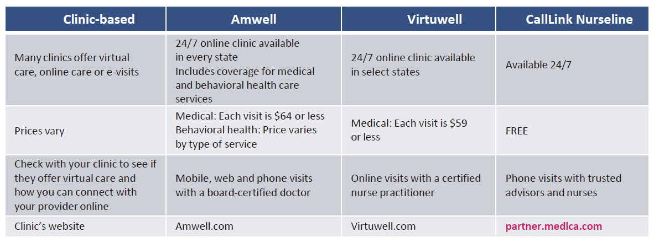
Virtual Care Options

Slide 13
Medica Retiree Option
For more information, please contact:
Leif Peterson, CLU
Account Executive, Individual Specialist
Leif_Peterson@ajg.com
952.345.2302

Slide 14
Review Plan Choices
Best/Worst Case Scenario 2025
Plans | 2025 Total Monthly Premium | City Share of Monthly Premium | Employee Share of Monthly Premium | Annual Employer/ Contribution to VEBA/HSA* Note: If these dollars are not used they will roll forward to future years | Annual Employee Share of Premium** | Annual Employer Cost | Best Case Scenario: Only Preventive visits for the year (Preventive Covered at 100% or $0) Total Employee Cost = Prem Cost - City Contribution | Max Annual Out of Pocket Per Plan Coverage | Annual Worse Case Employee Cost: Paid to Health Care Providers | Total Worst Case Employee Cost: Employee Cost = Prem Cost + Out of Pocket Cost - City Contribution
$1,000 CMM Plan
Employee | $1,122.92 | $1,122.92 | $0.00 |  | ($360.00) | $13,835.04 | ($360.00) | $2,000.00 | $2,000.00 | $1,640.00
Employee + 1 | $2,582.24 | $2,269.24 | $313.00 |  | $3,756.00 | $27,230.88 | $3,756.00 | $4,000.00 | $4,000.00 | $7,756.00
Family | $3,705.12 | $3,334.12 | $371.00 |  | $4,452.00 | $40,009.44 | $4,452.00 | $4,000.00 | $4,000.00 | $8,452.00
$1,850 VEBA Plan
Employee | $1,103.78 | $1,103.78 | $0.00 | $1,200.00 | ($360.00) | $14,805.36 | ($1,560.00) | $1,850.00 | $650.00 | $290.00
Employee +1 | $2,538.22 | $2,225.22 | $313.00 | $2,250.00 | $3,756.00 | $28,952.64 | $1,506.00 | $3,700.00 | $1,450.00 | $5,206.00
Family | $3,641.96 | $3,270.96 | $371.00 | $2,250.00 | $4,452.00 | $41,501.52 | $2,202.00 | $3,700.00 | $1,450.00 | $5,902.00
$3,500 VEBA or HSA Plan
Employee | $978.66 | $978.66 | $0.00 | $2,400.00 | ($360.00) | $14,503.92 | ($2,760.00) | $3,500.00 | $1,100.00 | $740.00
Employee + 1 | $2,250.50 | $1,937.50 | $313.00 | $4,000.00 | $3,756.00 | $27,250.00 | ($244.00) | $7,000.00 | $3,000.00 | $6,756.00
Family | $3,229.12 | $2,858.12 | $371.00 | $4,000.00 | $4,452.00 | $38,297.44 | $452.00 | $7,000.00 | $3,000.00 | $7,452.00
*The City funds half of the VEBA and HSA accounts on Jan. 1 and funds the remaining amount on July 1st, and if these dollars are not used they will roll forward to future years
**$30 montly rebate to Employee through Payroll
Numbers in Parentheses ( ) is Employee Rebate for CMM plan or Employee Rebate + VEBA/HSA City Contribution
Best Case Scenario – Employee pays their annual premiums only.
Worst Case Scenario – Employee pays their annual premiums + the out-of-pocket maximum, less any employer contribution to VEBA/HSA.

Slide 15
EAP
The number you call when you don’t know who to call!
Receive 24/7 telephonic and web based support
Up to 5 face to face visits per issue, per year, per family member
A variety of resources to address:
  Legal and mediation services/needs
    You receive a 30-minute legal consultation at no cost (in person or over the phone). If you decide to hire an attorney, you’ll get a 25% discount.
  Financial advisor support
  Child care referrals and support to help take care of elderly parents
  Community resources, like support groups.
  Help with dependency issues, like alcohol, tobacco, gambling or drugs.
  Education resources and career consulting.
EAP specialists are available anytime, 24 hours a day, 365 days a year at 800-626-7944.

Slide 16
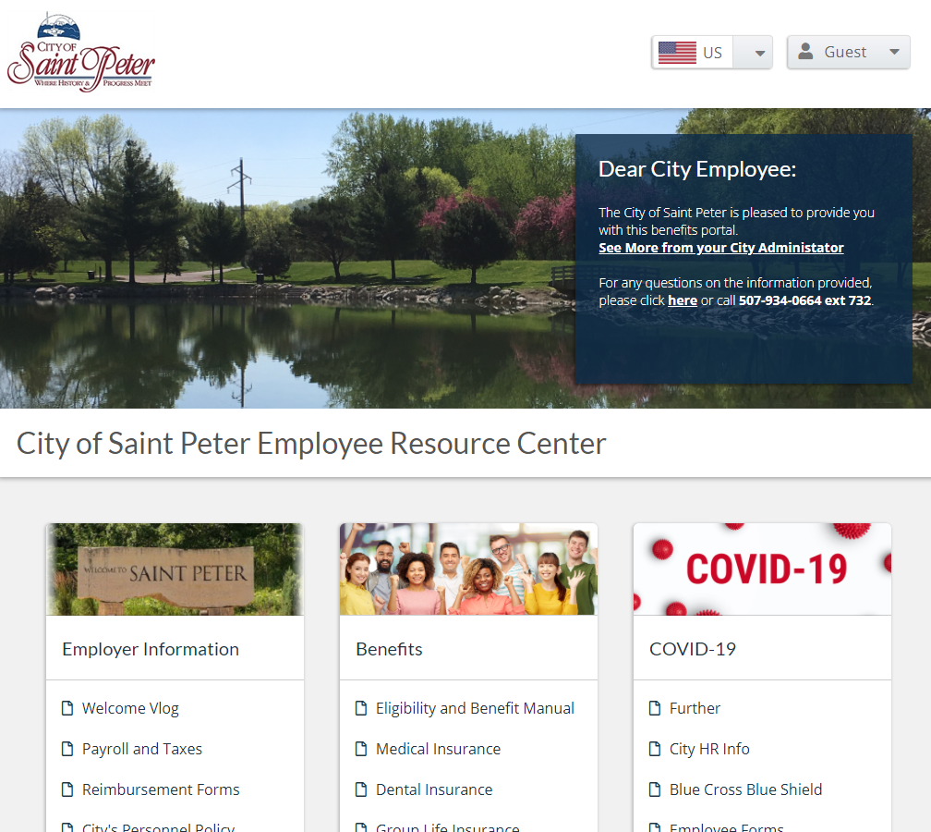
Employee Resource Center
The Employee Resource Center is our benefits web site that provides you and your family with 24/7 access to benefit plan details, educational content and carrier resources.
What will you find?
Link to Online Enrollment!
2025 Benefits Presentation
Benefit Plan Documents & Premiums
Benefit Forms
Employment Verification Information
New Employee Onboarding Forms
Financial & Benefit Calculators
Life Event Checklists
Information on State & Federal Programs
Carrier Resources & Websites
And much more!
It’s easy to access – no login required! You can access the site from our intranet or go to the following address https://cityofstpeter.benefithub.com/

Slide 17

Dental
Plan Design:
The plan pays 100% of the first $250 of eligible dental expenses, then 60% of the remaining expenses
$1,250 Policy/Plan Maximum
Orthodontics is not covered
Plan Highlights:
All procedures are covered except cosmetic procedures
You may use any dentist
Benefits can be paid directly to the dentist
There are no limits on how often you can have dental care
The patient and the dentist make all decisions on procedure & frequency of care

Slide 18
Enrollment Meetings
Online Enrollment
Monday, October 28 – Friday, November 8th
Sign up anytime after the all-employee meeting!
1:1 Meetings
October 16th and November 7th
Employee Meeting
Tuesday, October 8th

Slide 19


Slide 20
GBS Disclosures & Disclaimers
Coverage Notice
This presentation is an outline of the coverage proposed by the carrier(s), based on information provided by your company. It does not include all of the terms, coverage, exclusions, limitations, and conditions of the actual contract language. The policies and contracts themselves must be read for those details. Policy forms for your reference will be made available upon request.
Legal Notice
The intent of this presentation is to provide you with general information regarding the status of, and/or potential concerns related to, your current employee benefits environment. It does not necessarily fully address all of your specific issues. It should not be construed as, nor is it intended to provide, legal advice. Questions regarding specific issues should be addressed by your general counsel or an attorney who specializes in this practice area.
Renewal-Financial Notice
This presentation is for illustrative purposes only, and is not a guarantee of future expenses, claims costs, managed care savings, etc. There are many variables that can affect future health care costs including utilization patterns, catastrophic claims, changes in plan design, health care trend increases, etc. This analysis does not amend, extend, or alter the coverage provided by the actual insurance policies and contracts. Please see your policy or contact us for specific information or further details in this regard.
Financial Rating Notice
While GBS does not guarantee the financial viability of any health insurance carrier or market, it is an area we recommend that clients closely scrutinize when selecting a health insurance carrier or HMO. There are a number of rating agencies that can be referred to including, A.M. Best, Fitch, Moody’s, Standard & Poor’s, and Weiss Ratings (TheStreet.com). Generally, agencies that provide ratings of U.S. Health Insurers, including traditional insurance companies and other managed care (e.g., HMO) organizations, reflect their opinion based on a comprehensive quantitative and qualitative evaluation of a company’s financial strength, operating performance and market profile. However, these ratings are not a warranty of any insurer’s current or future ability to meet its contractual obligations.

Slide 21


SCSC Wellness
City of St. Peter
10/7/2024

Slide 22



MHC’s Medica Well-Being Programs ​
Programs that support your well-being journey
My Health Rewards by Medica®
My Health Rewards by Medica features online health assessments, lifestyle and condition management coaching and activity tracking. Members will earn points for completing activities and get rewarded on your own personal path to health. Open to all members 18+.
Omada is a personalized digital lifestyle change program. Combining technology with ongoing personal support, members can make the changes that matter the most to help lost weight and reduce risks for type 2 diabetes and heart disease.
Life Time Digital Fitness Program is a new on-demand, streaming digital fitness program available beginning Jan. 1, 2024. The program includes both on-demand and live virtual classes, digital wellness content, meditations, and resources for all fitness levels.
Self Care by AbleTo gives access to clinically-proven techniques for dealing with stress, anxiety, depression. Coping tools, meditations and Guided Journeys offer support needed to feel better.
Ovia Health offers support during the parenthood journey. Tap into personalized guidance, support and coaching. On demand support and clinically backed guidance helps achieve health goals.

Slide 23
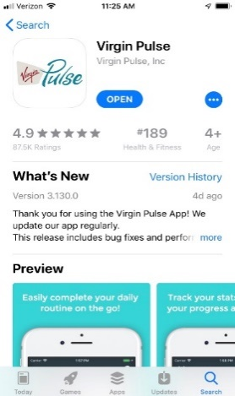
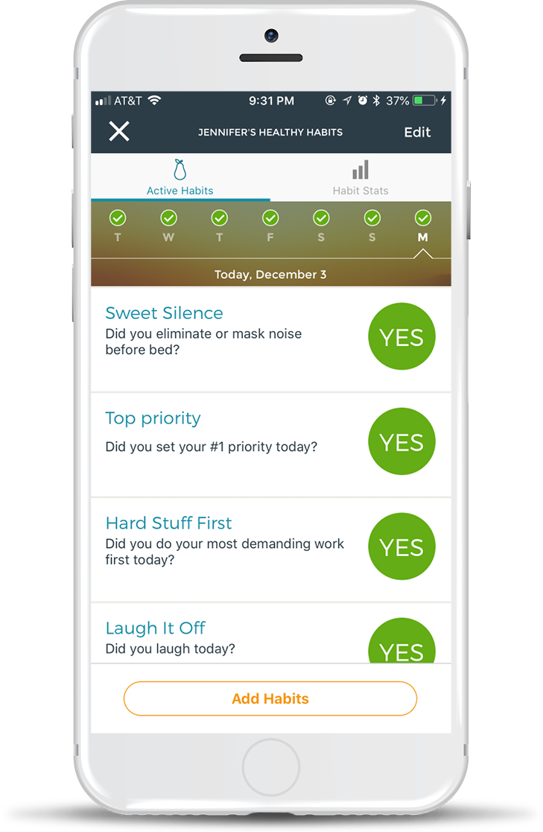
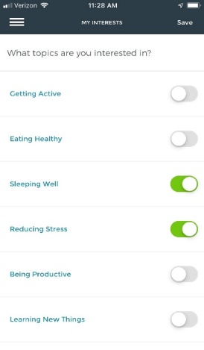
My Health Rewards by Medica
Members 18 years and older can earn up to $220 by reading well-being cards, getting enough sleep, steps, challenges, wellness conference and more!
Getting started is easy!
Download the App
Take the Health Assessment
Save Your Interests
Level | Points earned | Reward
1 | 2,000 | $10
2 | 10,000 | $20
3 | 25,000 | $50
4 | 40,000 | $80
Three options to redeem rewards:
E-gift cards: 15 merchants, including Amazon & Visa
Donate to a cause
Shop for health & fitness related products in the Virgin Pulse store

Slide 24

Max Buzz – It’s Worth the Buzz
Don’t have a fitness tracker? No worries!
You have the option of redeeming points for the Max Buzz™, a Virgin Pulse fitness tracker that can be used to track activity and sleep.
The Max Buzz™ is available in the Virgin Pulse store for 2,000 reward points (or $10 PulseCash).

Slide 25
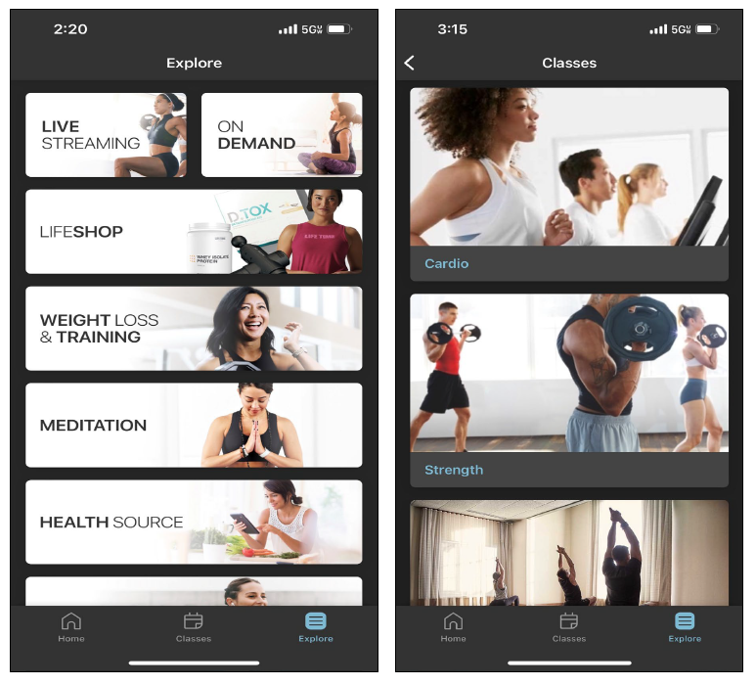
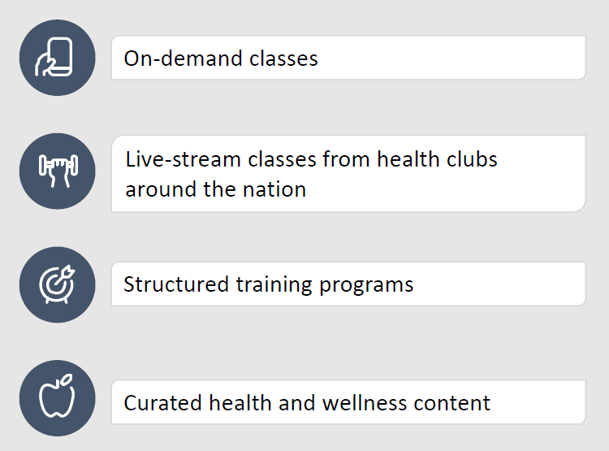
Life Time Digital Fitness
Get active anywhere, anytime with the Life Time Digital
app membership at no cost to you.

Slide 26

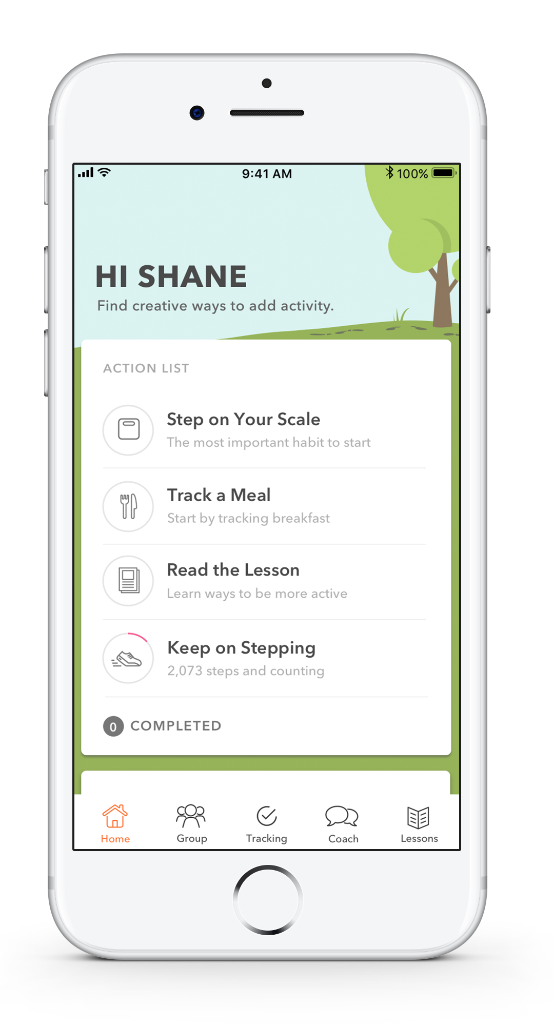






OMADA for Prevention
Improve Overall Health
Program Goals
Program Features
Omada is a digital lifestyle change program for people at risk for chronic conditions such as:
Prediabetes
Hypertension
High cholesterol
Cardiovascular disease
Participants learn how to apply meaningful changes around eating, activity, sleep, and stress, and then focus on sustaining those behaviors.
Lose weight (and keep it off) with small, sustainable lifestyle changes
Build strategies for healthy eating, activity, sleep and stress management
Reduce the risk of developing Type 2 diabetes, heart disease and stroke

Slide 27
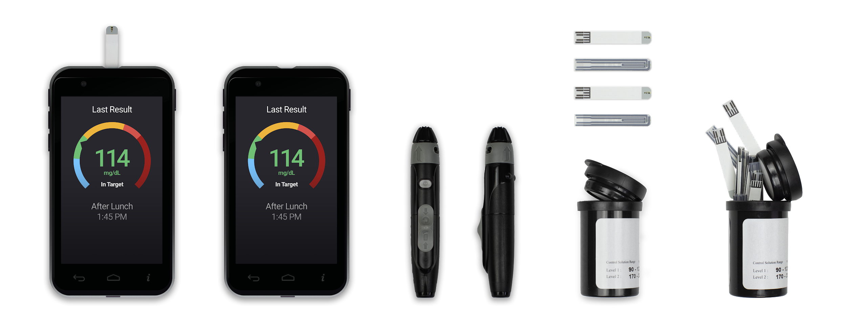

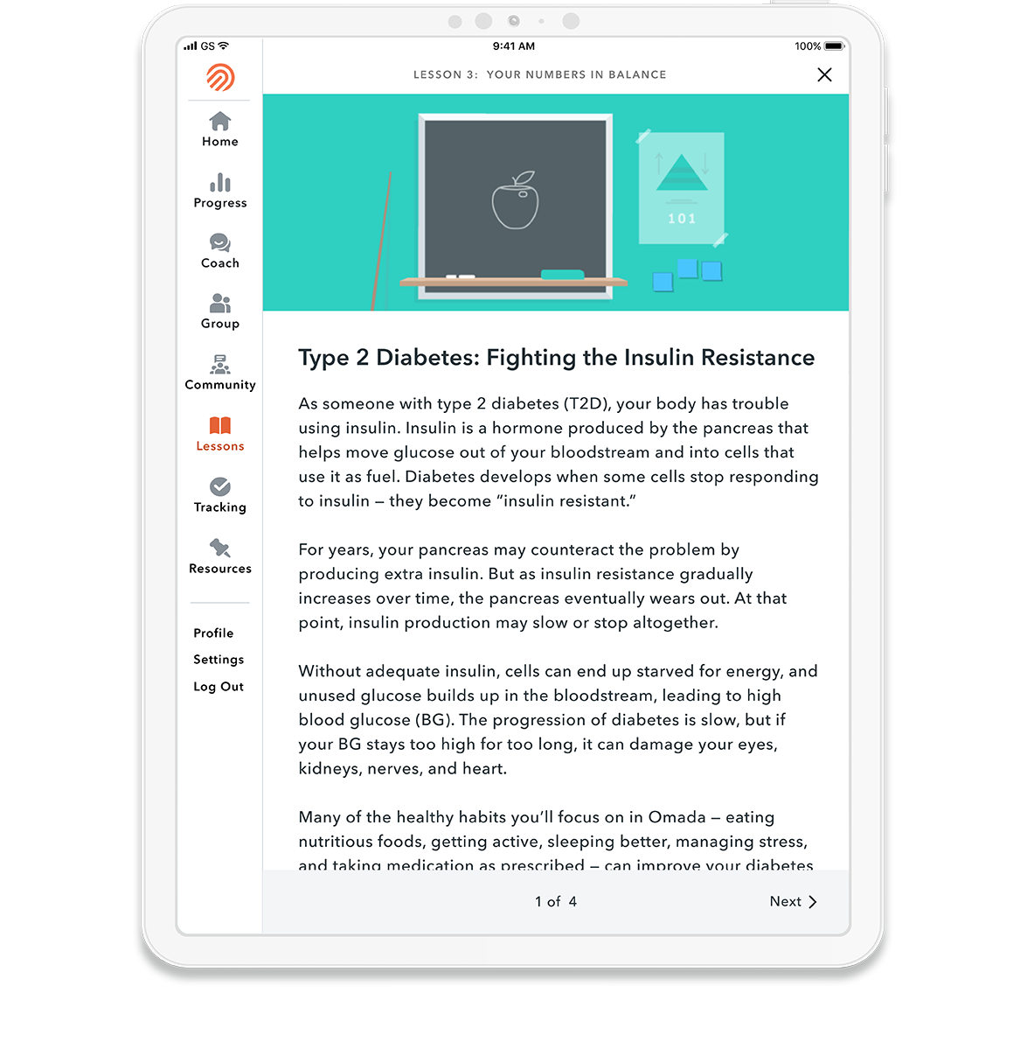



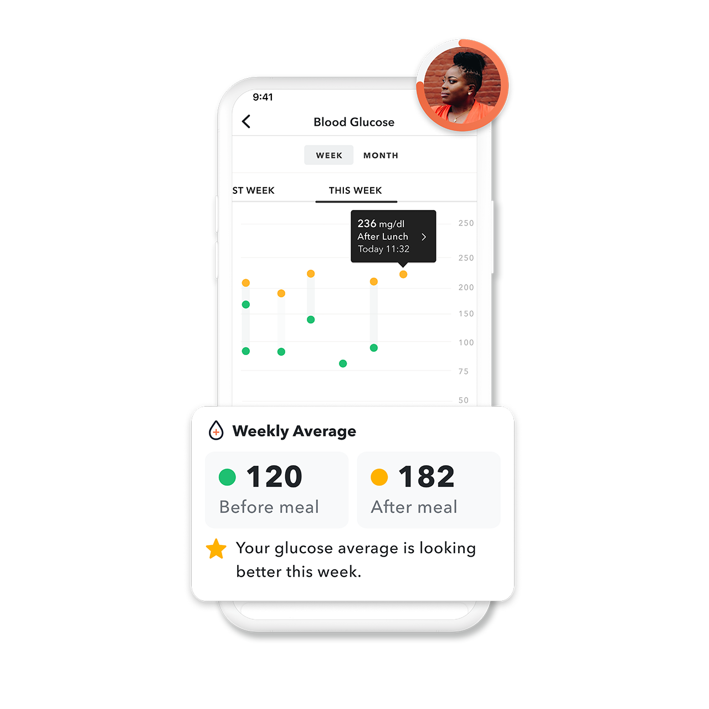


OMADA for Diabetes
Improve Glucose Control
Program Goals
Program Features
Proactive guidance from a professional health coach and Certified Diabetes Care and Education Specialist (CDCES) trained in diabetes management and the interpretation of glucose data
Type 1 or Type 2 diabetes curriculum covering all core topics of Diabetes Self-Management Education and Support (DSMES)
Reduce number of episodes of low-and high-glucose values to achieve target glucose levels.
Reduce number of episodes of low- and high-glucose values to achieve target glucose levels
Reduce risk of diabetes complications and decrease diabetes distress
Build problem-solving skills and promote confidence to self-manage diabetes or cholesterol medications
Encourage safe, achievable lifestyle changes and promote healthy coping

Slide 28
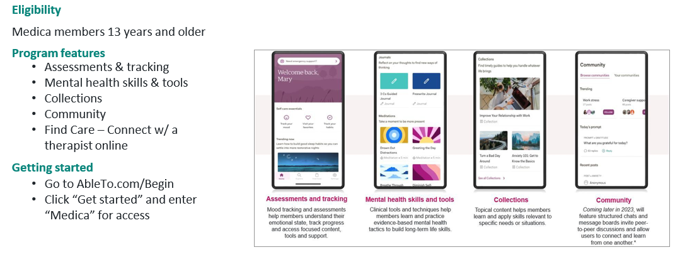
Self Care by AbleTo
Empowers individuals to engage with coping tools, meditations, sleep tracking, healthy habits and improve their mental health and build life skills.

Slide 29



Ovia Health
Three mobile apps offering fertility, pregnancy and parenting support:
Ovia Fertility
Understand cycle predictions and fertility calendar
Track symptoms, moods, medications and more
Receive feedback alerts on potential medical concerns
Learn about infertility health programs
Ovia Pregnancy
Weekly baby development summaries
Daily articles and tips
Supportive weekly videos
Return-to-work planning tools and support
Unlimited in-app coaching with nurse health coaches
Ovia Parenting
Learn about child development and health
Track baby’s feedings, diapers and sleep
Get guidance and support for mental health and wellness
Access thousands of parenting articles and tips
Unlimited in-app coaching with nurse health coaches

Slide 30

Medica Wellness Resources ​
Live and Work Well by Medica 24/7 access to professional care, self-help programs and a variety of helpful information.
Program Features
Explore a wealth of self-help services, interactive tools
View the latest news, events and library of expert articles and advice.
Participate in a variety of interactive, customizable self-improvement programs.
Access the substance use disorder (SUD) helpline and online chat, a free, confidential resource available to you or a loved one
Medica CallLink connects members with advisors and nurses around the clock. When a member calls, they’ll receive trusted answers, information and support for a wide range of health concerns.
Program Features
Get answers to your health-related questions:
Learn more about a diagnosis.
Decide what type of care meets your needs. Understand symptoms and treatment options. Understand how to take medications safely and effectively.
Find a doctor or hospital and schedule an appointment.
Get information about preventive screening services like health screens and immunizations.

Slide 31
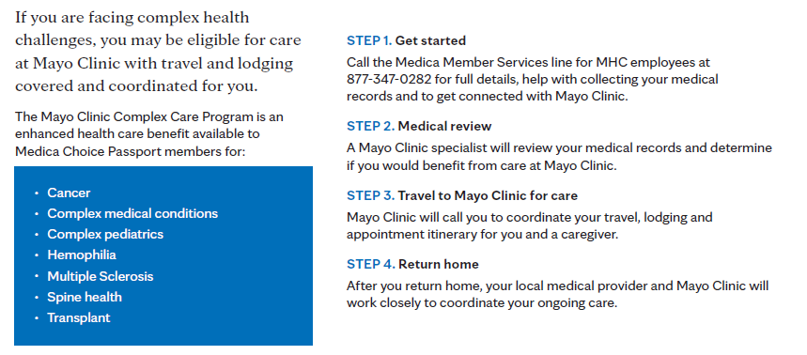
Mayo Complex Care

