Slide 1
EAP+Work/Life Training Seminar
Employee Orientation to EAP and Work/ Life Website Service

Slide 2
EAP+Work/Life Program Features
24/7, unlimited telephone access
In-person assessments and counseling
3 visits (in person or through video per issue per year)
Unlimited HR and management consultations
Employee wellness and prevention seminars
Critical incident debriefings
Medical Bill Saver service
Video counseling
Notes:
-Your Health Advocate benefit is being offered by your employee at no additional cost for you and covers eligible employees, their spouses, dependent children, parents and parent-in-law.
-Services are Free Sessions are available per problem situation per year—in-person and/or telephonic (note: each client/company is contracted with a specific number of sessions. Consult with the Training Coordinator if you are unsure what the session model is).
-Confidential—we maintain Federal and State laws about confidentiality.
The following information is provided as background for the presenters only…not necessary or encouraged to address with audience unless directly asked : exceptions are only if someone discloses being in imminent danger or putting others in danger/child/elder abuse), otherwise, we maintain all confidentiality and only share with the employer aggregate non-identifying information on (typically)a quarterly basis that captures percentage of employees that are utilizing the services and the top presenting issues that we are seeing, so we can further provide outreach targeted at helping in the most useful way.
-Professional—all of our providers are licensed and meet specific criteria—they are available within 30 minutes from home/work—employee’s choice.
-We offer unlimited consultation to managers who may be concerned about employees, we offer EAP overview seminars on a variety of wellness-related topics, and if there is a tragedy that occurs that impacts a work group, we are certainly available to consult and provide debriefings—typically those requests occur from our main HR contact.
Medical Bill Saver Program:
The Health Advocate Medical Bill Saver service gives you access to skilled negotiators who can help lower your out-of-pocket costs on your medical bills not covered by insurance. You could save hundreds—even thousands—of dollars .
Please encourage employees to contact us directly for additional information.

Slide 3
Employee Benefit
Benefit provided by your employer or plan sponsor that covers
employee
spouse/domestic partner
children
Parents and parents in-law
No cost to employee
Strictly confidential

Slide 4
Staff Qualifications
Health Advocate counselors are:
Licensed Social Workers
Licensed Psychologists
Licensed Family and Marriage
Certified CEAP
Certified CAC
Certified Family & Marriage

Slide 5
Work/Life Support
Work/Life Specialists find support services and local resources to help with:
Eldercare, childcare
Legal concerns
Financial issues
Time management
Relocation issues
Notes:
We can provide referrals for child/elder care resources, in addition to providing legal and financial experts in our network. Most legal concerns are centered around documentation reviews/wills, landlord disputes, non-employer related issues (if you are looking to take action against your employee, we can’t help with that), financial issues may center around debt issues, help with budgeting. credit issues, debt management.

Slide 6
Employee Assistance Program (EAP)
Short-term problem resolution with Licensed Professional Counselors for help addressing a wide range of issues:
Stress; depression; anxiety
Marital problems; family/parenting issues
Work conflicts
Anger, grief and loss; substance abuse
Provides referrals for more long-term support
Notes:
There is no problem too big or too small – anything impacting work/home, productivity, marital/relationships and more.
EAP’s focus is on short-term problem resolution—if it can be resolved within the EAP visits, which are at NO cost, and if it cannot, then it is our role to help get you connected to longer term or different kinds of services whether it is through one’s health insurance, or through the community—we always consider the most cost effective options

Slide 7
Medical Bill Saver
Complementary feature included with EAP+Work/Life program
Skilled negotiators help reduce medical or dental bills $400+ not covered by insurance
“Safety net” for employees enrolled in consumer-driven plans
Encourages smart healthcare decision-making
Helps support “financial fitness,” reduce stress

Slide 8
How to access the EAP online?
Step 1. In the address bar of your internet browser, enter: www.unum.com/employees/services/life-balance
Step 2. Click on
Note: You will be prompted to either “Register” or “Sign In” with a username and password when taking an Online Course, Training or Assessment

Slide 9
Consultation and training to build effective leaders, deal with sensitive issues
Critical Incident Response, reduce risk, minimize disruption
Crisis Preparedness, advising, ensuring policy and plans in place
Empowering employees/employers to resolve – and prevent - issues in earliest stages

Slide 10
Key Resources for Managers & Supervisors
Unlimited telephonic consultation for management and supervisors
Available to all levels of management team, 24/7
Improve managers’/supervisors’ interpersonal skills
Assist in resolving employee conflicts
Collaborate with management team and HR on sensitive cases
Critical incident support – diffuse, stabilize, minimize disruption
Crisis Preparedness – reduce risk, review and make recommendations on current policy.
Trainings and seminars – education to empower and prevent

Slide 11
Speak with Crisis Counselor
for initial consultation (Review best practices, staff notification management consult)
Care Manager will not inform caller that there is any cost.
Critical Incident Occurs…
HR/Manager calls the EAP Disruptive Event Management Team
On-site services NOT required
• Receive Grief/Critical incident handouts with EAP contact information
• Distribute to all impacted
Identify Key Information
• Description of event
• # employees directly impacted
• Company Information- address, point of contact, phone number
800-854-1446
24/7 availability
On-site services are required
• Consult to determine best day(s)/time(s) for on-site counselor
• Receive grief/critical incident handouts, receive letter to invite staff to group meeting and one-on-one session
• Prepare meeting room
Email action plan and confirmation of services.
EAP follows up with manager
EAP provides telephonic
or face-to-face sessions
as needed

Slide 12
Let’s Connect
For more information visit us on the web:
https://unum.com/employees/services/life-balance

Slide 13
Thank You
Any questions?
Phone: 800.854.1446

Slide 14
Appendix

Slide 15
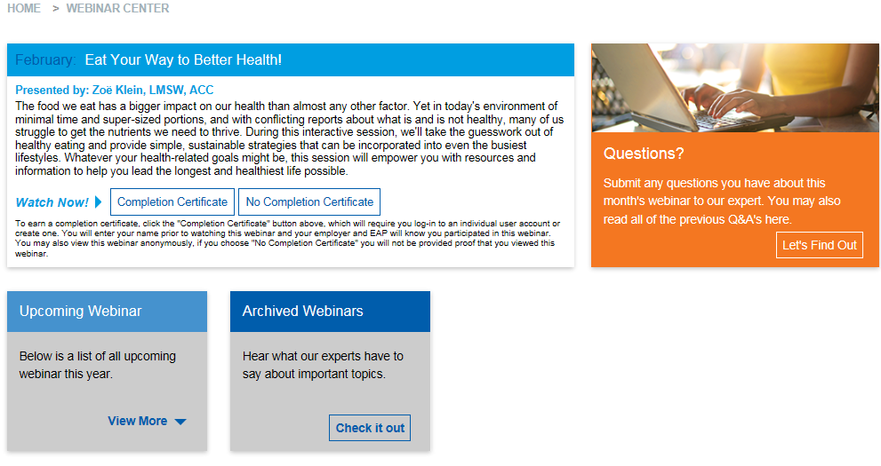

Slide 16
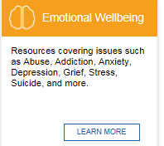

Slide 21
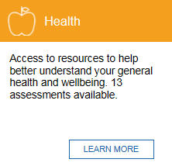
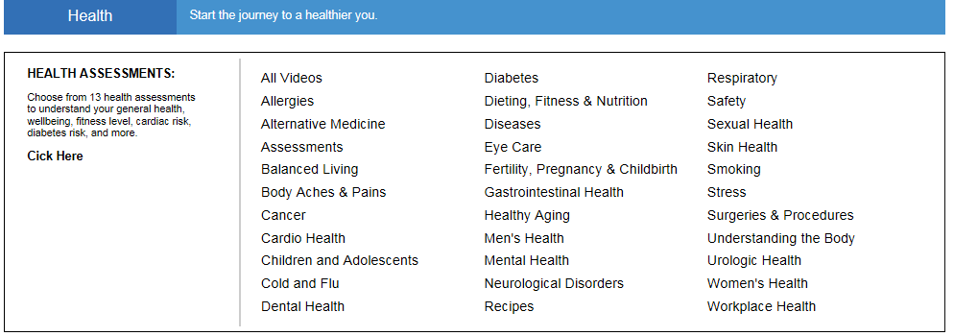

Slide 22
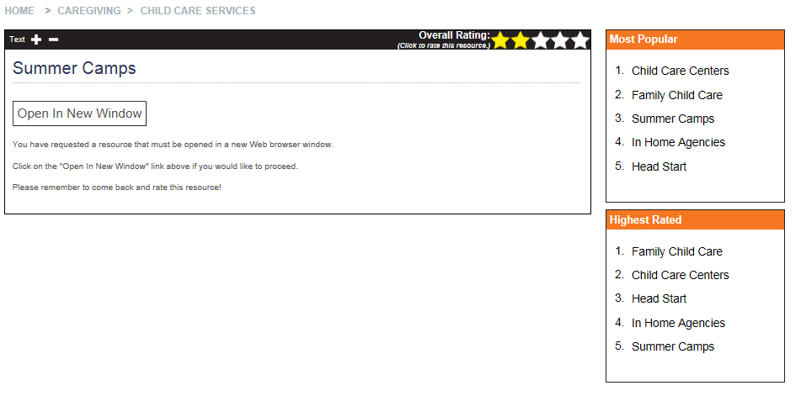

Slide 23
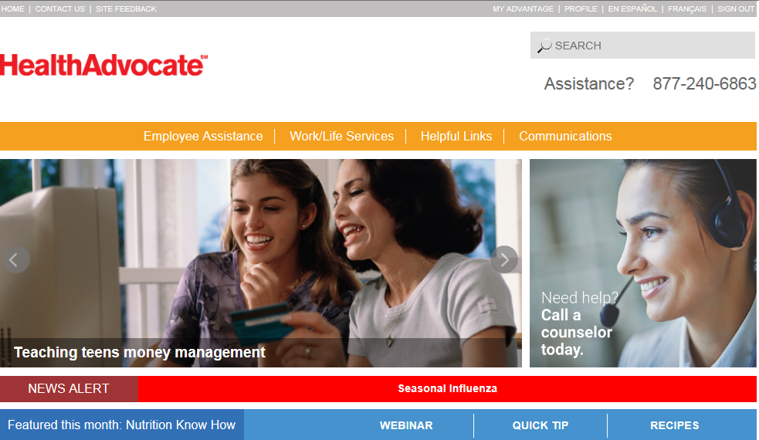
Helpful Links

Slide 24
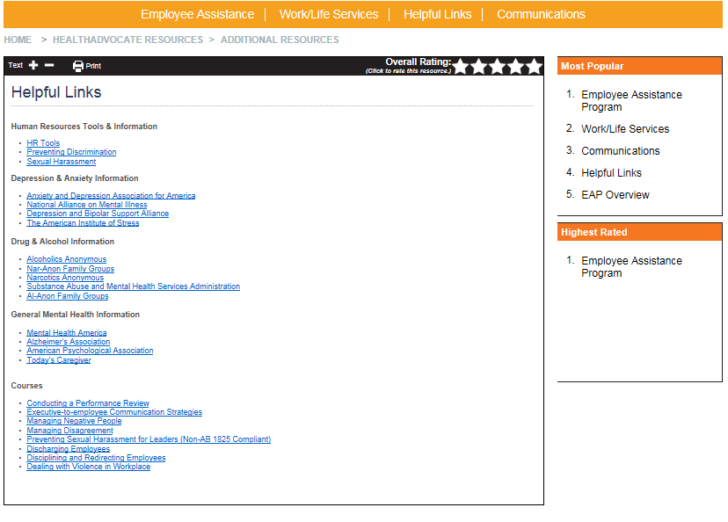
Helpful Links

