Slide 1
City of St. Peter Lunch and Learn
Long Term Disability

Slide 2
Why Long Term Disability
Helps you pay the bills in case of a disability.
Protects you for a long period of time (up to Social Security Retirement age – 65, 66 or 67)
An inexpensive way to have financial protection.

Slide 3
How does the plan work
Benefits start after 3 months and could continue to National Social Security Retirement age.
Select in Increments of $100 between $500 and $5,000 per month. Max of 60% of your monthly income.
Employees in the plan may increase benefit, subject to the 6/6/24 pre-existing conditions period. (no health questions)
Employees not in the plan may apply with health questions.

Slide 4
What qualifies you for LTD
You have a note from your doctor saying that you cannot do the material duties of your own job
You have a 20% income loss as a result of the disability.
After 36 months you qualify if you can’t do any occupation that is in line with your education, training and experience.
(60 months for city manager, city clerk and
department heads)

Slide 5
How much does it cost
AGE | Rate Per Month per $100 of LTD Benefit
0-24 | $.26
25-29 | $.27
30-34 | $.35
35-39 | $.41
40-44 | $.61
45-49 | $1.05
50-54 | $1.28
55-59 | $1.60
60-64 | $1.71
65-69 | $1.71
LTD Monthly Rates
For example: An employee at age 33 would pay
$3.50 per month for $1,000 per month in benefits.

Slide 6
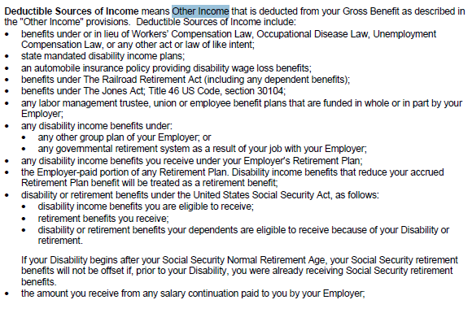
How does it integrate with other income

Slide 7
How does it integrate with other income
70% of all sources
Example:
30% Social Security Disability
30% PERA
10% Group Disability plan

Slide 8
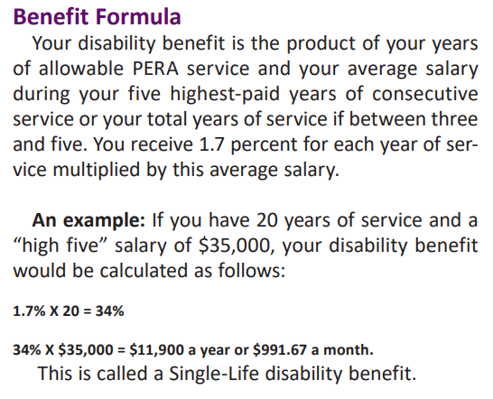
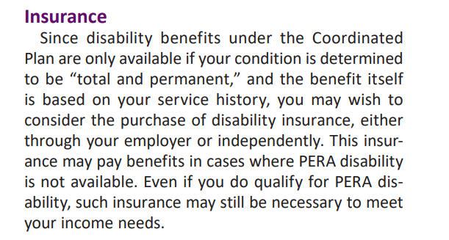
Why buy Group LTD if I have PERA

