Slide 1

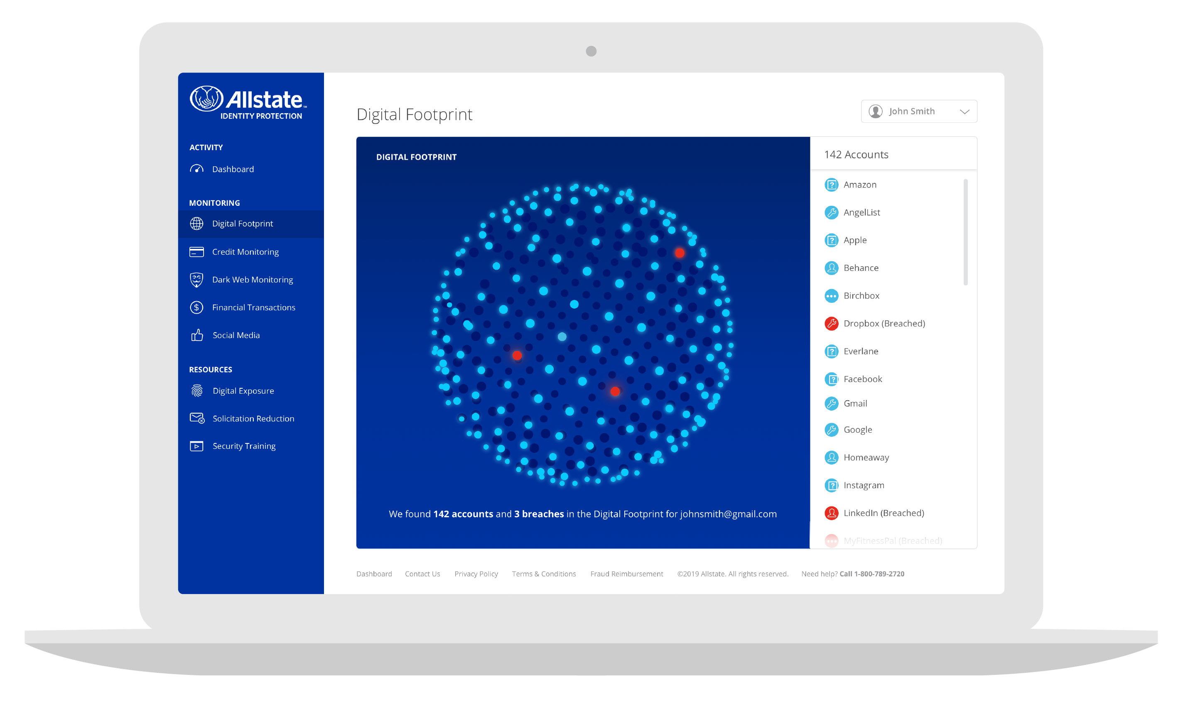

Slide 2
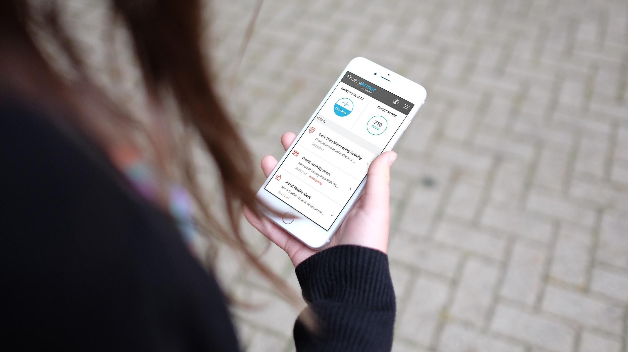

CREDIT MONITORING
Auto-on alerting
Rapid alert detection
Online credit disputes
Tri-bureau credit monitoring*
Unlimited TransUnion credit reports*
Unlimited TransUnion credit scores*
Annual tri-bureau report and score*
Credit lock*
WHITE GLOVE REMEDIATION
Our in-house staff of certified Privacy Advocates are available 24/7. With our pledge to treat every caller like a CEO, Privacy Advocates do everything to ensure a participant’s identity is fully restored.
DARK WEB MONITORING
Human-sourced intelligence
Proprietary data detection platform
Social account takeover
Compromised credentials
IP monitoring*
Data breach notifications*
REIMBURSEMENT
Stolen fund reimbursement*
401(k) and HSA reimbursement*
Tax fraud refund advance*
Lost wallet protection
$1 million insurance policy
OTHER MONITORING
High-risk transaction monitoring
Social media monitoring
Credit and debit card monitoring
Bank account transaction monitoring
Student loan activity alerts
401(k) investment account monitoring
Digital exposure reports
Deceased family member coverage*
* Pro Plus only

Slide 3

How it works
Enroll
Access to your full Pro Plus capabilities begins on the effective date.
We monitor
Our advanced technology looks for suspicious activity associated with your personal profile.
We alert
We alert you to any activity associated with your account or personal information.
We restore
In the event of identity theft, we fully manage the process of recovering your identity, credit, and sense of security so the impact to your life is minimal.
We reimburse
Our $1 million identity theft insurance policy covers the costs associated with reinstating your identity.

Slide 4
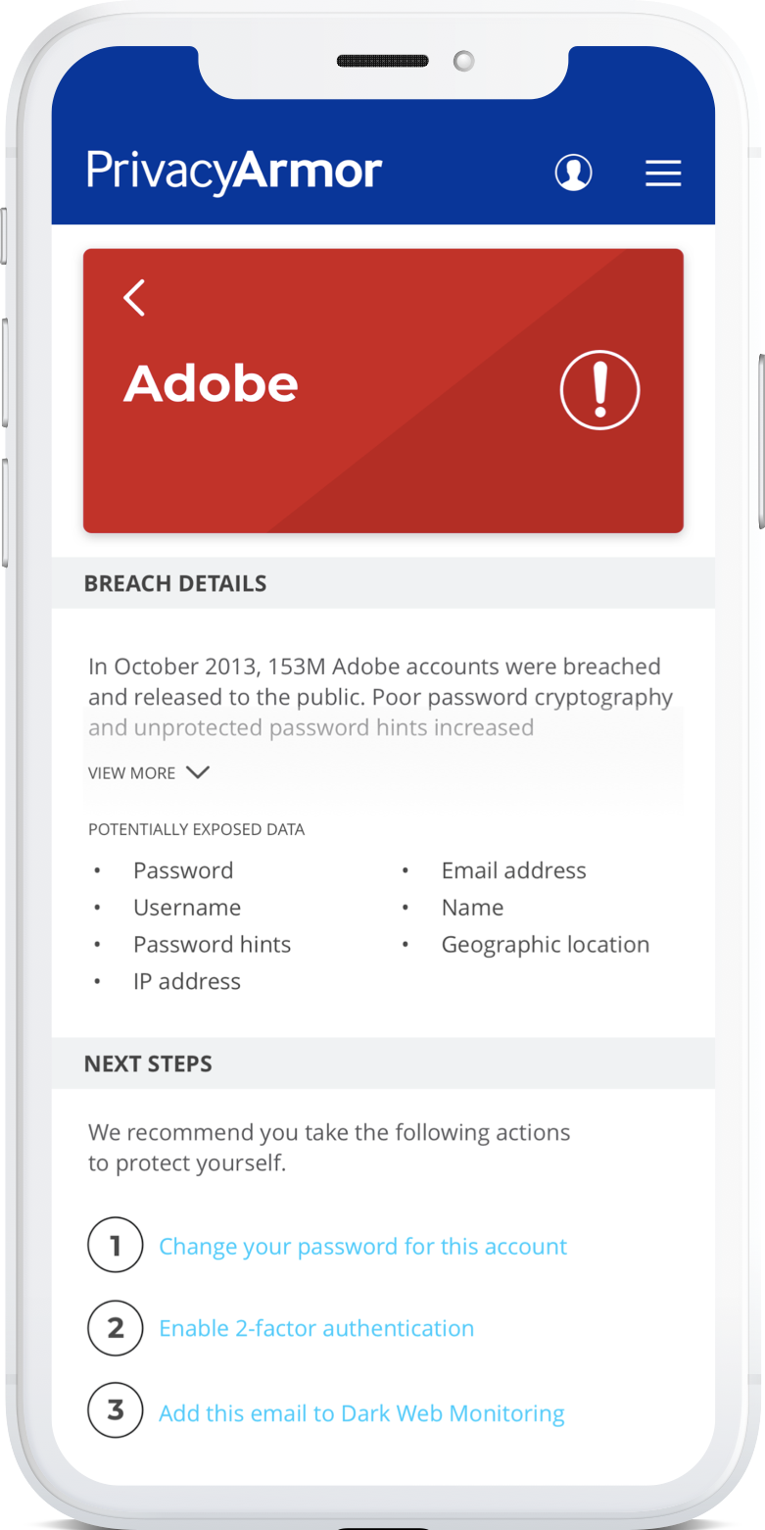

Allstate Digital Footprint service empowers users to take control of their data and privacy
Choice
Users can uncover who’s collecting their personal data — and learn how it may be used
Control
Clarity
Users receive alerts on known account breaches and advice on how to resolve them
Users can gain insight into what makes up their Digital Footprint
*These images are for illustrative purposes only. Ongoing testing may necessitate design changes.

Slide 5


Seriously secure
SSAE18 SOC2 Type 2 accredited and updated annually
Relentlessly reliable
WORLD-CLASS SECURITY
Perfect track record with zero security incidents, and 99.99% site uptime.
Two factor authentication
Security is our top priority and a part of everything we do.
For even stronger protection and peace of mind.

Slide 6


Comprehensive identity monitoring
Comprehensive identity monitoring
Fraud remediation and restoration
ID theft reimbursement
Credit monitoring
Dark web monitoring
Financial transaction monitoring
Social media reputation monitoring
Lost wallet protection
Digital exposure report
Pre-existing conditions
Fraud remediation and restoration
ID theft reimbursement
Credit monitoring
Dark web monitoring
Financial transaction monitoring
Plans and pricing
$x.xx per person/ month
$x.xx per family / month
Social media reputation monitoring
Lost wallet protection
Digital exposure report
Pre-existing conditions
Learn More At
www.AllstateIdentityProtection.com

